Slide 1
Tweens, Teens and (Smartphone) screens
Amanda Johnson, FNP
Notes:
FNP who cares for middle and high school students in a DC public school
Mother to a Tilden student who is MORTIFIED that I am giving this talk and has sworn me not mention his name
Phones are GREAT – enable us to keep track of our kids, communicate with them, etc.
But there is now more and more data that is giving some of us pause about giving them to our kids at too young of an age

Slide 2
Why are we concerned?
Dramatic increase in rates of mental health problems in adolescents in the past two decades
Major depression among teenagers (12-17yo) in the US have increased:
              145% for girls since 2010
              161% for boys since 2010
ER visits for self-harm have among children 10-14 increased:
              188% for girls since 2010
              48% for boys since 2010
Suicide is the second leading cause of death for children 10-14:
              167% increase for girls since 2010
              91% increase for boys since 2010

Slide 3
What is causing this change?
Trend is not unique to the United States; similar patterns are being seen in Canada, the UK, Australia, New Zealand, and many other developed nations
Cell phones are not the problem – communication is the not the issue, but smartphones and 24/7 access to the internet and endless apps are dangerous to developing minds
First iPhone came out in 2007, the App Store was introduced in 2008, and the iPad came out in 2010
2011: 23% of teenagers had a smart phone
2015: 73% of teenagers had a smart phone
In 2015, a quarter of teenagers said they were online “almost constantly”

Slide 4
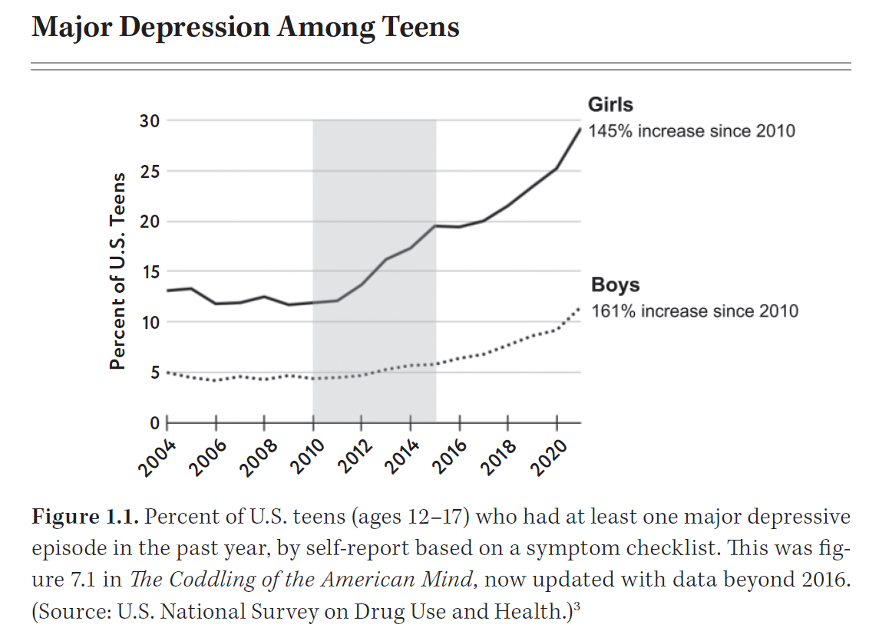
Haidt, Jonathan. The Anxious Generation: How the Great Rewiring of Childhood is Causing an Epidemic of Mental Illness. Penguin Press, 2024.
Notes:
The grey bar represents the period of time from when young people started acquiring smartphones to when they became almost ubiquitous among young people; please note that the numbers have not leveled off, but have continued to grow!

Slide 5
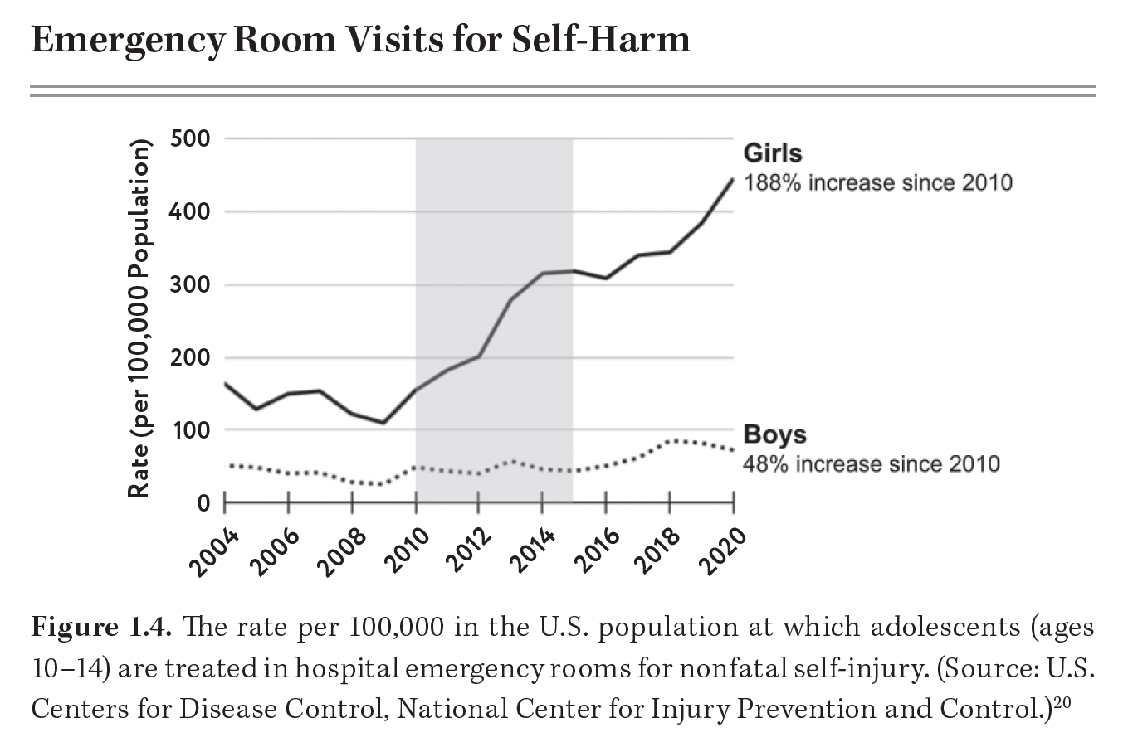
Haidt, Jonathan. The Anxious Generation: How the Great Rewiring of Childhood is Causing an Epidemic of Mental Illness. Penguin Press, 2024.

Slide 6
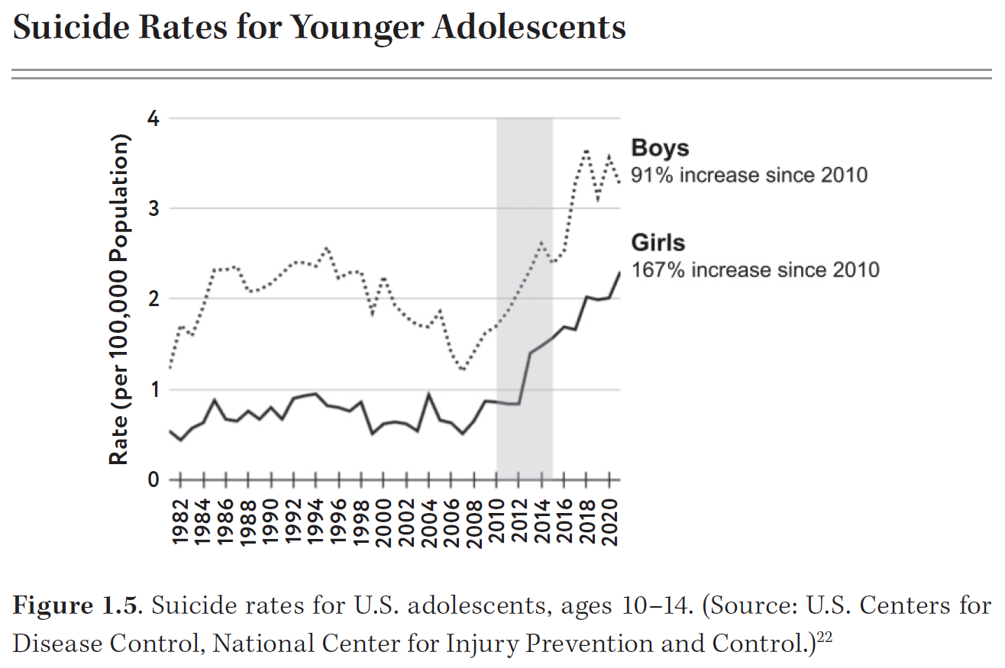
Haidt, Jonathan. The Anxious Generation: How the Great Rewiring of Childhood is Causing an Epidemic of Mental Illness. Penguin Press, 2024.

Slide 7
Surgeon General’s Warning about Impact of Social Media on Youth Mental Health
In June of this year, the Surgeon General called for social media platforms to have a warning label advising parents that using the platforms may damage adolescent mental health
Adolescents who spend more than three hours a day on social media have double the risk of anxiety and depression symptoms
Average daily use of social media for adolescents was 4.8 hours (as of summer 2023)
Nearly half of adolescents say social media makes them feel worse about their bodies
Notes:
I want to add – because my son always argues that because social media doesn’t seem to be as damaging for boys – that it means he should get a phone. While this is true, boys and girls have different interests, and the bigger problems for boys are gaming and pornography. One psychiatrist with whom I heard an interview tells parents who ask her the right age to get their kid is when they are ready for their child to watch pornography.

Slide 8
How can smartphones be so damaging?
Opportunity cost: 24 hours in a day. American teens spend about 5 hrs a day on social media alone. What activities can they no longer do with that lost time? Experience boredom?
Social deprivation – interacting with people in the virtual world, or even people you know IRL, via text, does not nourish growth and development and relationship formation in the same way that interacting with each other synchronously and in person does.
With more time on devices, most kids are getting LESS SLEEP.
Attention fragmentation – phones supplant the need to maintain attention for any lengthy period of time.
Behavioral addiction – addictive behavior is addictive behavior regardless of the substance.

Slide 9
So what do we do about it?
Collective problems can be solved with collective action – we must change cultural and societal norms!
Adopting four basic principles can dramatically reduce or reverse these trends:
No smartphone until high school
No social media until 16+
Phone-free schools – all day, truly phone-free, not just phone-free classrooms
      Some schools have tried phone pouches like Yonder; Virginia has adopted a state-wide policy banning cell phones for grades K-12 that goes into effect January 1st
      The less we rely on teachers to monitor or police device use, the more time they have to actually teach our (less distracted) kids!
More independence, responsibility, and free play in real life!
We are overprotecting our kids in the real world and failing to protect them online!

Slide 10
What if I’ve already gotten my kiddo a phone?
You can always take it back – this is not a binding contract! Consider an alternative device – smart watch? Dumb phone?
Set up your child’s phone for a minor with parental controls. Involve your kid in creating a contract about safe device use.
Tell your child that their phone will have a passcode that you know, and that you will be checking it regularly.
Create guidelines about phone use for you child and in your home.
    No phones at the dinner table
    Device curfew – no phones in bedroom at night
    No phones when friends are over – ALL devices (including friends’) can stay in a box
    Turn off notifications!
Let your kid know you will be there to help them resolve problems when they (inevitably) screw it up! There is a plethora resources to help parents navigate what is undeniably fraught and tricky area…
Notes:
Don’t panic! Most of us as parents are doing the best we can and we need to show each other and ourselves some grace. To paraphrase Maya Angelou, we do the best we can, then when we learn better, we do better.

Slide 11
Helpful Resources and Further Reading
Podcasts: Highly recommend this podcast where Dr. Becky interviews Jonathan Haidt right after his book came out, as well as this podcast, a recording of a moderated conversation between Dr. Becky and Haidt. This podcast, an interview with a psychiatrist on the Screen Strong podcast, is also full of great information.
Screen Strong: A nonprofit that helps parents navigate healthy screen use and resolve problematic behavior, especially around social media, pornography, and video games. They have an online community, Facebook group, podcast, and courses for parents and kids about safe media use.
The Anxious Generation: Website of social scientist, NYU professor, and NYT bestselling author Jonathan Haidt. The website has a huge resource library, with book recommendations, resources for families and educators, newsletters, videos, podcasts, and recommendations for alternatives to smartphones! There is also a pdf he created with Dr. Becky and Good Inside to help parents navigate this territory.
Good Inside: Website of Dr. Becky, clinical psychologist and parenting expert; has lots of online parenting classes, including one on managing screen time.
Social Media and Youth Mental Health: The US Surgeon General’s Advisory provides lots of information and data guiding the recommendation to put warning labels on social media.
Healthy Children: Consumer-facing website of the American Academy of Pediatrics, with lots of resources to help families navigate media use.
Wait Until Eighth: Collective agreement parents can sign agreeing to wait until *at least* the summer after 8th grade to get their kid a smartphone. (The pledge becomes “active” for a school once the parents of at least ten students in the same grade and school have signed it; it is active at Tilden MS, so you can tell your child they’re not the only one without a smartphone at Tilden!)
Parent Encouragement Program: Kensington-based nonprofit that offers in-person and virtual parenting classes and lectures to “help parents and caregivers build strong and harmonious family relationships.” They have a few online course – look here for one about social media (free!), and here and here for talks about setting boundaries around tech ($25 each).

Slide 12
Sources
Barry Ellen, Kang Cecilia. Surgeon General Calls for Warning Labels on Social Media Platforms. The New York Times. June 17, 2024.
Haidt, Jonathan. End the Phone Based Childhood Now. The Atlantic. March 13, 2024.
Haidt, Jonathan. The Anxious Generation: How the Great Rewiring of Childhood is Causing an Epidemic of Mental Illness. Penguin Press, 2024.
Hempe, Melanie. A Psychiatrist’s Perspective on Screen Addiction with Dr. Adriana Stacey. ScreenStrong Families. January 25, 2023. https://podcasts.apple.com/us/podcast/screenstrong-families/id1474681355. Accessed November 8, 2024.
Kennedy, Becky. The Anxious Generation with Jonathan Haidt. Good Inside with Dr. Becky. March 26, 2024. https://www.goodinside.com/podcast/7065/the-anxious-generation-with-jonathan-haidt/. Accessed November 8, 2024.
Kennedy, Becky. The Anxious Generation: Dr. Becky & Jonathan Haidt in Conversation with Stephanie Ruhle at 92NY. Good Inside with Dr. Becky. October 22, 2024. https://www.goodinside.com/podcast/9394/the-anxious-generation-dr-becky-jonathan-haidt-in-conversation-with-stephanie-ruhle-at-92ny/. Accessed November 8, 2024.
Murthy, Vivek H. Surgeon General: Why I’m Calling for a Warning Label on Social Media Platforms. The New York Times. June 17, 2024.

Slide 13
