Slide 1
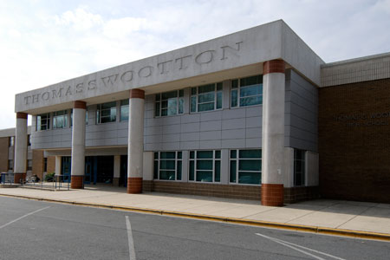
The road to college:
starts with junior year

Slide 2

Prepare Yourself for college NOW
colleges evaluate you on your…
Transcript
  GPA, Courses and Grades
Test Scores- ACT, SAT, Accuplacer (SAT II, TOEFL)
Essay(s)
Letters of Recommendation
Extracurricular Activities, Volunteer Experience

Slide 3
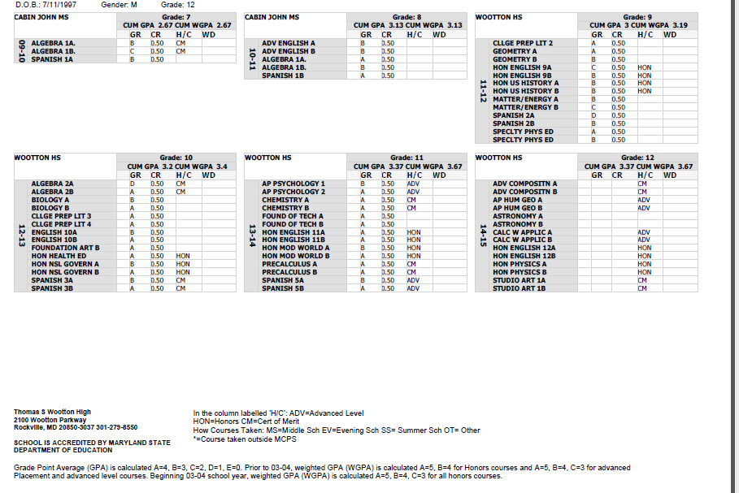
Your Transcript
Cumulative
Weighted GPA
Cumulative Unweighted GPA
Notes:
Academics
This year matters most for college admissions
Maintain good grades
Last year to raise the GPA before applying to colleges
Upward Trend
Get to know your counselor and Ms. Davis if you have not done so already!

Slide 4
Testing: Which test is best for you?
 | CURRENT SAT (Until Jan. 2016) www.sat.collegeboard.org | NEW SAT (March 2016) www.sat.collegeboard.org | ACT www.actstudent.org | ACCUPLACER www.montgomerycollege.edu
The Test | Focus on critical reading, writing, and math reasoning skills 3 hrs, 45 min | Focus on reasoning plus knowledge, skills, & understanding 3 hrs; 3 hrs 50 min w/optional essay | Focus on academic achievement in English, math, reading, and science 2hrs. 55min (no writing) 3hrs. 55min. | Measures readiness for college level coursework in math, reading, & writing Untimed, however average is 3 hrs.
Test Content | Math: geometry & algebra Critical Reading: sentence completion, short & long critical reading passages, reading comprehension Required Writing: questions & an essay testing grammer, usage, and word choice | Vocabulary: testing within the context of the passage Reading: emphasizes use of analysis and evidence Math: emphsizes problem solving & data analysis: calculator and no-calculator sections Essay: (optional) evaluates ability to analyze and utilize evidence | Math: up to trigonometry Science: charts, experiments Reading: based on 4 types of reading selections: Social studies, Natural sciences, Prose fiction, Humanities English: stresses grammer Optional Writing (encouraged): an essay | Online, computer adaptive
Scoring | Highest score: 2400 Penalty for wrong answers Math: 200-800 Critical Reading: 200-800 Writing: 200-800 | Highest Score: 1600 No Penalty for wrong answers Math: 200-800 Evidenced-Based Reading & Writing: 200- 800 Optional Essay receives a separate score: 2-8 **There are 7 subscores: each scored 1-15 | Highest score: 36 No Penalty for wrong answers Math: 1-36 Reading: 1-36 English: 1-36 Science: 1-36 Writing: 1-36 4 domains each scored 2-12 (domain scores don’t necessarily add up to reported writing score) | Maryland Community Colleges Target Scores for college level courses: Sentence Skills: 90 and Reading Compregension: 79 Elementary Algebra: 62 and College Level Math: 45
Sections | 10 Sections: 20-25 minutes each 3 Critical Reading 3 Writing 3 Math 1 Experimental --5 answer choices for multiple choice | 3 sections: 1 Evidenced-Based Reading & Writing: 65 min Reading, 35 min Language & Writing 1 Math: 55 min with calculator, 25 min without calculator 1 Essay (optional-50 min) --4 answer choices for multiple choice | 4 Required Sections: English Math Reading Science Optional Writing (essay) | Adaptive: questions depend on prior answer Arithmetic Elementary Algebra College Level Math Reading Comprehension Sentence Skills Writing (optional)

Slide 5
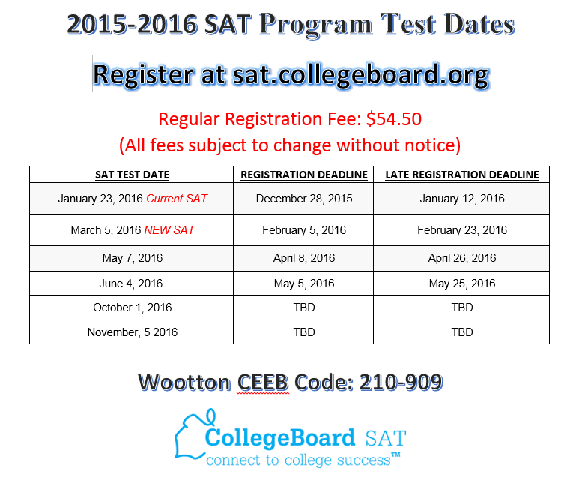
When will I take the sat?
Notes:
PSAT in October, this test will count towards scholarships. Students should begin registering for the SAT after they have spoken with their counselor and research careers and colleges that they may be interested in.
Get to know your counselor and the career coordinator as they are going to help you gain the resources you will need to begin looking for colleges.

Slide 6
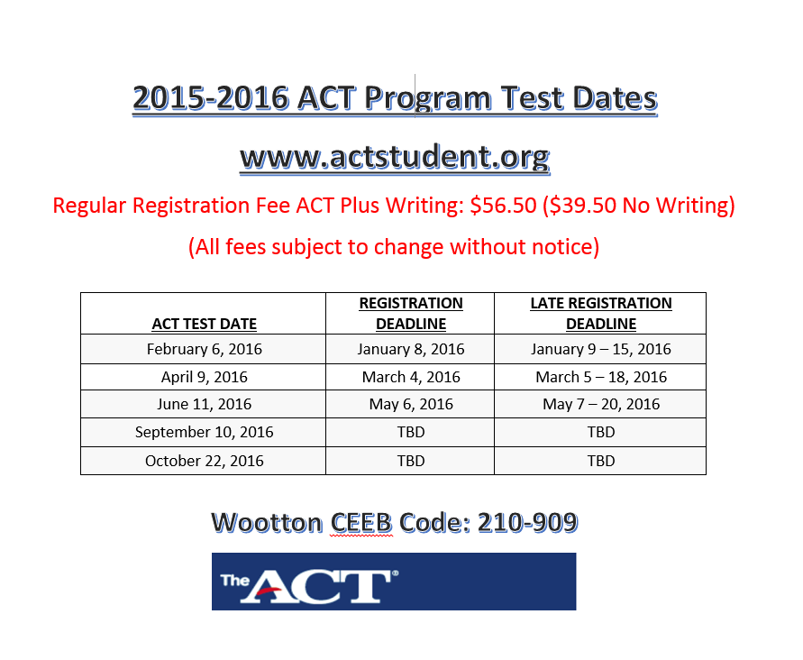
When will I take the act?

Slide 7
Preparing for the sat & act
Prep Courses:
  .5 Credit SAT Prep course at Wootton
  Montgomery College offers courses evenings & weekends ($)
  Other companies- Kaplan, Princeton Review, etc ($$$)
Self Prep
  College Board, ACT, Books, Public Library
  Khan Academy https://www.khanacademy.org/test-prep/sat
  There are ACT/SAT workbooks in the college/career center that can help you practice at home.
How to register for a test:
  collegeboard.org
  actstudent.org
  Accuplacer – ask Mr. Oliver or career center

Slide 8
Naviance: College Planning
How can Naviance help me with the college process?
  College Search Feature
    Generate lists of colleges that may be a good match based on your GPA, test scores, other personal preferences
  Scattergrams
  College Visits to Wootton: Fall of Senior year
  Track your Transcript Requests
  Get periodic emails & notifications regarding scholarships, special opportunities, & more.

Slide 9
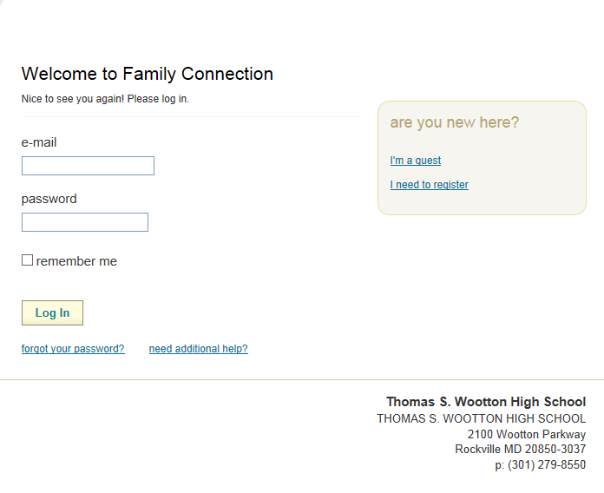
http://connection.naviance.com/wootton
Naviance

Slide 10
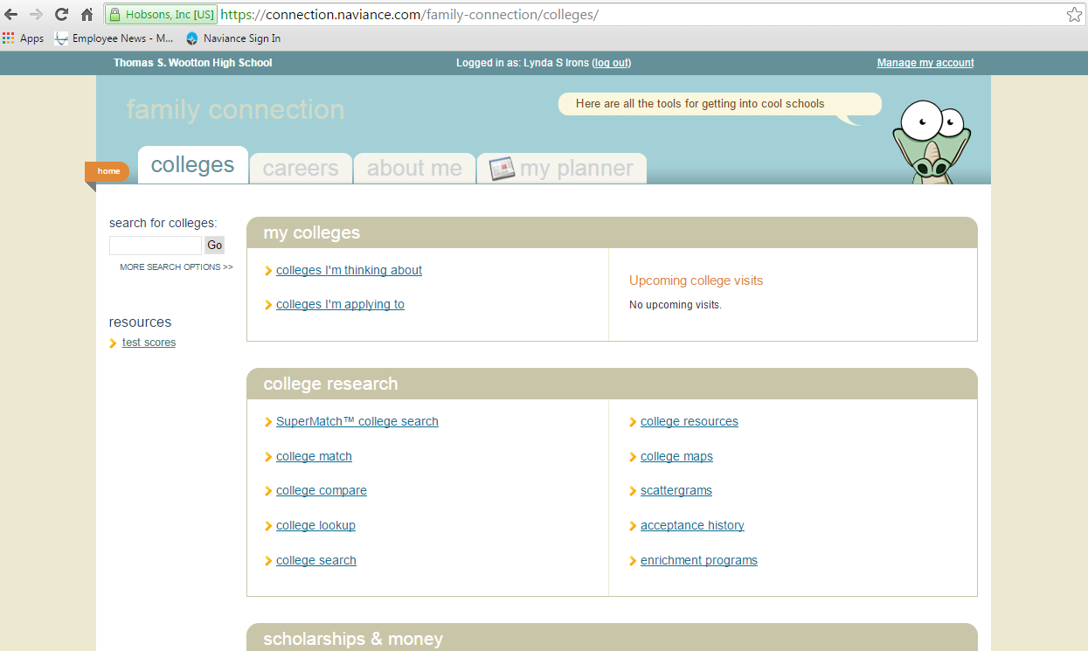
College SuperMatch
Click here to complete a college search . You can decide the criteria that is important to you.

Slide 11
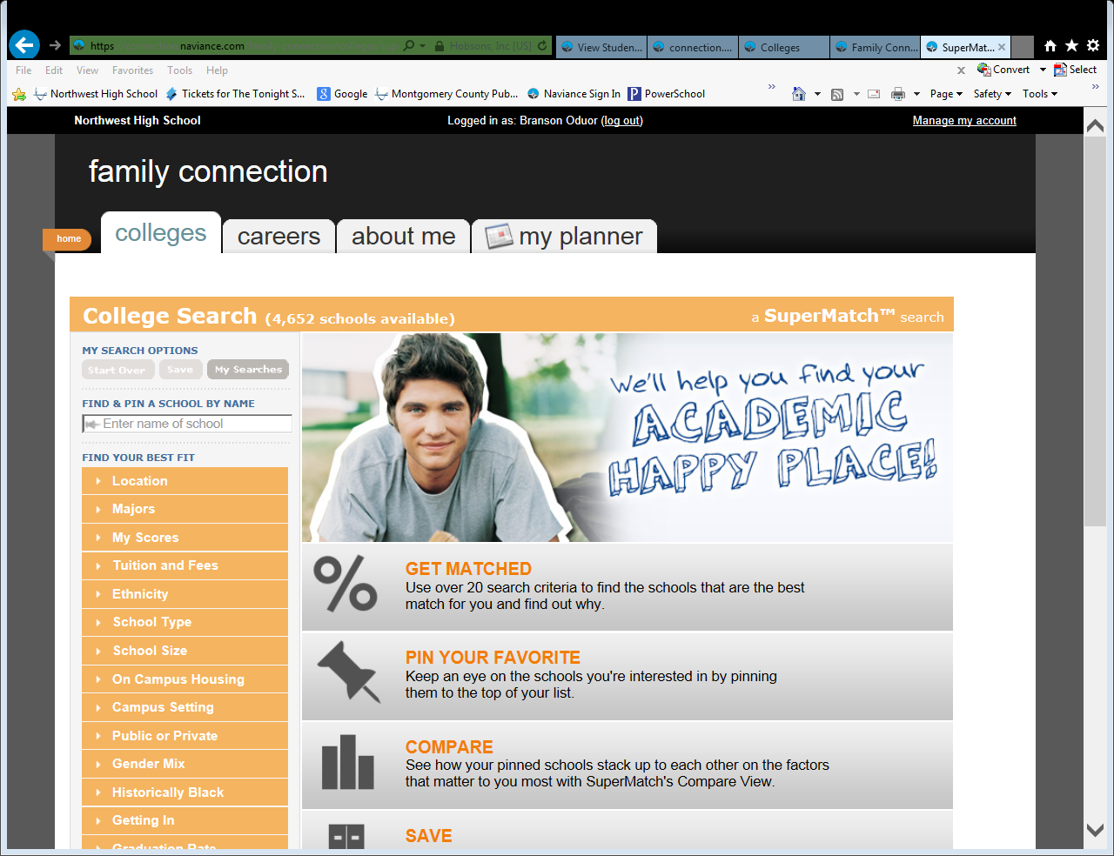
College Search

Slide 12
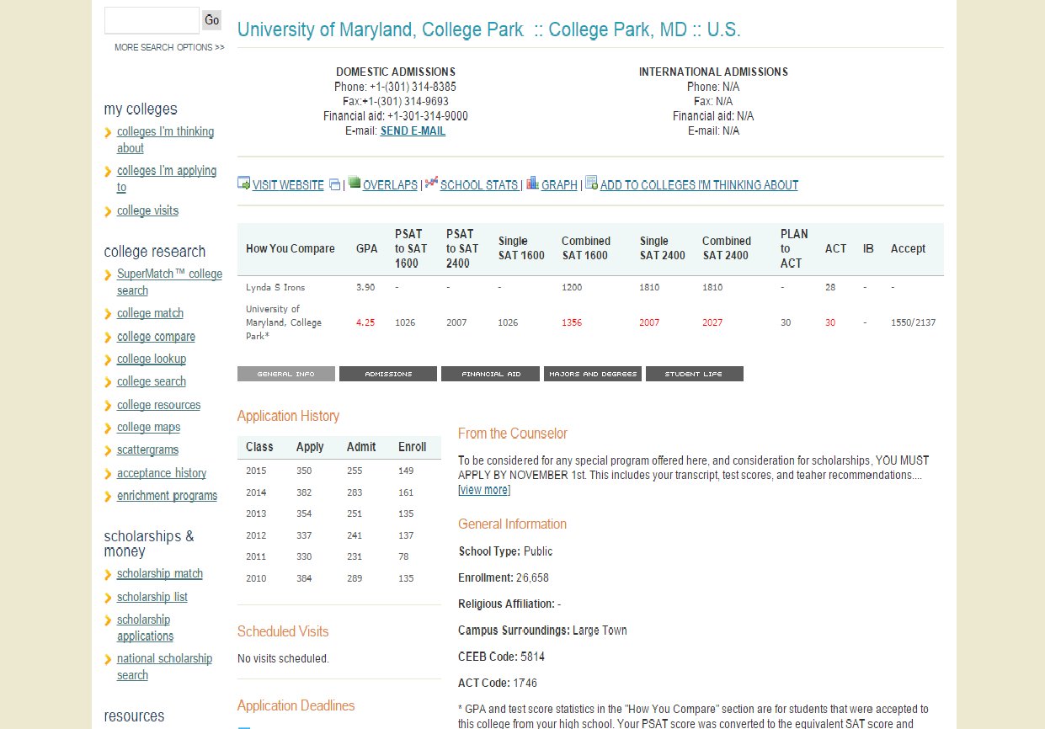
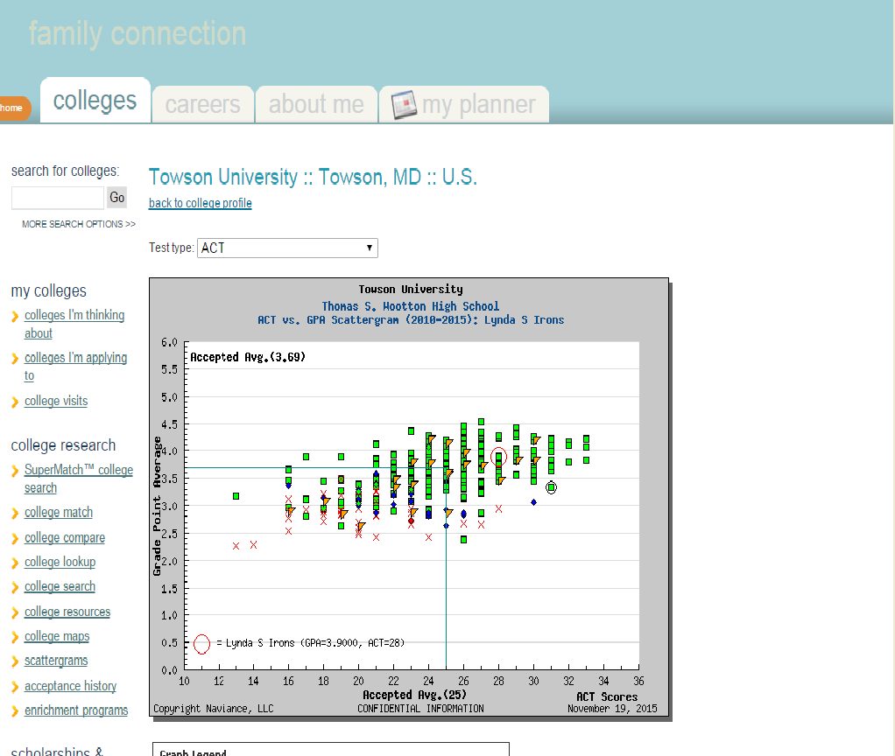
College Scattergram
Click here to see if your GPA & SAT scores would be a good match for a particular college

Slide 13
The Next Few Months…
  Add a list of colleges you are considering to your “colleges I’m thinking about” on Naviance
  Plan and Register for SAT/ACT/SAT II/Accuplacer testing
  Course selections for senior year in January/February
  Jan. 26th 7:00pm: College Panel Night
  February 5th 6-8:30pm Gap Year/Summer Programs Fair
  March-June: Group and Individual meetings with counselors regarding college application process
  April 20th: National College Fair @ Montgomery County Fairgrounds
  Visit & research colleges over spring break (March 24th-April 3rd)
  May 2nd-13th: AP Exams
  June 13th-17th: Final Exams
  August: Wootton summer institute college bootcamp classes

