Slide 1
Financing Your Students Education
How to pay for college
Presented by Hood College Financial Aid Office

Slide 2
Topics We Will Discuss Tonight
What is financial aid?
Free Application for Federal Student Aid (FAFSA®)
Cost of attendance (COA)
Expected family contribution (EFC)
Financial need
Categories, types, and sources of financial aid
Financial aid terms to know

Slide 3

What is Financial Aid?
Financial aid consists of funds provided to students and families to help pay for postsecondary educational expenses

Slide 4
It’s all about The FAFSA
Free Application for Federal Student Aid
Free Application for Federal Student Aid
A standard form that collects demographic and financial information about the student and family
May be filed electronically or using paper form
Required for all Federal Aid

Slide 5
Completing the FAFSA
FAFSA on the Web – https://studentaid.gov
Obtain FSAID (federal student aid password) at https://studentaid.gov
  Each student will need their own FSAID and at least one Parent
Fill out all parts of the FAFSA (make sure to answer all questions and when asked, put a zero (0) in for dollar amounts
October 1, 2022 for 2023-2024 use 2021taxes
Send all requested documents to the College/University your student has chosen
An award package will now be created for your student by the Financial Aid offices
Most colleges set FAFSA filing deadlines
DRT-Data Retrieval Tool, connects with the IRS, Data is masked

Slide 6
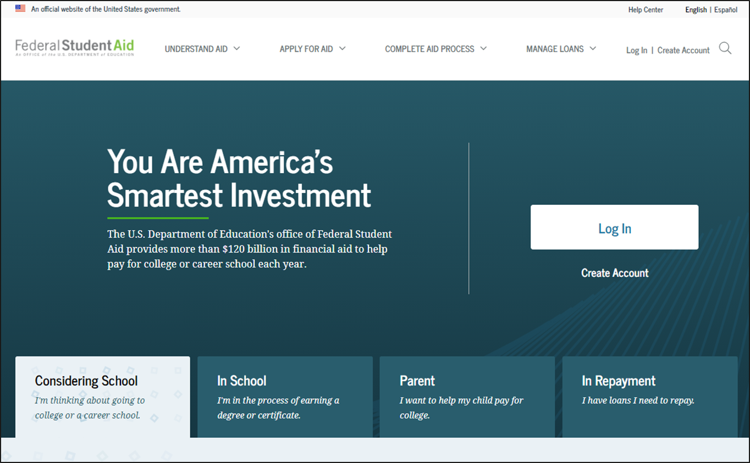

Slide 7
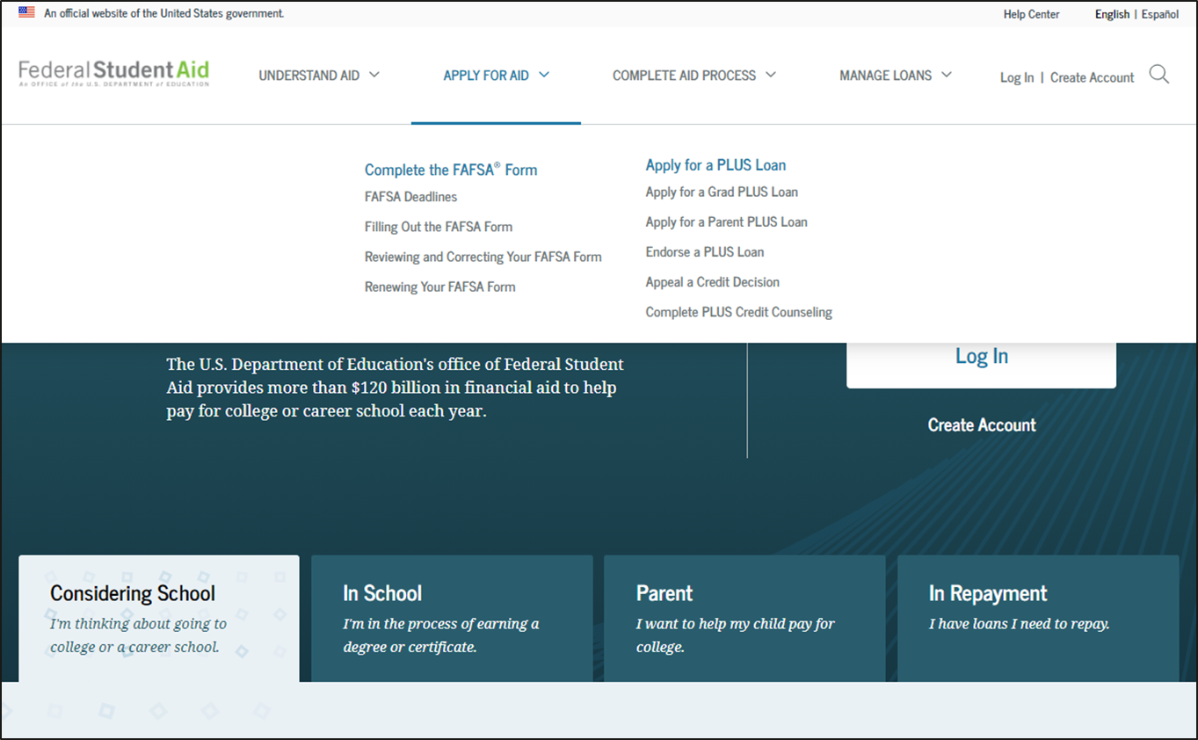

Slide 8
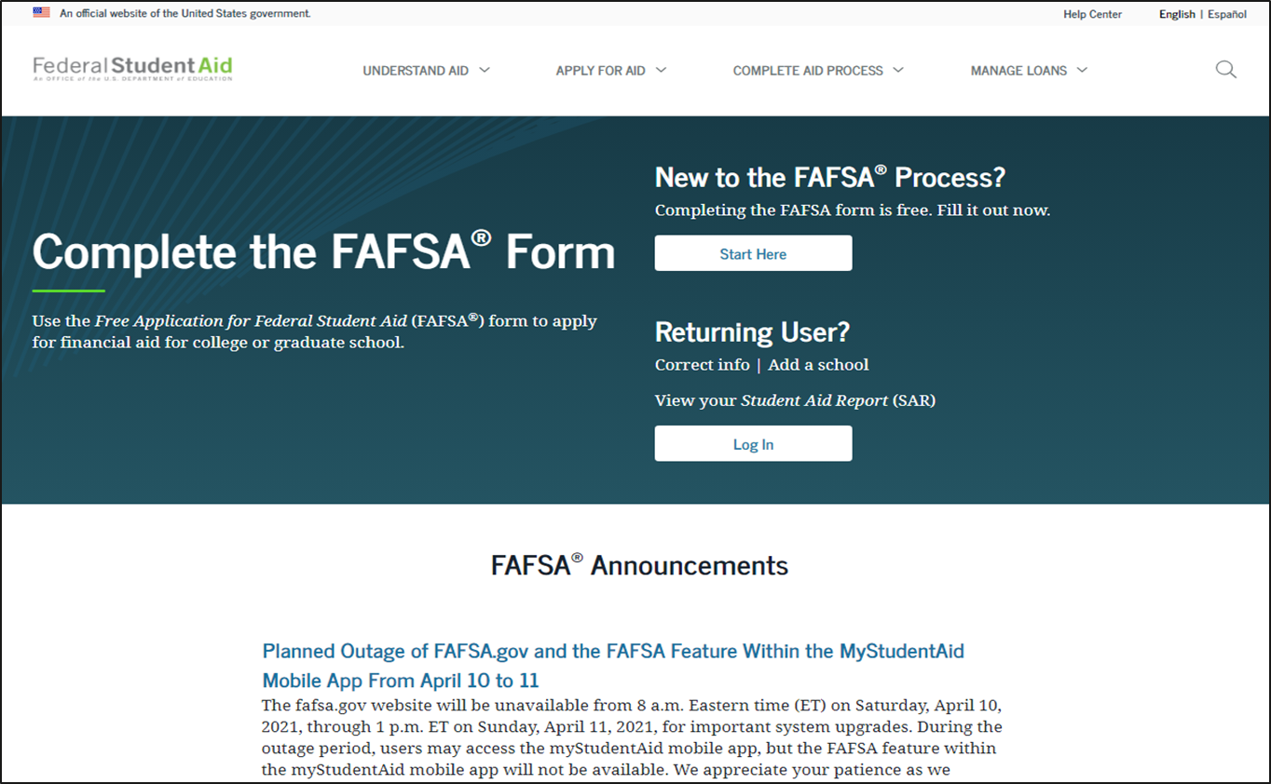

Slide 9
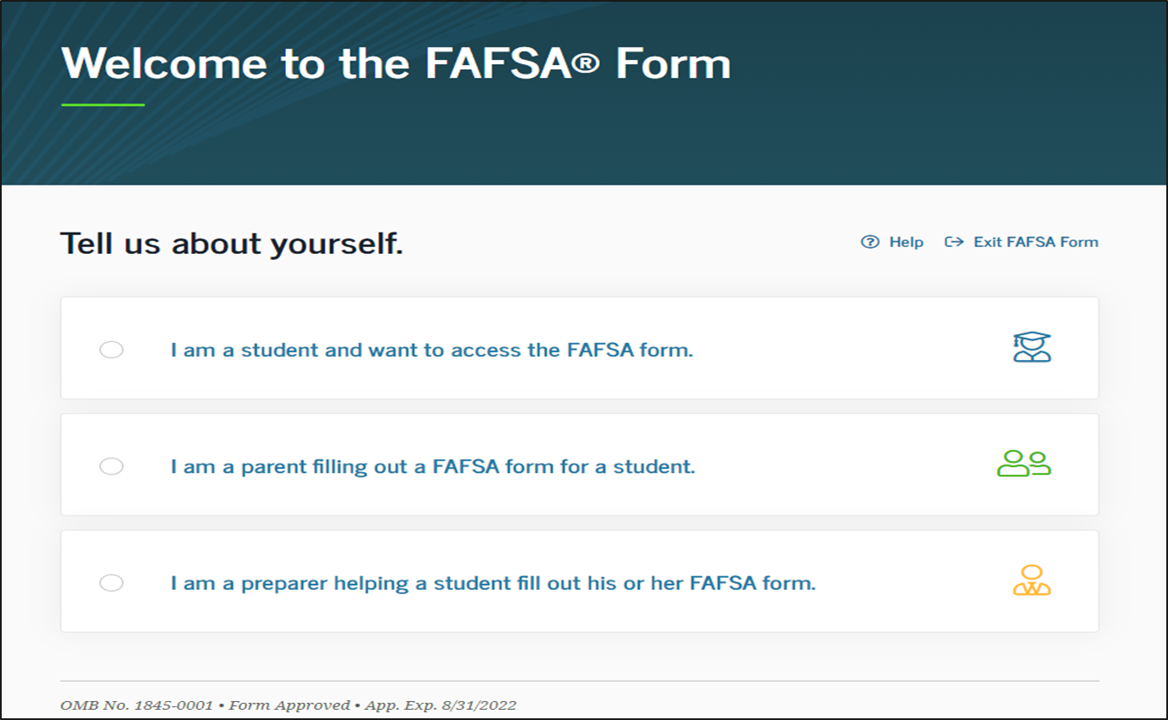

Slide 10
Who can get federal student aid?
U.S. citizen or permanent resident
High school graduate/GED holder
Eligible degree/certificate program
Valid Social Security number
Satisfactory academic progress in college/career school

Slide 11
Dependent/Independent Students
Independent Students are students who can answer yes to one of the following:
    Student is at least 24 years old
    Student is a graduate or professional student
    Student is married
    Student is supporting children
    Student is an orphan or ward of court
    Student is a veteran of the U.S. Armed Forces

Slide 12
Who is not the parent?
FAFSA application must be completed by student and the student’s biological or adoptive parents
    If the student’s biological parents are separated/divorced the parent with whom the student lives with is reported on the FAFSA. If the parent is remarried, the step-parent’s information must be included on the FAFSA
Parents do not include:
Grandparents (or others) who are supporting the student
Foster parent
Legal Guardians

Slide 13
Special Circumstances
The FAFSA is based on your 2021 federal tax information. There are various circumstances that may affect your financial situation such as:
  Change in employment
  Medical expenses not covered by insurance
  Student cannot obtain parent information
  One-time taxable distribution
  Please contact the Financial Aid Office of the school you are considering to attend to discuss your situation. Financial Aid Offices have the option to complete a Professional Judgment to assist you with additional financial aid

Slide 14
Verification
*** A term to know
Approximately 1/3 of all students are selected
Some schools do 100% verification
You may link your taxes to your FAFSA
Documents will be requested to verify information on the FAFSA
  Tax transcripts for parents and students
  Verification worksheet
  Sometimes W-2 Parents and Students

Slide 15
Frequent FAFSA Errors
Social Security Numbers
Divorced/widowed/remarried parental information
Income earned by parents/stepparents
Untaxed income
U.S. income taxes paid
Household size
Number of household members in college
Real estate and investment net worth

Slide 16
Types of Federal and state Aid
“Free Money”
Loans-Student
Loans-Parent
Work Study

Slide 17
Federal aid break down
Pell Grant - maximum is $ 6,895 [2022-2023]
FSEOG (Federal Supplemental Educational Opportunity Grant) -neediest students
Direct Student Loans - all students, repayment 6 months after student leaves school
  Subsidized - Government subsidizes the interest
  Unsubsidized - family subsidizes the interest
Parent Plus Loan - repayment after second disbursement, credit check is done by federal Government.
Federal Work-Study - depends on funds available at school

Slide 18
Institutional Aid
Merit aid - grades, extra-curricular activities, and information found on the college application. These amounts are awarded through the admission office.
Need-based aid - Funds are awarded by the Financial Aid Office
    Federal and state aid is based primarily on the FAFSA information
    Institutional aid may be based on the FAFSA information as well as other institutional criteria.

Slide 19
State Aid (Maryland Programs)
Senator
Delegate
Guaranteed Access Grant
Educational Assistance Grant
Deadline is March 1, FAFSA needed and list at least one MD School
www.MHEC.state.md.us
Student must go back in and accept award
Contact Senator / Delegate
Determined by FAFSA

Slide 20
Applying for State Financial Aid
Maryland College Processing System (MD CAPS)
MDCAPS is the State of Maryland’s financial aid system
You must create a Student Login Profile and then click on the activation link in the message sent to your email account, which was provided when you created your account in MD CAPS
To create a profile, log onto https://mdcaps.mhec.state.md.us
The MDCAPs account can be created at any time
Through your MD CAPs account you can monitor the status of your application and accept the awards offered by the State

Slide 21
Other Funding Options
Alternative Loans
Private lenders
  Varying interest rates/terms/lenders/types
Home Equity Loans

Slide 22
Outside Scholarships and Grants
Civic Organizations
Check with your high school Guidance Counselors
Varying amounts, due dates, criteria
  www.fastweb.com
  www.myscholly.com
  www.scholarship.com
  www.central-scholarship.org
  www.gocollege.com
  www.cffredco.org
  www.mdcommunityfoundations.org

Slide 23
College by College

Slide 24
Cost of attendance (Budget)
There are 5 categories
  Tuition and Fees
  Room and meal plan
  Books and Supplies
  Transportation
  personal expenses.
  This total is what the Financial Aid Office
  can award aid up to.
Direct costs
Indirect costs

Slide 25
What is Cost of Attendance (COA)?
Direct costs
    (Tuition and fees, Room and Meal plans)
Indirect costs
    (Books & Supplies, Transportation, Personal Expenses)
Cost of Attendance
    Combination of direct and indirect cost
Varies widely from college to college

Slide 26
Financial Need
Cost of Attendance
– Expected Family Contribution
= Financial Need

Slide 27
What is Expected Family Contribution (EFC)?
*** A term to know
Amount family can reasonably be expected to contribute
Stays the same regardless of college
Two components
  Parent contribution
  Student contribution
Calculated using data from a federal application form and a federal formula

Slide 28
Award Package
*** A term to know
All awarded funds from a college which include:
  Merit
  Federal
  State
  other Institution aid
  outside scholarships

Slide 29
Satisfactory Academic Progress
*** A term to know
Satisfactory Academic Progress (SAP) is required by all institutions. Students must maintain a certain GPA in order to keep their financial aid in subsequent semesters/years. Students must have a cumulative 67% passing rate.
The GPA for institutional aid (merit awards) may be different from the federal requirements. Please check with the school you will be attending.

Slide 30
Helpful Web Sites:
www.FAFSA.gov
www.FSAID.ed.gov
www.Studentaid.gov
www.mhec.state.md.us
www.mdcaps.mhec.state.md.us
www.studentloans.gov

Slide 31
Things to Remember
Deadlines – Institutional and Scholarship deadlines may vary
October 1st – FAFSA available for 2022-2023 academic year
March 1st – State of Maryland FAFSA deadline
Keep a copy of your Student Aid Report (processed FAFSA results)
Notify the Financial Aid Office of special circumstances
Apply for scholarships

Slide 32
Questions?
Susan W. Erb
Associate Director of Financial Aid
Hood College
erb@hood.edu

