Slide 1
Career Readiness: Cover Letters
Presented by: Dr. Dimar Brown,
The Readiness Movement, LLC

Slide 2
Agenda
After today, you will know:
What cover letters are
Their purpose
How to use them in the hiring process
Notes:
After today, you will know: what cover letters are, their purpose, and how to use them in the hiring process. (Next slide)

Slide 3
Cover Letters

Slide 4
What are cover letters?
It is your personal greeting that will accompany your job application. It is equivalent to:
A “hello,”“what’s up?,” or “how’s it going?” in a conversation
A “WYD” or “HRU” in a text message
A voicemail during a missed call
A postcard in the mail
Notes:
Cover letters are your personal greeting that will accompany your job application. It is equivalent to a “hello,” or “what’s up?,” or “how’s it going?” in a conversation. It could also be a “WYD” or “HRU” in a text message, or a voicemail, or a postcard in the mail. (Next slide)

Slide 5
Cover Letters Have
Two Primary Functions

Slide 6
Function #1: First Impression
Cover letters are designed for you to make your first impression on individuals a part of the hiring process.
Notes:
The first function is the First Impression. Cover letters are designed for you to make your first impression on individuals a part of the hiring process.

Slide 7
Function #2: Introduce Resume
In addition to allowing you to make an everlasting first impression, cover letters introduce your resume.
Notes:
The second function is Introducing your resume. In addition to allowing you to make an everlasting first impression, cover letters introduce your resume.

Slide 8
So What’s “Covered” In The Letter?

Slide 9
Cover letters should “cover”:
Who you are and why you are applying
What relevant skills and qualifications you possess
How you have effectively used these in the past
How would your skills and qualifications benefit the employer
Why you want to work for the employer
Notes:
Cover letters should “cover”: who you are and why you are applying for the job, what relevant skills and qualifications you possess, how you have effectively used these in the past, how your skills and qualifications would benefit the employer, and why you want to work for the employer.

Slide 10
Cover letters are not:
A letter version of your resume (it introduces it)
A general template (it should be customized)
Going to land you employment (cover letters provides opportunities to show employers how you differ from other candidates with similar skills and qualifications)
Notes:
Cover letters are not a letter version of your resume (it introduces it). They should not use a general template (it should be customized). Cover letters are not used to land you employment (they provide opportunities to show employers how you differ from other candidates with similar skills and qualifications).

Slide 11
What do cover letters look like?
Here are some guidelines:
No more than 1 page in length (3 paragraphs).
Write clearly, concisely, and error-free.
Address it to the hiring manager (if unknown, use something general like “The Human Resources Search Committee”).
Ensure headers and formatting is consistent with your resume.
Notes:
What do cover letters look like? They tend to be no more than 1 page in length (3 paragraphs), written clearly, concisely, and free from errors. Cover letters should be addressed to the hiring manager (if unknown use something general like “The Human Resources Search Committee”). Make sure that the letter contains headers and formatting consistent with your resume.

Slide 12
Do you always need a cover letter?
If a job posting asks for a cover letter: YES
If a job posting doesn’t ask for one, but you allowed to add additional attachments: YES
If a job posting doesn’t ask for one and you are applying to a job via email: YES, the cover letter can serve as the body of your email.
If a job posting doesn’t ask for one and there is no option to provide one: NO
Example: Job asks for one and applying through email: https://www.idealist.org/en/nonprofit-job/f1e273d1253f4fdcafb8fe4e4751addd-communications-content-officer-the-fund-for-global-human-rights-washington
Notes:
Do you always need a cover letter? Yes, if a job posting asks for one; if a job posting doesn’t ask for one, but you are allowed to add additional attachments; if the posting doesn’t ask for one and you are applying to a job via email; and if the cover letter can serve as the body of your email to submit the application. If a job posting doesn’t ask for a cover letter and there is no option to provide one.
Here’s a real-life example: your job posting asks for a cover letter as part of applying through email (show example of a job posting online (Idealist, Indeed, etc.).

Slide 13
Before you begin writing you should:
Find a job to apply to.
Review the job description to scan for required skills, education and qualifications (highlight and key terms, words used).
View the company’s website to look for:
  Mission statements and visions
  Language used
  Name of hiring manager (if available)
Notes:
Before you begin writing you should do these three things: find a job to apply to, review the job descriptions to scan for required skills, education and qualifications (highlight and key terms, words used); view the company’s website; look for mission statements and visions; determine the main language being used (if necessary); and the name of hiring manager (if it is available).

Slide 14
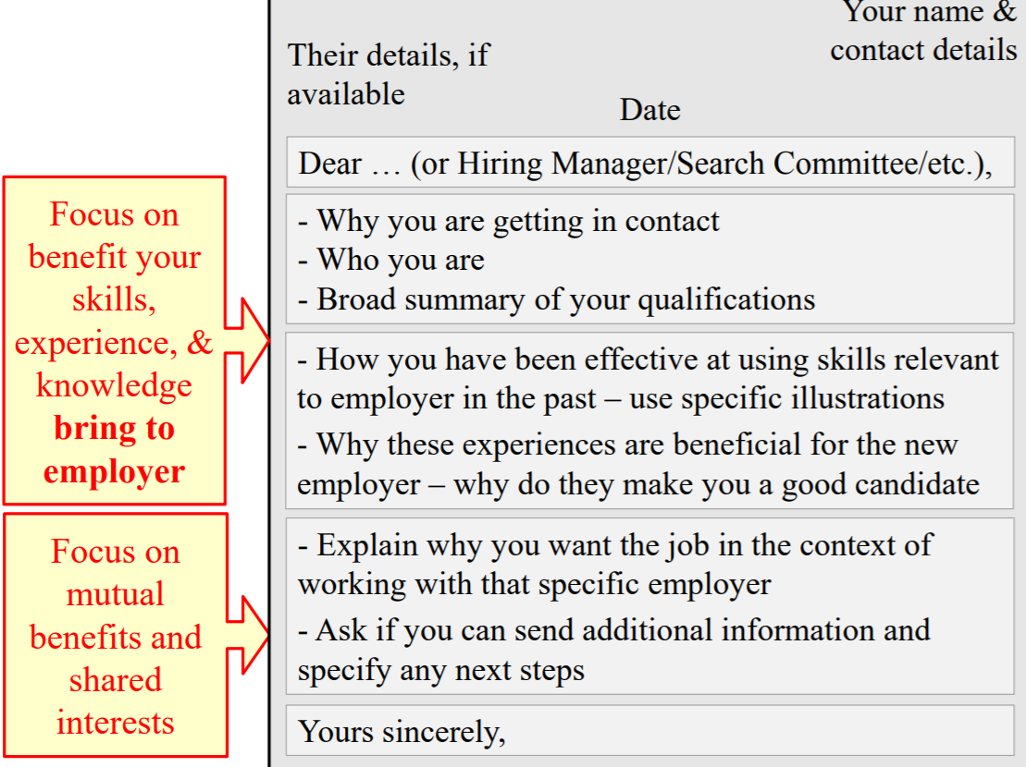
Notes:
Your cover letter should focus on the benefit your skills, experience, and knowledge will bring to your employer. It should also focus on any mutual benefits or interests you may share. (Read and explain the section to the right.)

Slide 15
After the cover letter has been written:
Check for typos.
Ensure that the formatting and alignment matches your resume.
https://bit.ly/2yrmTEz
Notes:
After the cover letter has been written, you should check for typos and ensure that the letter’s formatting and alignment matches your resume.

Slide 16
Recap:
Cover letters serve as your first impression.
They are customized to explain you, your skills and interest in the position.
They are brief.
They should introduce the resume.
Notes:
To recap: Cover letters serve as your first impression to a potential employer. They are customized to explain more about you, your skills, and your interest in the position. They should be brief and should introduce your resume.

