Slide 1
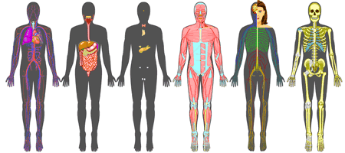
Col. Z. Magruder High School
Honors Human Anatomy and Physiology
Summer Introduction Packet
Dr. Newman

Slide 2
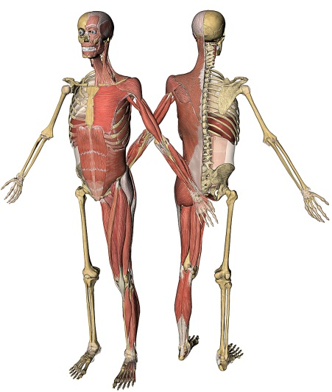
Welcome to Honors Human Anatomy and Physiology! I look forward to working and learning with you about the structure and function of the most amazing machine known; the human body. This introductory packet will get you started on your journey by introducing the language of anatomy. Please complete the accompanying assigned lab packet activities and have them ready for evaluation on our first day of class. If you know another student taking A and P with you this year, I encourage you to work on this packet with them. Team and group learning is a very successful strategy in Anatomy and Physiology.
Our Anatomy and Physiology class here at Magruder High School is comprehensive and challenging. In addition, my expectations for you as well as myself are high. I will teach you Human A and P along with techniques to better process and comprehend complex concepts. I also plan to improve your preparation for the many difficult assessments you will face in this class and throughout your academic careers.
I can’t wait to start our journey. Until then, enjoy your summer!
Steven M. Newman DDS, MS
Col. Z. Magruder High School
Honors Human Anatomy and Physiology/Biology/ESOL Biology
Adjunct Faculty: Montgomery College

Slide 3
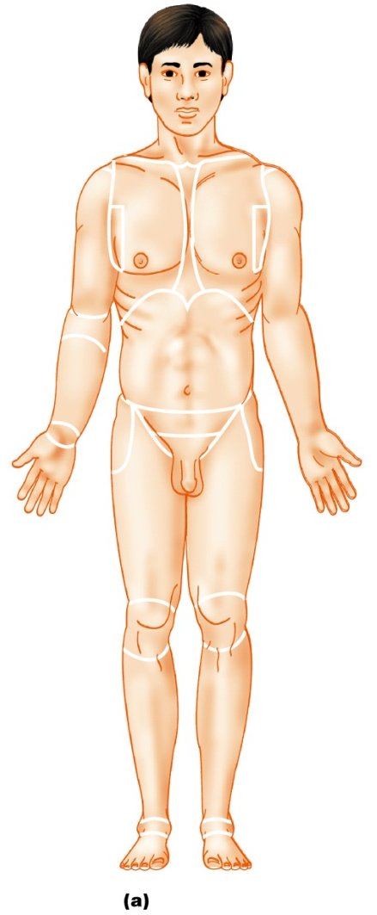
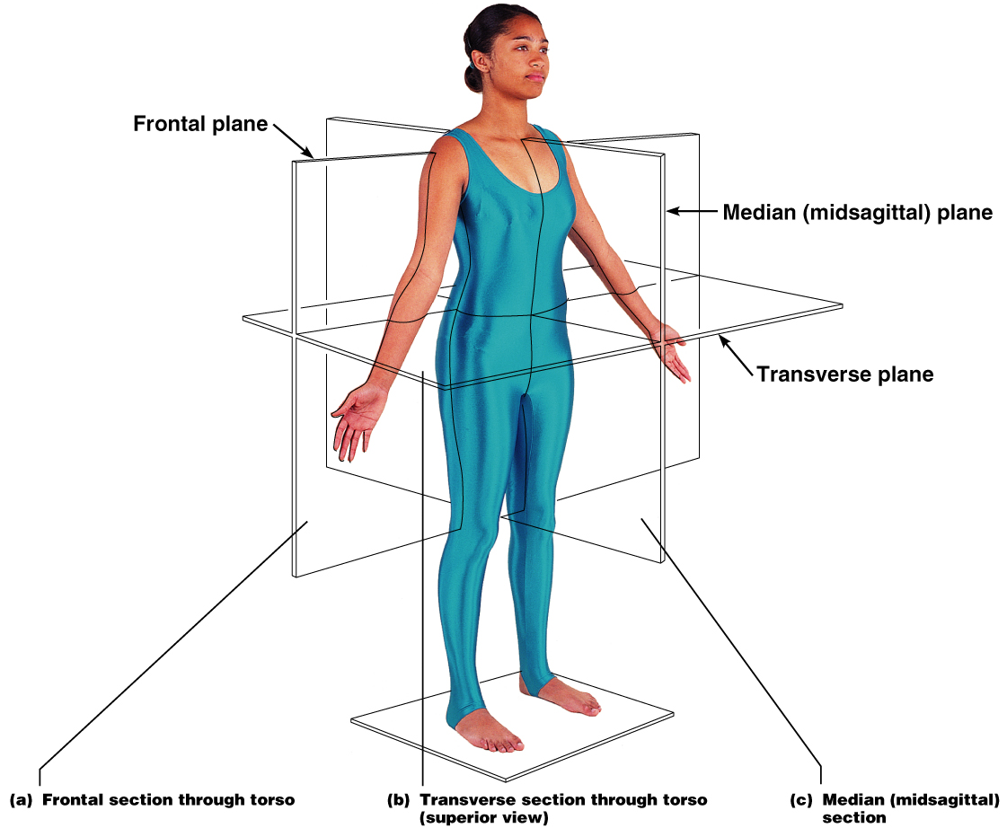
Anatomical Position
Body Planes
Body erect, feet slightly apart,
palms facing forward, thumbs
point away from body
Sagittal – divides the body into right and left parts
Frontal or coronal – divides the body into anterior and posterior parts
Transverse or horizontal (cross section) – divides the body into superior and inferior parts
Figure 1.7a

Slide 4
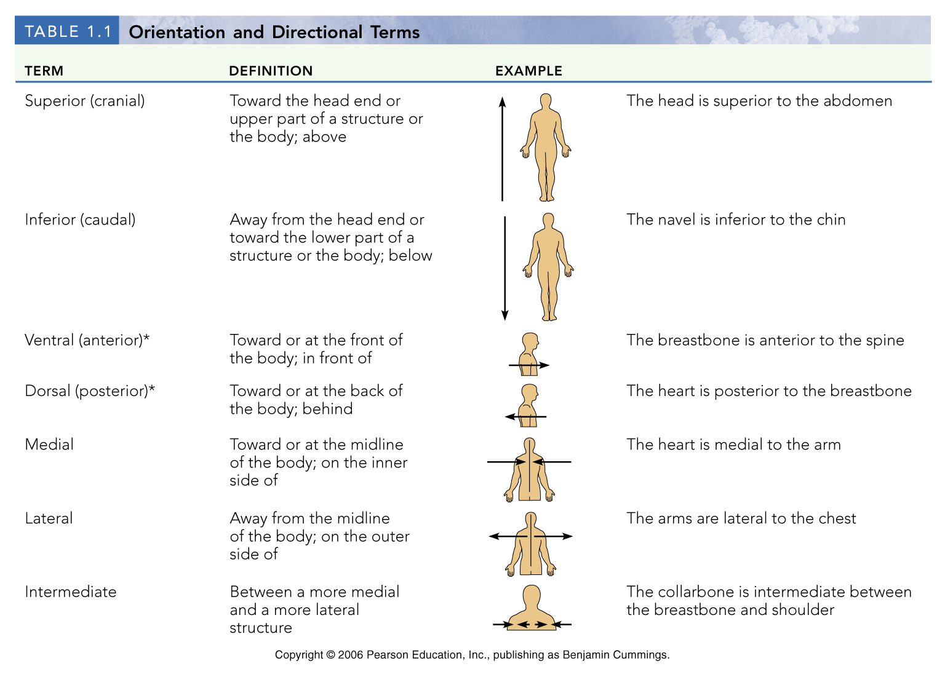
Table 1.1a

Slide 5
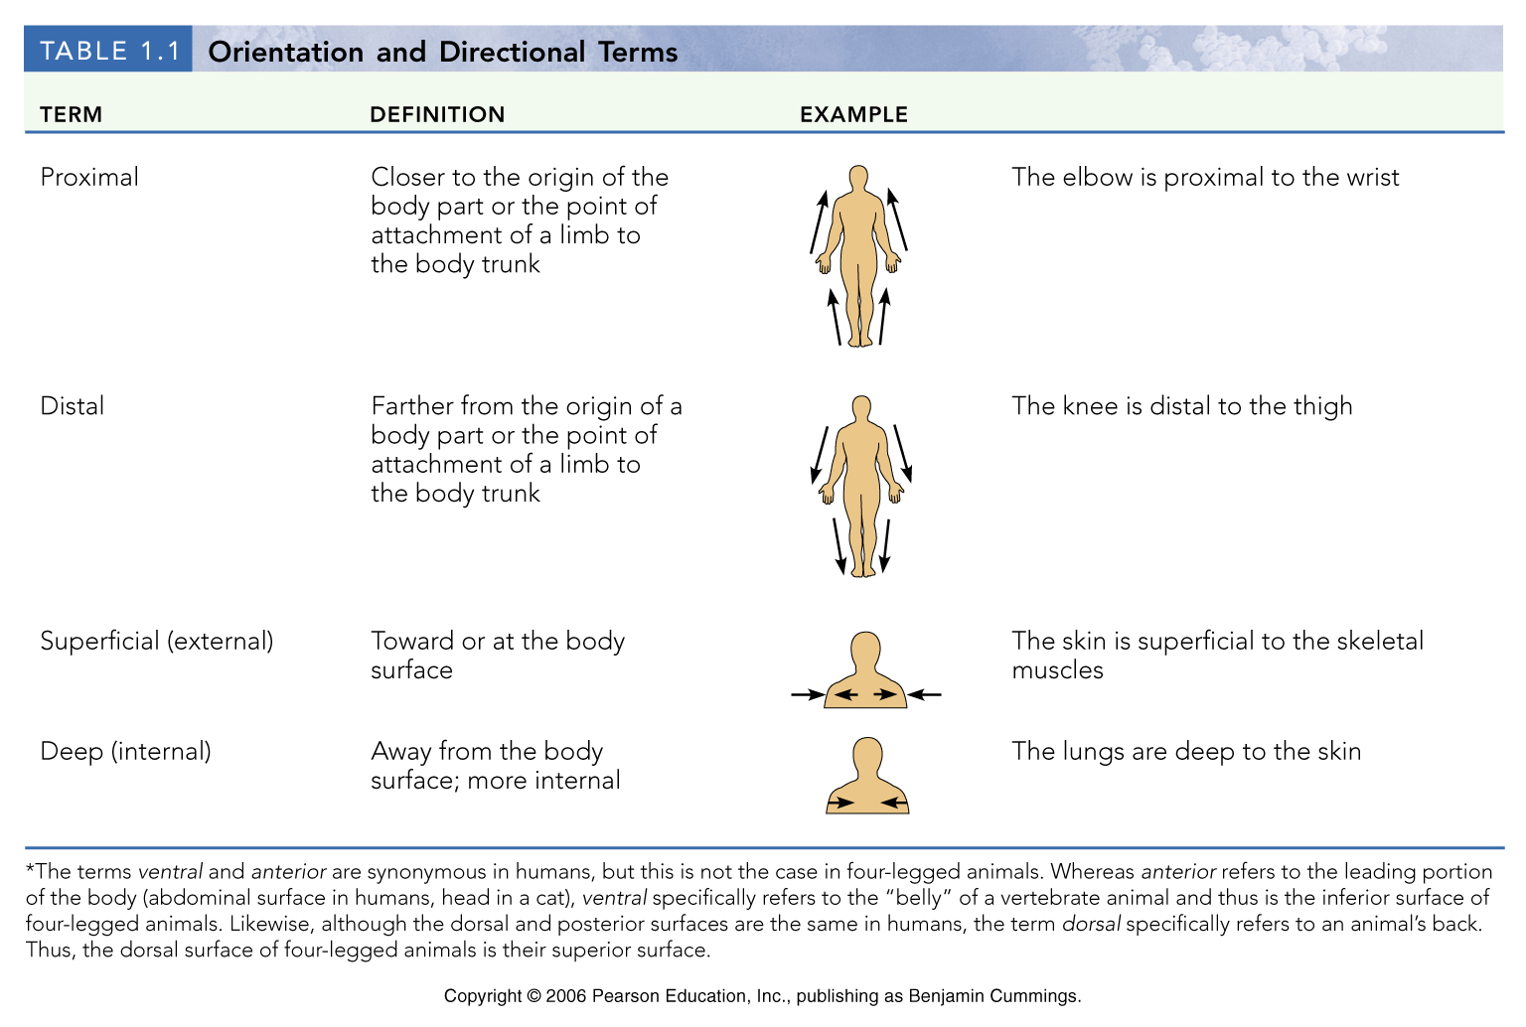
Table 1.1b

Slide 6
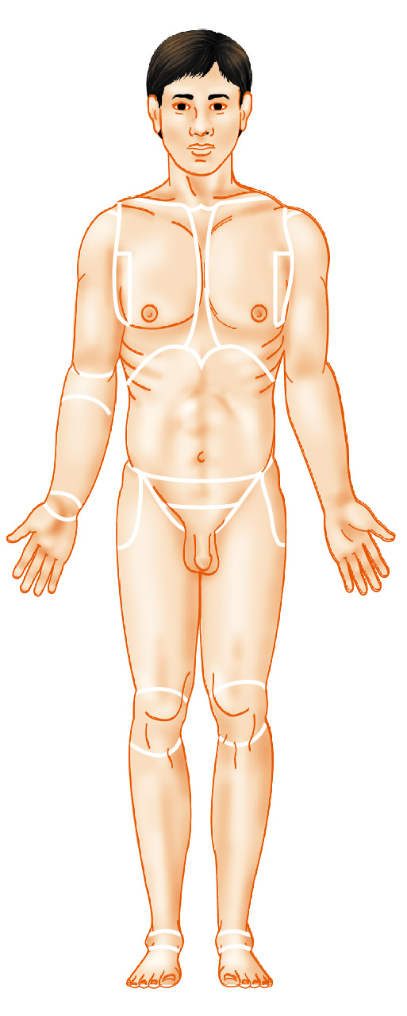
Regional Terms:
Anterior View
Nasal (nose)
Frontal (forehead)
Oral (mouth)
Orbital (eye)
Cervical (neck)
Buccal (cheek)
Mental (chin)
Acromial
(point of shoulder)
Sternal
(breastbone)
Axillary (armpit)
Thoracic
(chest)
Abdominal
(abdomen)
Mammary
(breast)
Brachial (arm)
Antecubital
(front of elbow)
Antebrachial
(forearm)
Umbilical
(navel)
Pelvic (pelvis)
Carpal (wrist)
Pollex
(thumb)
Palmar
(palm)
Coxal
(hip)
Digital
(fingers)
Inguinal
(groin)
Pubic (genital region)
Femoral
(thigh)
Patellar
(anterior knee)
Fibular, or
peroneal
(side of leg)
Crural (leg)
Pedal
(foot)
Tarsal (ankle)
Hallux (great toe)
Digital (toes)
(a) Anterior
Figure 1.7a

Slide 7
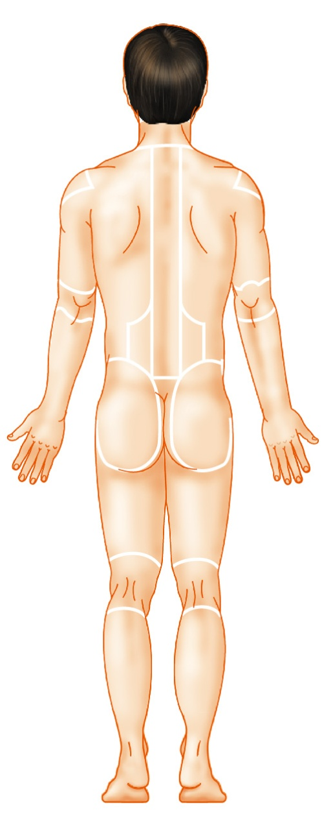
Regional Terms:
Posterior View
Otic (ear)
Cephalic
(head)
Occipital (back of
head or base of skull)
Acromial
(point of shoulder)
Vertebral
(spinal column)
Scapular
(shoulder blade)
Upper
extremity
Brachial (arm)
Dorsum or dorsal
(back)
Olecranal
(back of elbow)
Lumbar (loin)
Sacral
(between hips)
Manus
(hand)
Gluteal (buttock)
Perineal
(region between
the anus and
external genitalia)
Lower
extremity
Femoral (thigh)
Popliteal
(back of knee)
Sural (calf)
Calcaneal (heel)
Plantar (sole)
(b) Posterior
Figure 1.7b

