Slide 1
Understanding Your PSAT/NMSQT® Results
Notes:
Note to Presenter: Use this PowerPoint presentation to help your students understand their PSAT/NMSQT results and benefit from the feedback provided on their score reports. The notes provided throughout the presentation can be read aloud to students or used simply as reference information.

Slide 2


Agenda
  Four Major Parts of Your PSAT/NMSQT Results
  More About Your Skills
  National Merit Scholarship Information
  More About Your Answers
  Next Steps
  How My College QuickStart™ Can Help You
Notes:
Our agenda will cover:
An overview of the four major parts of the PSAT/NMSQT results
A look at how to use your results in the Skills section
Information about the National Merit Scholarship Qualification
How to interpret your answers
Your next steps in planning your road to careers and college
An introduction to the features of My College QuickStart and your own personalized college planning kit

Slide 3
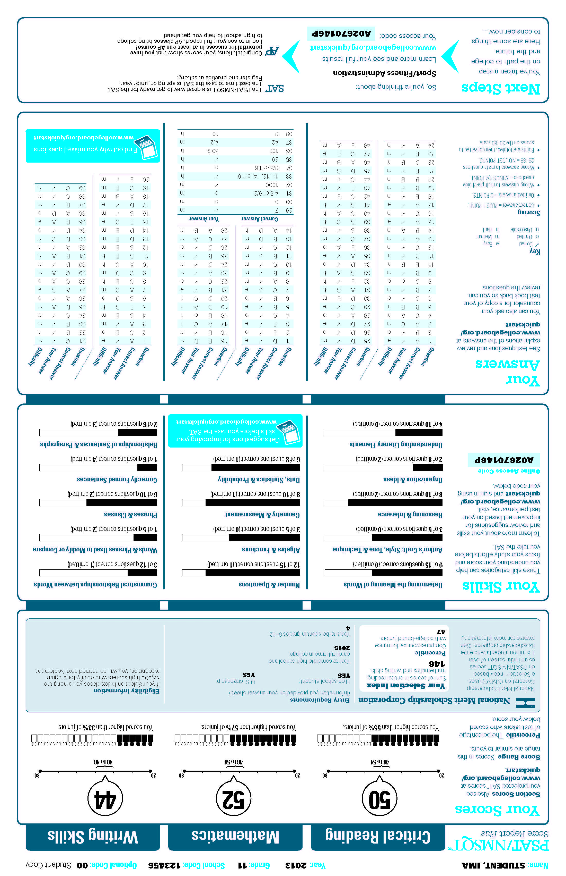
Four Major Parts of Your PSAT/NMSQT Results
Your Scores
Your Skills
Your Answers
Next Steps
3 Test Sections
Critical Reading
Mathematics
Writing Skills
Notes:
There are 4 major parts to the PSAT/NMSQT Score Report:
-Your Scores
-Your Skills
-Your Answers
-Next Steps
The score report shows how you performed on each of the three sections of the PSAT/NMSQT:
-Critical Reading
-Mathematics
-Writing Skills

Slide 4
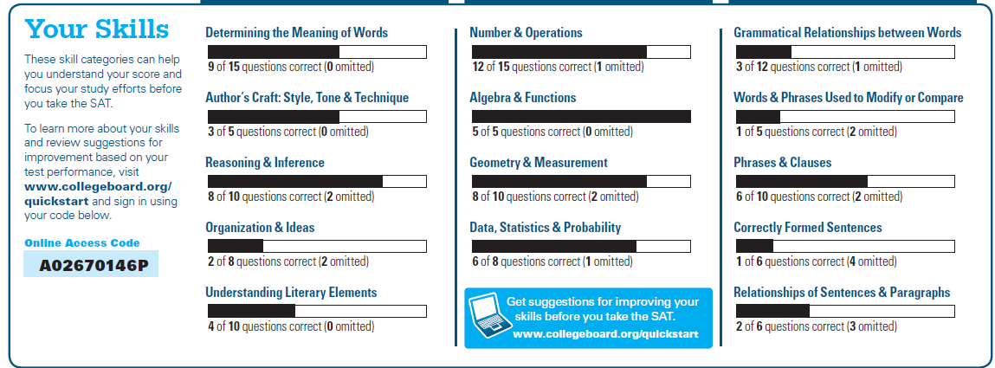
Your Skills
See how you did on each skill. The same skills are tested on the SAT.
You can try hundreds of practice questions, organized by skill, online in My College QuickStart (www.collegeboard.org/quickstart).
Notes:
Your Skills Section
The “Your Skills” section is a valuable part of your PSAT/NMSQT results, showing you a complete picture of how you performed on the different skills tested by the PSAT/NMSQT. Take a closer look to see where you did well and where you might want to improve.
The same skills are tested on the SAT. To get more practice before you take that test, try the hundreds of practice questions available online at www.collegeboard.org/quickstart.

Slide 5
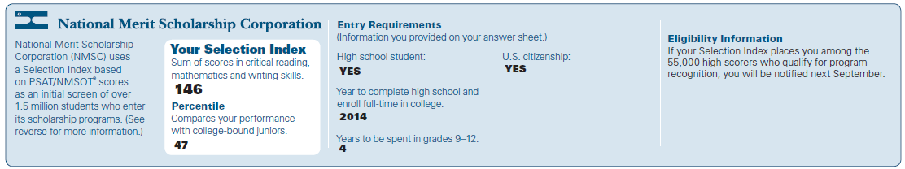
National Merit Scholarship Corporation Information
The Selection Index is the sum of your critical reading, mathematics and writing skills scores.
If it has an asterisk, you do not meet all of the eligibility requirements for the competition.
The Percentile compares your performance to that of other college-bound juniors.
The Entry Requirements section displays information you provided on your answer sheet.
Notes:
Below your scores, you’ll find information about eligibility for scholarships available through the National Merit Scholarship Corporation. Each student who takes the PSAT/NMSQT has a Selection Index. The Selection Index is the sum of the Critical Reading, Math, and Writing Skills scores (CR+M+W).
To enter National Merit Scholarship Corporations competitions, you must:
1. be a full-time high school student;
2. graduate the following year and enroll in college full-time;
3. complete grades 9-12 in four years; and
4. be a U.S. citizen.
If your Selection Index has an asterisk (*) next to it, this means you do not meet all the eligibility requirements for entrance into the competition. Typically, it is because you are not graduating next year.
More than 1.5 million juniors enter this competition each year. About 50,000 qualify for recognition, and about 9,600 of these students receive an award. Be sure to look at your own Selection Index and eligibility when you receive your score report.

Slide 6
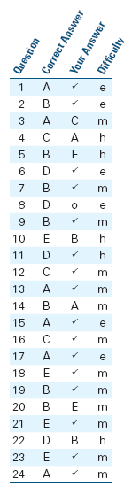
Your Answers
You will get your test book back with your PSAT/NMSQT results, so that you can review the questions.
You can also review each test question in My College QuickStart.
Notes:
Review Your Answers Section
The middle section of the report is the “Review Your Answers” section. When you receive your results, you will also get your test book, the one you used when you took the test. Be sure to ask for your test book if you don’t have it.
Use your Test Book:
Using your actual test book will help you make the most of the “Review Your Answers” section, since you’ll be able to go back to questions you got wrong and, with the help of the explanations available on www.collegeboard.org/quickstart, figure out why. You can also look at the notes you made in your test book to see how you got to your answer.
Four Columns: The Critical Reading, Mathematics, and Writing Skills sections of your score report all contain the following information.
The first column displays the number of each question as it appeared in the test booklet.
The second column displays the correct answer to each question.
In the third column you will see the answers that you chose:
-a checkmark means CORRECT
-O means OMITTED
-an alphanumeric letter shows the incorrect answer you chose
In the fourth column we see the letters E, M, or H, which identify the level of difficulty of each question.
-E means EASY questions
-M means MEDIUM difficulty
-H means HARD (the most difficult questions on the test)
Remember: This test is for high school juniors who are preparing for college, so it’s possible that an E or easy question might seem difficult to younger students.

Slide 7
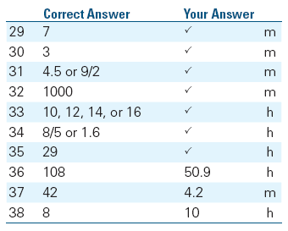
Your Answers: Student-Produced Responses
Some of the math problems required you to grid in answers instead of selecting an option. For these questions, you will see the correct answer(s) written out.
Notes:
Review Your Answers: Mathematics Student-Produced Responses
Not all the math questions on the PSAT/NMSQT are multiple-choice. The Math section contains Multiple-Choice and Student Produced Response Questions, or “grid-ins”. Here, you solved problems and then recorded answers on a grid.
Only answers gridded in the circles are scored. You receive no credit for answers, even correct ones, written in boxes and not gridded or gridded incorrectly.

Slide 8
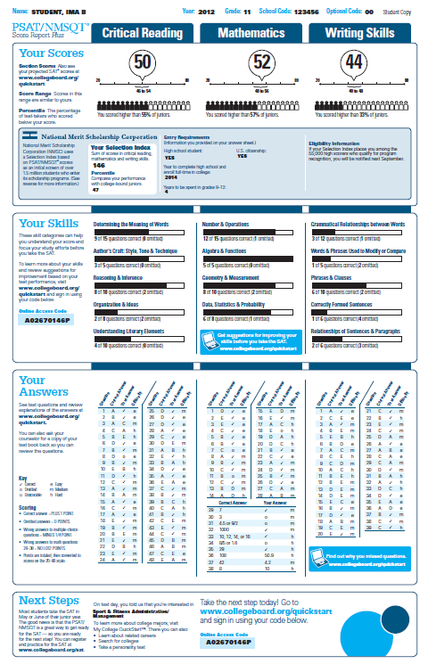
Next Steps
What’s next?
Use the access code on your report to log in to My College QuickStart, a personalized college and career planning kit. There you can:
Search for colleges
Get a personalized SAT study plan
Take a personality test to find majors and careers that fit you
Learn more about AP® courses that you might be ready to take
www.collegeboard.org/quickstart
Notes:
Your Educational Plans
Read this section to see how well your future plans match your current interests and skills, as well as the courses you will be taking.
On your answer sheet, you provided:
grade average
a college major of interest
Your report gives a description of what college students learn and do with the major you indicated. It also notes skills important to that major and high school courses you should take. Check the AP potential message for what steps to take to help you get ahead.

Slide 9
How Can My College QuickStart® Help You?

Slide 10
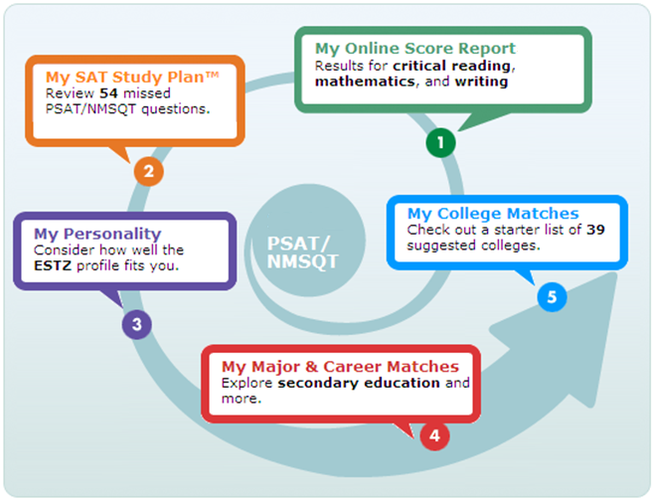
My College QuickStart
Notes:
My College QuickStart
My College QuickStart is a free personalized college planning kit based on your PSAT/NMSQT results. Your kit has four parts:
My Online Score Report: Review your online PSAT/NMSQT Score Report—you'll be able to sort answers and explanations by difficulty and question type. You'll also be able to view projected SAT score ranges, state percentiles, and more.
My SAT Study Plan: Prepare for the SAT with a customized study plan based on your strengths and weaknesses, as determined by your PSAT/NMSQT performance.*
My College Matches: Get a starter list of colleges to explore based on the information you provided when you took the PSAT/NMSQT. Refine and customize your list to fit the college criteria that are important to you.
My Major & Career Matches: View a personalized list of suggested majors and careers, based on the information you provided when you took the PSAT/NMSQT. Use MyRoad to take a personality test and learn more about majors and careers that fit your strengths and interests.
* My SAT Study Plan is only available to high school students.

Slide 11
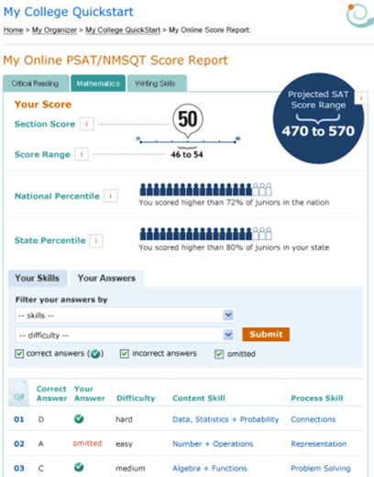
My College QuickStart
  My Online Score Report
  Projected SAT®
  score ranges
  State percentiles
  You can filter questions
  Questions and
  answer explanations
Notes:
My Online Score Report lets you learn about your test results:
Review questions and answer explanations.
Sort the questions by those questions they omitted or answered incorrectly, by the question’s level of difficulty, or by skill.
Compare performance to state percentiles.
View projected SAT score ranges.

Slide 12
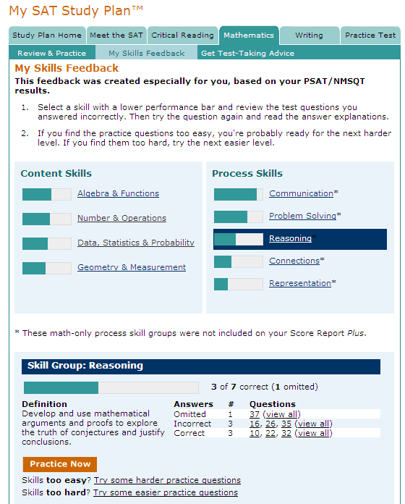
My College QuickStart
  My SAT Study Plan™
  Personalized skills
  to improve
  SAT practice questions
  An official SAT practice test
Notes:
My SAT Study Plan, creates a customized SAT study plan on your PSAT/NMSQT results.
You can try hundreds of practice questions and even try a full-length SAT practice test.

Slide 13
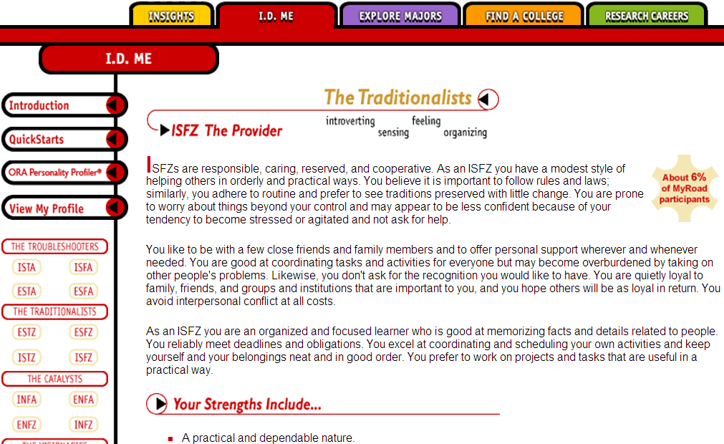
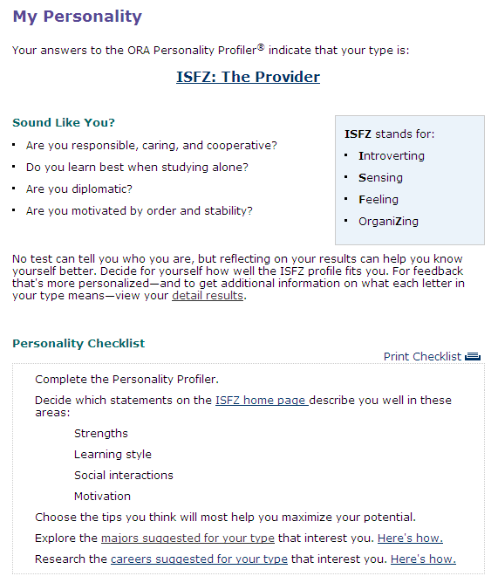
My College QuickStart
  My Personality
  Personality test
  Description of your type
  Tips for success
  Majors and careers that might be a good fit for you
Notes:
My Personality helps you better understand your strengths, interests, and preferences. You can take a personality test to find your type and explore majors and careers that may be a good fit for you.

Slide 14
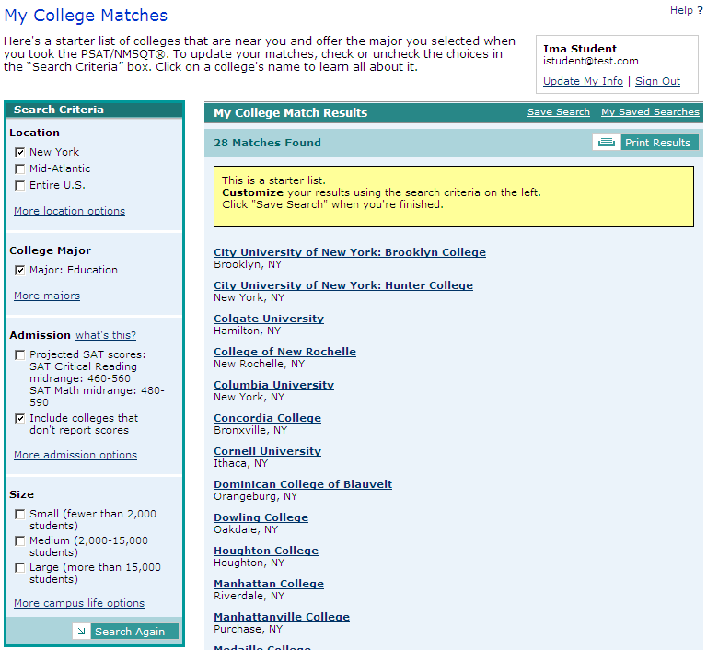
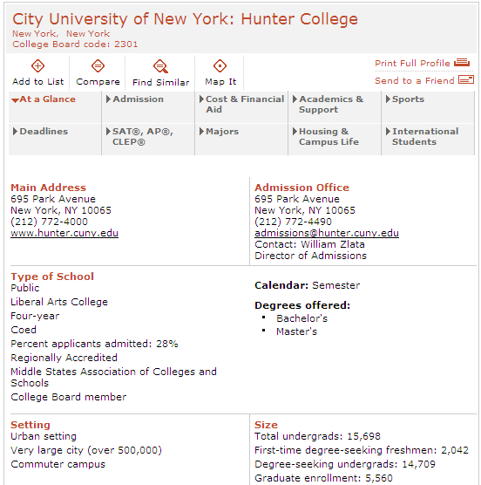
My College QuickStart
  My College Matches
  Starter list of colleges
  Criteria to customize search
  Ability to save searches
Notes:
You can jump-start your college search with a starter list of colleges based on your home state and selected major. You can then customize this list to meet the criteria that are important to you.

Slide 15
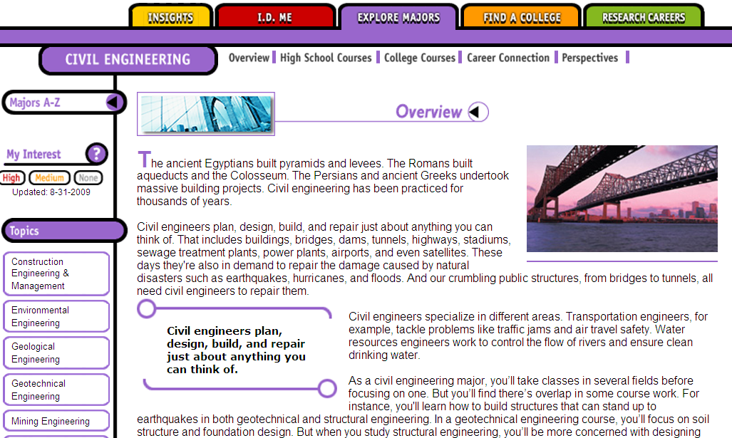
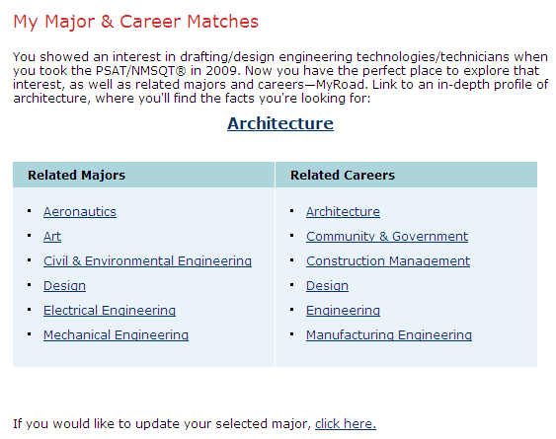
My College QuickStart
  My Majors & Career Matches
  Major you chose
  Related majors
  Related careers
Notes:
My major and career matches lets you explore major and career profiles, read firsthand accounts from students and professionals, and learn about required skills and academic preparations.

Slide 16
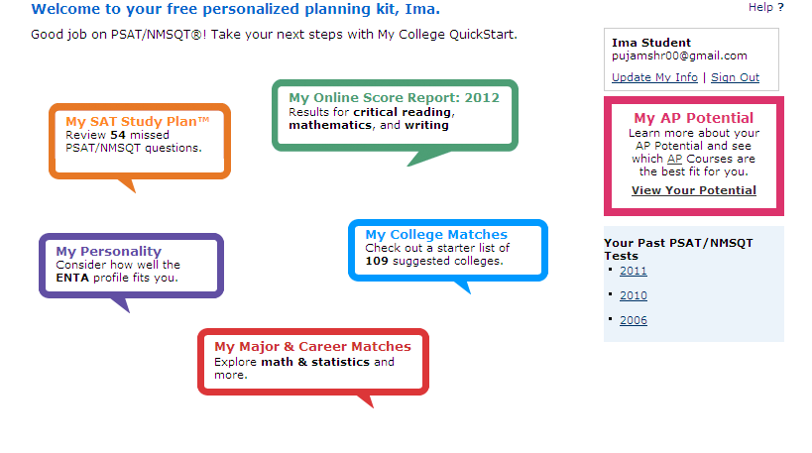
My College QuickStart
  My AP Potential
  List of AP courses
  Which ones are offered at your school
Notes:
You can learn more about your AP Potential by following the link to View Your Potential. This will list all the possible AP courses, and whether they are given here at your school.

Slide 17
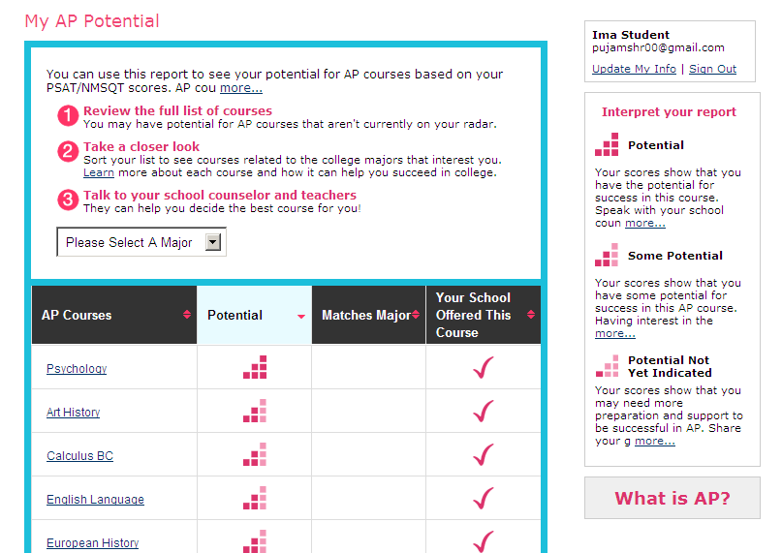
My College QuickStart
  My AP Potential
  Choose a major to see which courses match it.
  Interpret your report to see whether you are ready to take a course.
Notes:
Select different majors that interest you to see which AP courses relate to them.
Use your scores to help you see which courses you might be ready to take.

Slide 18
My College QuickStart
  Log in to your personalized account at
  www.collegeboard.org/quickstart

