Slide 1

2020-2021
Course Registration
James Hubert Blake High School
Notes:
Welcome to James Hubert Blake High School’s registration for the 2020-2021 school year.

Slide 2


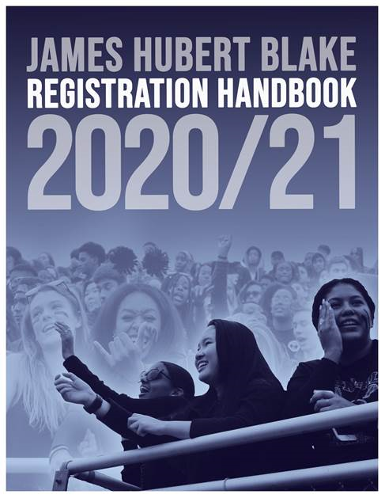
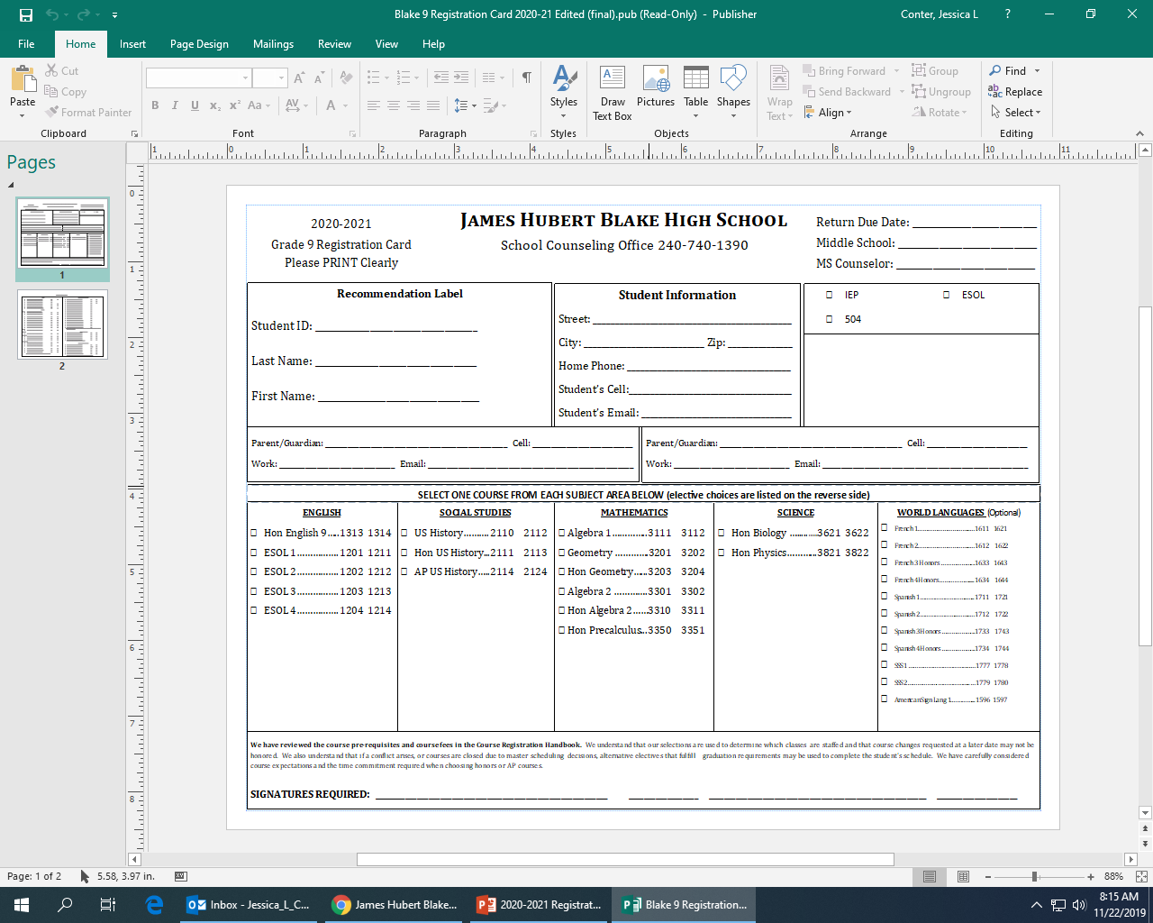
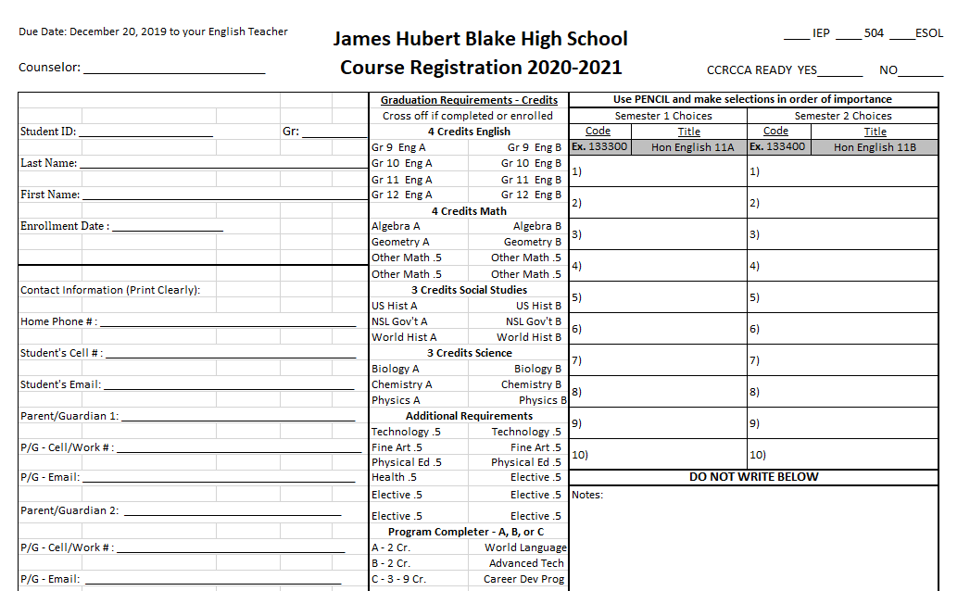
Overview:
You will be using this information to register for your classes for the 2020-2021 school year.
  Please have your Registration Card available
  New this year, the Registration Handbook will be online only
Schedule change policies and procedures are here for you to review
Notes:
You will be using the information contained in this presentation to successfully select your classes for the 2020-2021 school year. Please have your registration card available during the registration process, as you will be referring to it frequently. This year, the registration handbook is available online only. Should you not have access to the internet at home, please come to the Counseling office for a paper copy of the registration handbook.
Please remember, it is important to select the courses you truly want and are willing to take, as the schedule change policies will show that changing courses only occurs for very specific reasons.

Slide 3
Counseling Services Department
Counselor Assignments:
  Ms. Conter……………A-Card Jessica_L_Conter@mcspmd.org
  Ms. Smith………….....Care-F Jean_A_Smith@mcpsmd.org
  Ms. Hayes……………G-Kar Jeannette_L_Hayes@mcpsmd.org
  Mr. Tolbert……………Kas-Man Kim_D_Tolbert@mcpsmd.org
  Ms. Baer……………..Mao-Par Jaime_L_Baer@mcpsmd.org
  Mr. Thomas………….Pas-She Dwayne_Thomas@mcpsmd.org
  Ms. Costenbader……Shi-Z Katryn_A_Costenbader@mcpsmd.org
  College and Career Coordinator: Ms. Prochnow
  Registrar: Ms. Marks
  Secretary: Ms. McMillan
Notes:
It is important to know who your Counselor is. You will be meeting with them later to complete the registration process. All counselors at Blake High School are listed here, as well as their email addresses. If you have questions while registering, simply return to this slide, click on your Counselor’s email address, and send them your questions. Please allow 24 hours for your Counselor to respond, as this is an extremely busy time of the year for them.

Slide 4
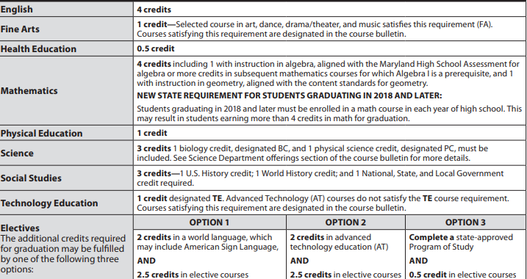
HS Graduation Requirements
Class of 2021: https://www.montgomeryschoolsmd.org/uploadedFiles/curriculum/1025.19_GradReqAtAGlanceClass2021_Flyer.pdf
Class of 2022: https://www.montgomeryschoolsmd.org/uploadedFiles/curriculum/1025.19_GradReqAtAGlanceClass2022_Flyer.pdf
Class of 2023: https://www.montgomeryschoolsmd.org/uploadedFiles/curriculum/1025.19_GradReqAtAGlanceClass2023_Flyer.pdf
Class of 2024: Information not available at this time. Will update when available.
Notes:
The chart included on this slide contains all of the high school graduation course requirements. A link to the grade specific requirements is included as well. The basic requirements are as follows:
-4 credits in English
-4 credits in Math, please see the graphic and links for more specific information
-3 credits in Science, including 1 credit in Biology and 1 credit in Physical Science
-3 credits in Social Studies, including 1 credit in US History, 1 credit in World History, and 1 credit in National/State/Local Government
-1 credit in Fine Arts
-1 credit in PE, ½ (.5) credit in Health
-1 credit in Technology
-1 Program Completer, of which there are 3 options: Foreign Language, Advanced Tech, or a State approved program of study

Slide 5
HS Graduation Requirements – Tests/SSL
Maryland Comprehensive Assessment Program (MCAP)
  Algebra 1
  English 10
High School Assessments (HSA, MISA)
  NSL Government
  Science
For more information, please visit: http://www.montgomeryschoolsmd.org/curriculum/graduation-requirements.aspx
SSL Hours: 75 hours
  Certificate of Meritorious Service if you earn 260 hours
  Join the SSL Google Classroom for more information:
    Class code: vqw5asg
Notes:
In addition to the course requirements, students are required to meet State testing standards for graduation. For grade level specific information, please click on the link provided on this slide.
Also, most students must earn a minimum of 75 Student Service Learning hours. The hours needed for graduation are determined using the year you entered MCPS. For more information on SSL hours, please join the SSL Google Classroom.

Slide 6
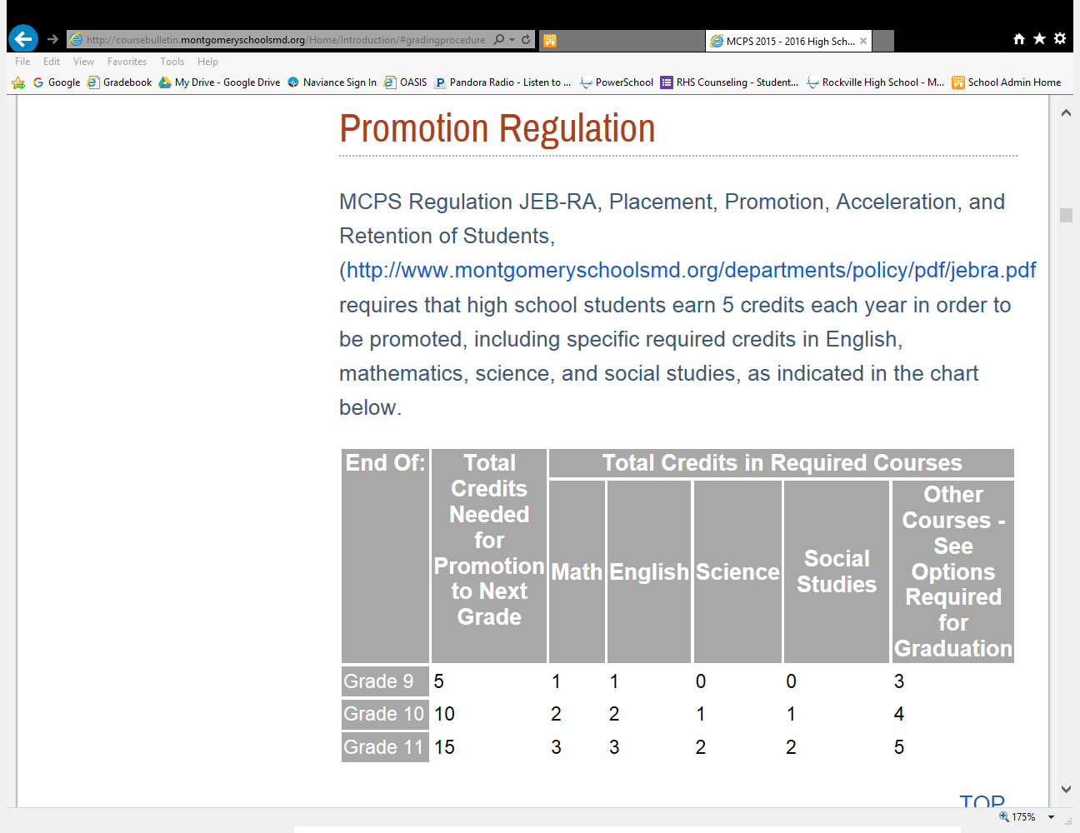
MCPS Promotion Policy
Notes:
In order for a student to be promoted to the next grade level, they must meet specific minimum credit requirements. These requirements are listed here on the promotion regulation table. If a student fails to meet a requirement, they are retained in the previous year’s grade level until the credit(s) can be earned. Students will not be required to repeat courses in which they earned credit.

Slide 7
College Readiness Tips
Take rigorous courses
Improve your grade point average
Explore career opportunities (ASVAB)
Prepare for SAT, ACT or Accuplacer
Earn meaningful SSL hours
Get INVOLVED in extracurricular activities!
Notes:
When it comes to preparing for life after high school, many students gravitate toward the college bound path. Should this be your chosen path, here are a few helpful tips to better prepare yourself for what college admission advisors look for. Make sure you challenge yourself, but always work within the world of reason.

Slide 8
Scheduling – Insider Info
A master schedule is developed by the number of course selections identified by students during this registration process.
School administrators make decisions regarding the number of sections per department based on students’ course selections.
Under-enrolled courses may not be offered.
Notes:
When it comes to the Master schedule, student course selections are a vital component. Because of this, it is of the utmost importance that students select their courses wisely. It is imperative that students select only courses that they want and are willing to take.

Slide 9
Schedule Correction Policy
Schedule corrections will ONLY be made for the following reasons:
  Completion of a summer school course
  Incomplete schedule (missing a class)
  Failure of prerequisite course
  Master schedule conflict
  Requests for specific teachers will NOT be honored!
Notes:
Because of the complexity of the master scheduling process, it is important for schools to have a schedule correction policy. Blake’s policy can be seen here. In order for a correction to be requested, students need to fill out the correction request form located in the Counseling office. As always, please remember that requests for specific teachers will NOT be honored.

Slide 10
Course Registration
Please make sure to submit your Registration Card to your English teacher by December 20th.
Notes:
Now, please get your registration card out, as we are about to begin the registration process. Please ensure that your card is completely filled out before you begin the course selection process. Including your current contact information allows Counselors to contact you directly should there be an issue with your course selection or schedule. You will be returning your completed and signed registration card to your English teacher no later than December 20th.

Slide 11
Course Registration
Students will now select their classes online through MyMCPS Scheduler (link on next slide).
Students will meet with their counselor individually between Jan 6th and Jan 24th to review course selections.
Notes:
We will now begin the course selection process for the 2020-2021 school year. Again, please have your registration card completely filled out. You will be meeting with your Counselor individually between January 6th and January 24th. Again, please ensure that your card has been filled out completely and signed by your parent or guardian.

Slide 12
Course Registration Steps
Click on the link for MyMCPS Scheduler:
https://portal.mcpsmd.org/public/
***Please note: Must use Google Chrome. If hyperlink opens in Internet Explorer, copy and paste link to Google Chrome.***
    If you need Google Chrome: https://support.google.com/chrome/answer/95346?co=GENIE.Platform%3DDesktop&hl=en
Notes:
Let’s get started. First, either click the link seen here, or copy and paste the link into your browser. Please note, you must use Google Chrome for this process, as Internet Explorer is not compatible.

Slide 13
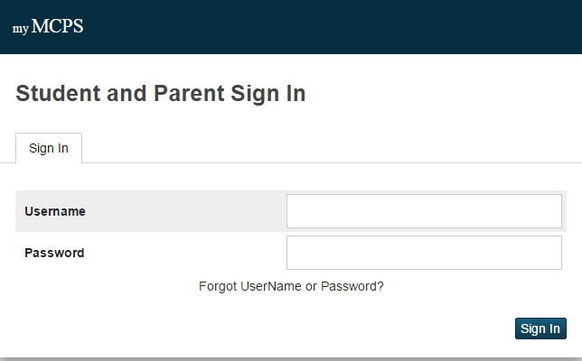
Enter your username (your 6-digit ID number) and computer password. Click Sign In.
Next, please enter your 6-digit ID number as your username, and your computer access password. Then, click sign-in.
Notes:
Next, please enter your 6-digit ID number as your username, and your computer access password. Then, click sign-in.

Slide 14
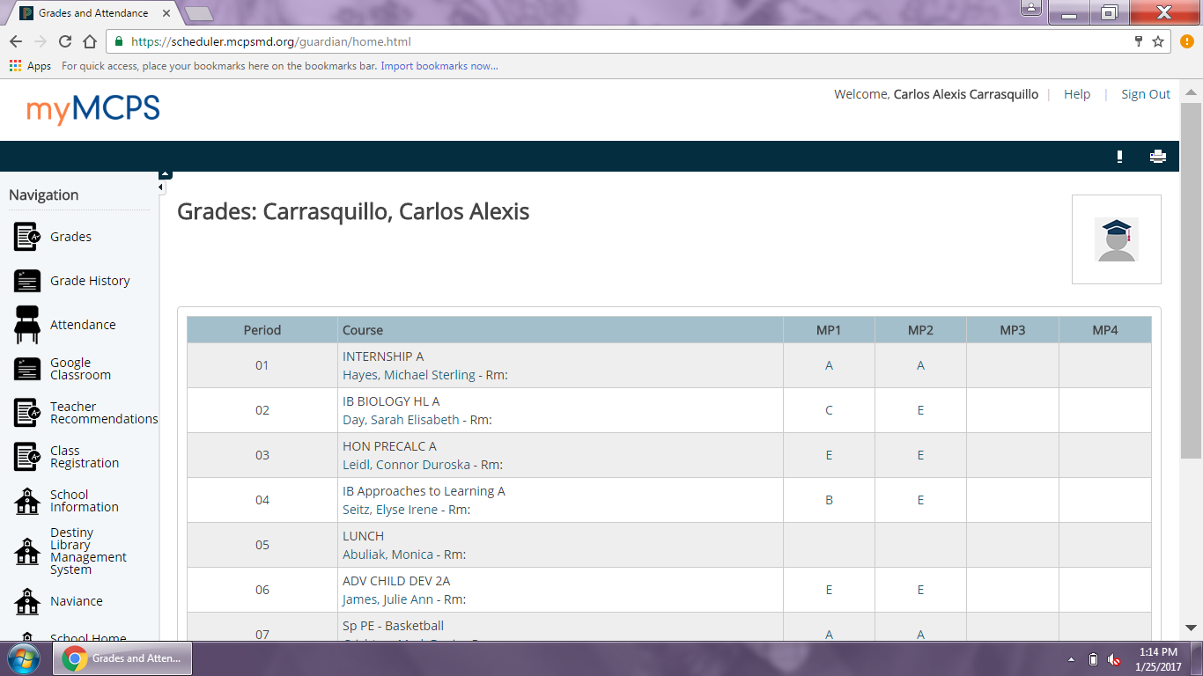
Once you have logged in, you will see the screen shown below. Click on “Class Registration,” which is on the left-hand side.
Notes:
Once you have successfully logged in, you should see this screen. Please click on class registration, which can be found on the left-hand side of the screen.

Slide 15
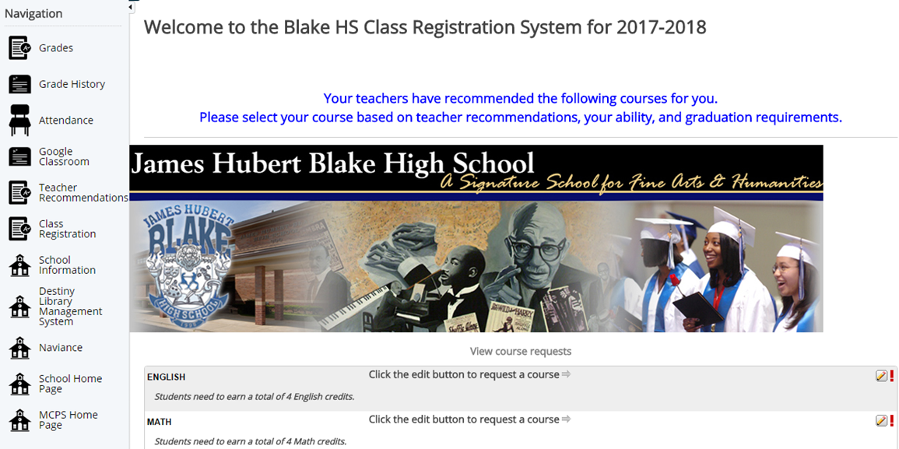
Starting with English, click on the pencil and select your
course
****You MUST select both an A and B class****
Click on the pencil icon to view and select courses in each subject.
You will see a screen with subject categories (i.e. English, Math, etc.). Here you will select your courses for next year. You can also view your Credits/Grade History by using the links in the left hand column.
Notes:
Your screen should now look like this. Please note, any subject area that has a red exclamation mark next to it is mandatory, and you must select an A and B course from that subject area.
Starting with English, click on the pencil icon. A list of course options in each subject area will now pop-up, as seen on the next slide.

Slide 16
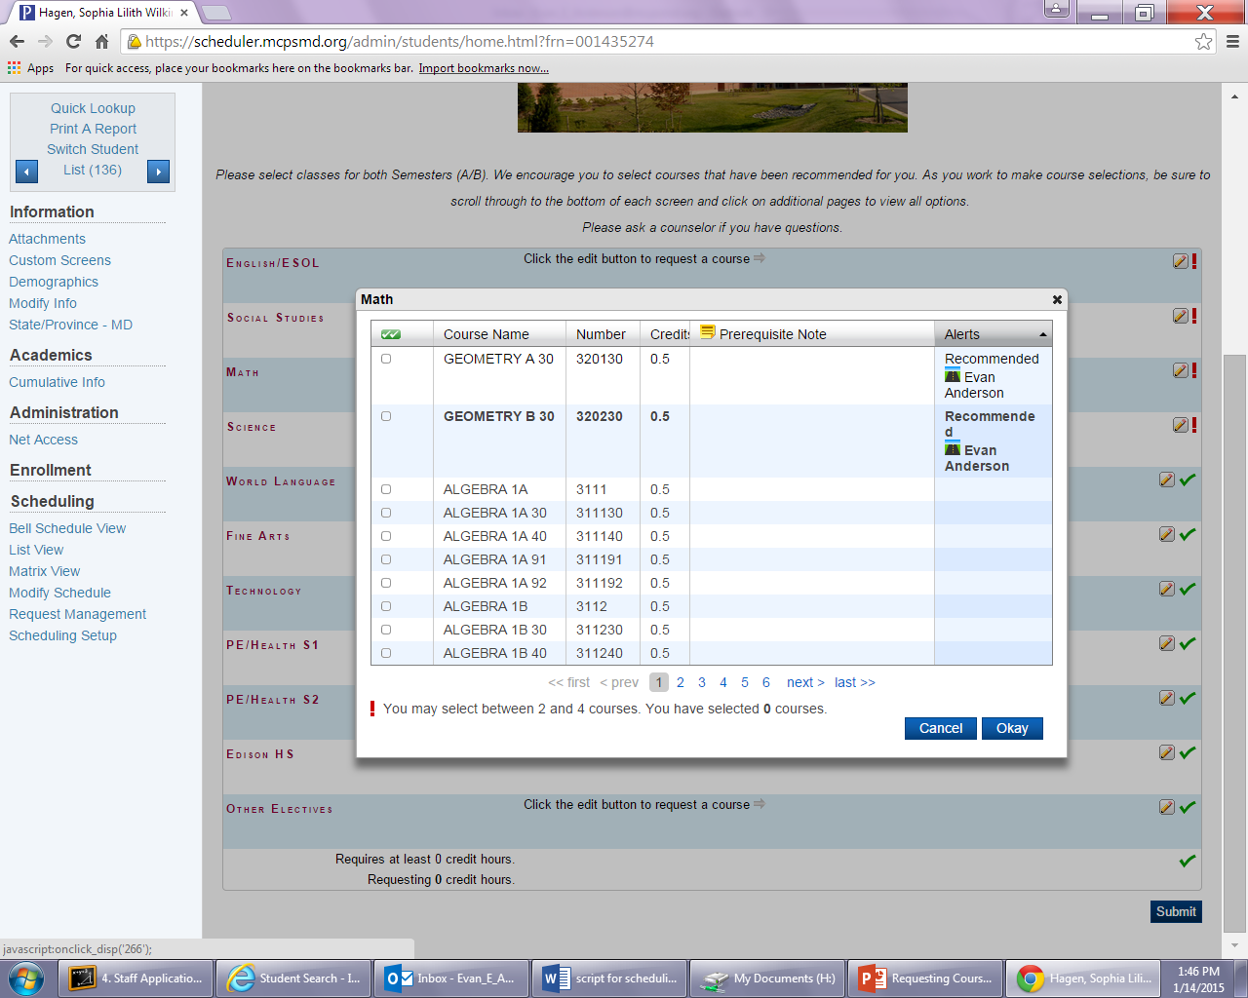
A list of courses in each subject category will appear in alphabetical order. Scroll through the list to find the courses you want to request.
NOTE: Some courses may have 2 or more pages of offerings.
Notes:
The list of courses in each subject area will look similar to this. All courses are listed in alphabetical order. Scroll through the list until you find the courses you want to request. Please be aware that some subject areas may have multiple pages of course offerings. Be sure to click through all pages when looking for the correct course.
Also note that some elective courses may last for only one semester. In the back of the registration handbook found online, under the alphabetic course descriptions, you will see courses that are not followed by A/B. This indicates that the course is a one semester course.

Slide 17
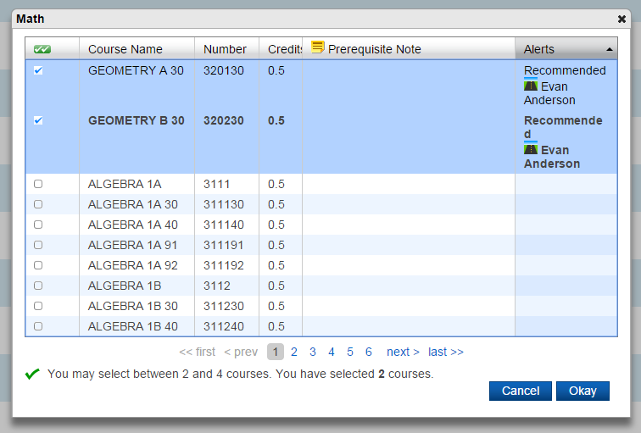
Select your courses, both A & B semesters, by checking the boxes on the left hand side.
Follow this step to request courses in different subjects areas until you have selected 7 courses for both first and second semester.
Once selected, click Okay
Notes:
Once you have found the course you want to request, select that course by clicking on the box to the left of the course title. Be sure to select both A and B semesters for each course being requested. In some subject areas, you will be able to select more than one course. Remember to keep your graduation requirements in mind when selecting your courses. If you are unsure what subject area a certain course is listed under, please refer to the Blake high school course handbook.
If you are a current Edison student, please select the correct Edison course codes for your accepted Edison program. If you are interested in becoming an Edison student, please select regular Blake courses, and let your counselor know of your interest in Edison when you meet with them individually.
Once your courses have been selected, click OK in the bottom right-hand corner of the dialogue box. Follow this step to request courses in different subject areas until you have selected 7 courses for both 1st and 2nd semester.

Slide 18
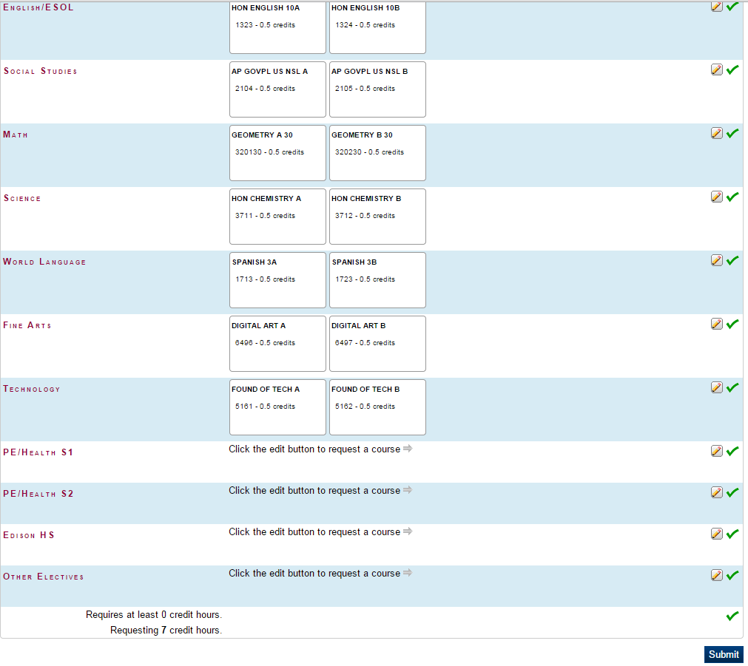
Have a parent/guardian review your course selections. Once they have reviewed them, click SUBMIT.
Review your course selections to make sure they are correct. At the bottom of the screen check to see that you have requested 7 credit hours (14 units). Once selections have been reviewed, click Submit.
Notes:
Once all courses have been selected, review them with your parent or guardian to ensure they are all correct. Double check to make sure that you have selected 7 courses for each semester. At the bottom of the screen, check to see that you have requested 7 credit hours. All students must select 7 credit hours.
Once your selections have been reviewed, click submit in the bottom right-hand corner.

Slide 19
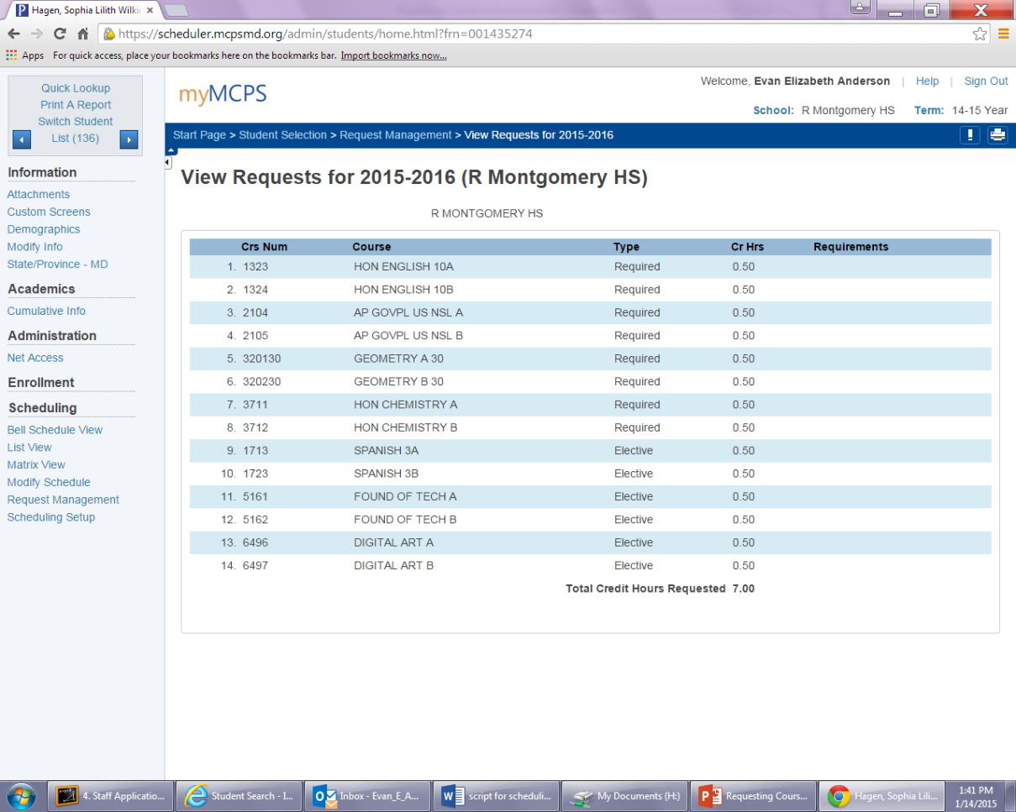
Completing Class Selections
Once you click submit, a list of your requested courses will appear on your screen. Confirm that this list exactly matches the courses on your paper registration card. You have now successfully requested courses for next year and may sign out of myMCPS Scheduler.
Notes:
After you click submit, a list of your requested courses will appear on your screen. Make sure that this list exactly matches the courses on your registration card, and print the page as confirmation that you have registered for classes. It is a good idea to keep this printout for your records.
Once all courses are correct, you have successfully requested courses for the 2020-2021 school year, and may sign out.
If there is an error, simply click the back button on your browser and fix the error.

Slide 20
Need Help?
Counselors are available to assist with online course registration during LUNCH in room A103 on December 17th & December 18th.
Parents/Guardians, should you have questions, please email your student’s Counselor directly. The Counselor will get back to you as soon as possible. Refer to slide 3 for a full list of Counselor emails.
For students with NO internet access, Counselors will be available during lunch in the Counseling Office to assist with the registration process.
Notes:
Should you need help during the online course registration process, please know that your Counselors are available to help. Please refer to slide 3 for a list of Counselors and their email addresses. Counselors will also be available during lunch to answer questions for students only. Parents/Guardians, please email your student’s counselor directly with any questions you may have.
For students without internet access at home, please come to the counseling office during lunch the week of December 16th, and our counselors will be available to assist you with accessing the registration website.

