Slide 1

Two Way Immersion
Rolling Terrace Elementary School
Christine Miller
Supervisor, ESOL and Two Way Immersion

Slide 2
Why Two Way Immersion? (Thomas & Collier)
Improved academic achievement for all
TWI closes the achievement gap
Model of ESOL instruction
Additive bilingualism (or trilingualism)
Notes:
Additive - honoring the home language and culture of all students, regardless of whether their language is a language of instruction - this model brings in the strengths of the Spanish speaking community in Rolling Terrace.

Slide 3
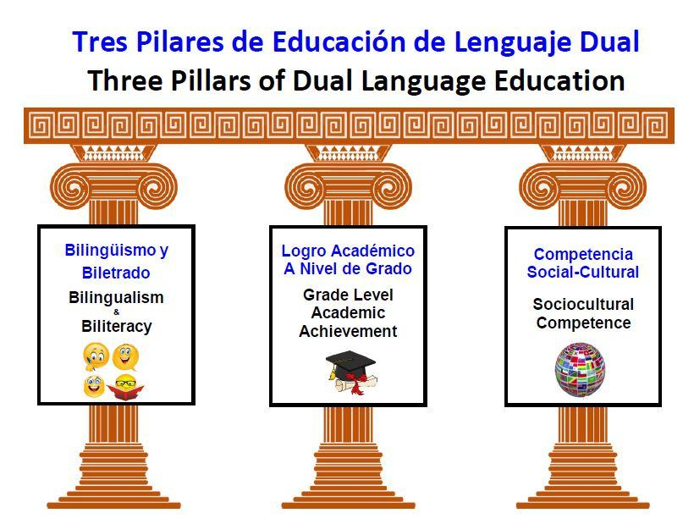
Notes:
Bilingual - speaking and listening
Biliterate - reading and writing
4 domains of language

Slide 4
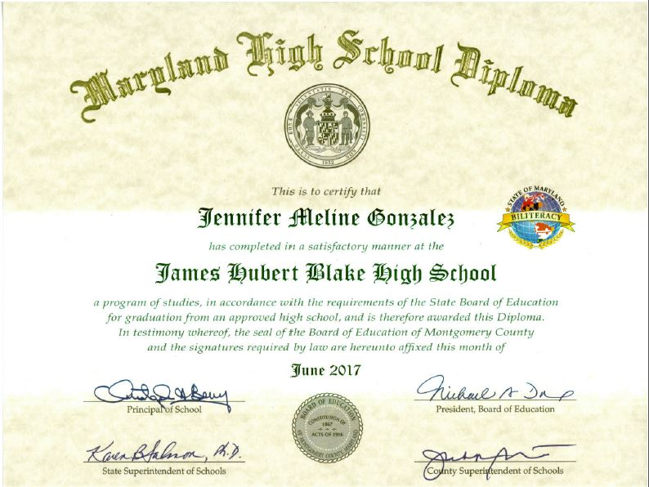
Benefits of bilingualism
Academic
Economic
Social
Cognitive
Notes:
Social - bilingual students have stronger cultural identity and self-esteem; can develop friendships across language or social class barriers; social benefits with family members as well
Cognitive - Overall, proficient bilinguals outperform monolinguals in:
creativity
problem solving
mental flexibility
metalinguistic awareness
executive function
attention to detail
ability to ignore distractions
task switching
working memory
conflict management
Also more resistant to the onset of dementia and Alzheimer’s

Slide 5
Unique Characteristics
of Two Way Immersion
Balance of students from both languages
  “Ideal” ratio is 50% speakers of each language; no more than ⅔ speakers of one language to ⅓ speakers of the other (Guiding Principles for Dual Language Education, Third Edition)
All are models of one language and learners of a second (or additional) language
Meta-linguistic focus
Notes:
Ratio of students - talk about the demographics of other MCPS schools, ie who is a “fluent” or “dominant” speaker of Spanish? How do we define? Larger number of bilingual students entering K, in all schools

Slide 6
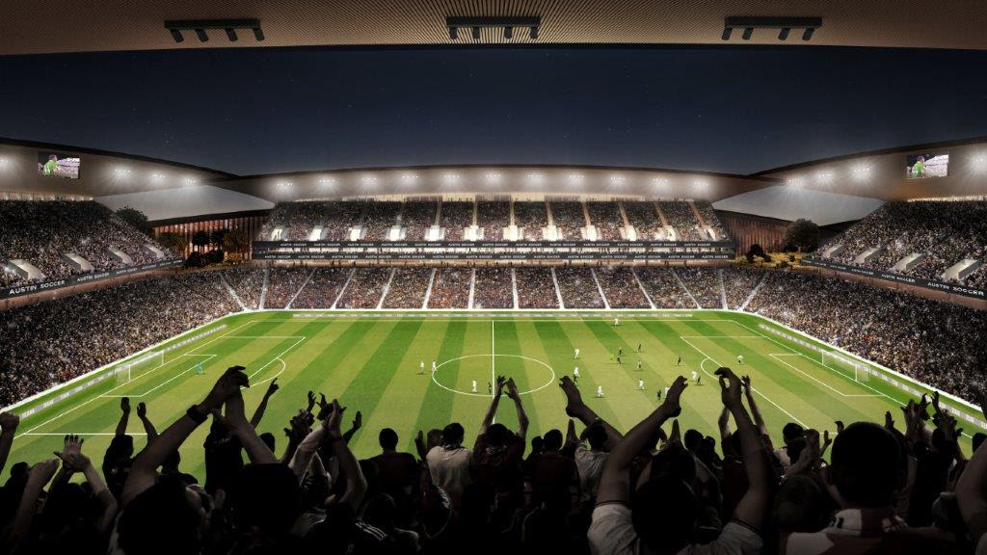
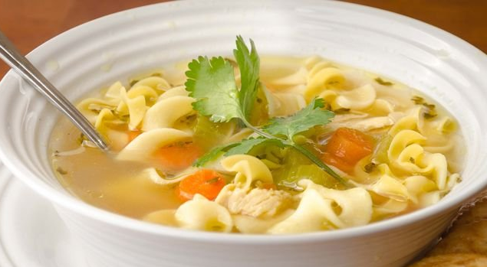
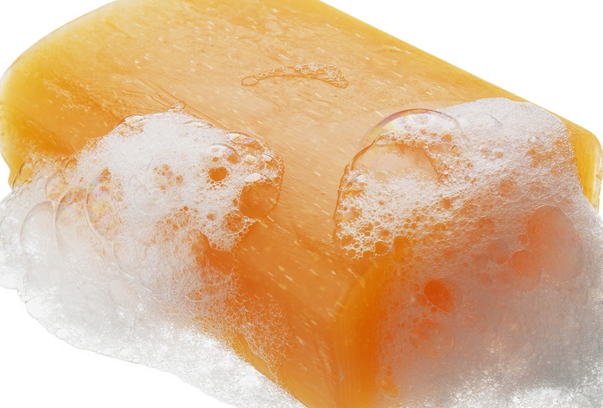

For example….
Cognates (presidente, president)
False cognates (sopa, soap; arena, arena)
Comparing and connecting languages
Teaching students to use “Meta-language”
Notes:
Graphophonic - letters, sounds, how they are mapped on a page
Semantic - meaning of words and phrases/morphology = word parts that carry meaning
Syntactic - how words and phrases are put together to make meaning (ie La Casa Blanca) - word order
Pragmatic - social, cultural, historical context of language - social register (formal, informal)

Slide 7
Design Features of Two Way Immersion Programs
Is sustained for at least 6 years
At least 50% of instruction is in the partner language
Literacy instruction in both languages
Notes:
We are looking at what works for OUR population, in the Rolling Terrace community

Slide 8
Rolling Terrace Implementation
2018-19 | 2019-20 | 2020-21 | 2021-22 | 2022-23 | 2023-24
K-1 | K-2 | K-3 | K-4 | K-5 | K-5
Notes:
Advance preparation that has taken place, for example at K orientation, teachers collected some basic info on students’ abilities in both languages in order to balance students in the classrooms

Slide 9
TWI as home school model
All students entering kindergarten are automatically enrolled, no separate application
In-boundary students only
Opt-out is through MCPS COSA process
Notes:
This is an Equity issue - all means all - so all students deserve this access, without need to navigate a lottery process
COSA - have to demonstrate a hardship

Slide 10
Two Way Immersion
Current Rolling Terrace Kindergarten Class
(rising 1st graders)
Ethnicity:
12% African American
2% Asian
14% Caucasian
69% Hispanic
3% Multi-Racial
Other demographics:
63% LEP
74% FARMS
7% Special Education
Notes:
MCPS current TWI - 213 Kindergarteners at 3 schools
Ethnicity:
16% African American
8% Asian
9% Caucasian
65% Hispanic
2% Multi-Racial
Other demographics:
52% LEP (this includes all levels, don’t assume NO English)
71% FARMS
11% Special Education

Slide 11
Supporting Implementation of Two Way Immersion at Rolling Terrace
Central Office supports
Funding for materials and professional development
Contracting with expert consultants
Differentiated grading and reporting
Notes:
Quarterly Planning - Cohorts of teachers at 4 other schools (3 of which are veteran TWI)
RTES already has other practices in place for current students, support structures, resources, those same practices will continue

Slide 12
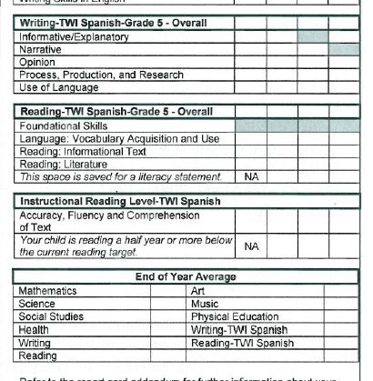

Slide 13
What is a typical day for a student in
Two Way Immersion?
Arrival and instruction in the morning classroom (English - Literacy, Social Studies)
Recess and lunch
Instruction in the afternoon classroom (Spanish - Literacy, Math, Science)
Specials
Departure
sample here
Notes:
Note that content instruction is not repeated in other language classroom; rather teachers plan collaboratively to ensure that students connect the learning across languages
Curriculum is aligned to MCPS curriculum
Resources include authentic Spanish literature; leveled readers
Importance of collaboration between partner teachers
Homework - collaboration between language teachers

Slide 14
Impact on the school community - beyond kindergarten and first grades
Increased use of Spanish and English throughout the building
More involvement of all families in the school
Home language and culture as a strength

Slide 15
How parents can help
Support your child in your strongest language(s)
Be a voice in the community
Be a presence in the school and be involved
Volunteer in the classroom

Slide 16
Steering Committee
Provide input on school level decisions
Consists of administrators, parents, and teachers
First meeting with Center for Applied Linguistics (CAL)

