Slide 1
Giving voice and vision to young environmentalists
How to start an environmental film festival

Slide 2
Hannah Ehrlich – live at MAEOE
Learn what it takes to make and film and why it is worth the effort, from a real live student film producer,
  who is sharing her voice and vision.

Slide 3
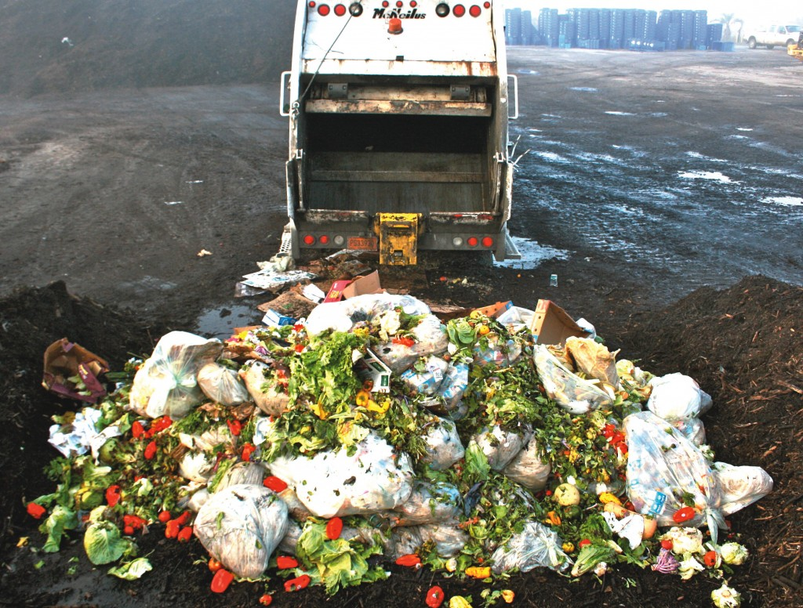
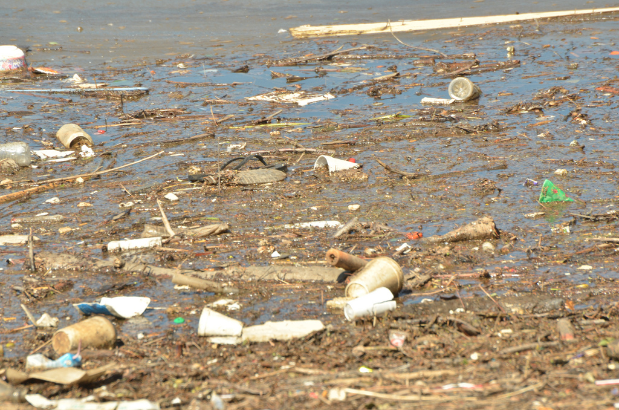
Environmental Documentaries
Making a documentary as a Capstone Project as part of High School Environmental Science
https://youtu.be/D_eLOIeRCsY - Wasted
https://youtu.be/02gjieQweQ8 - Murky Future

Slide 4

4SW – The Secret Society of Science Song Writers
Teaching science through music production, after school, at a camp, or _______
https://youtu.be/R0q4_JNXuz0 -
Undocumented Impacts (turn off the lights) by 5 Degrees
https://youtu.be/0vz5LYV7ZHc - Sorry Boston

Slide 5
Find the right school or program
At Roberto Clemente Middle School there is a ______________magnet. There is also a very strong film program, and a bit of humor.
https://youtu.be/jjD8zIdoflo?list=FLXKO_ltiCwW1Il_52OH6IvQ - 2043
Many schools have media classes. Combining Maryland Environmental Literacy Standards with Digital literacy standards is like a great marriage!
https://youtu.be/VBhtgOQEsXQ - Coke and pepsi

Slide 6
Make it a staff Expectation
Offer a teacher course and make the expectation that teachers will complete a PBL lesson for their students. Make that lesson a student-produced environmental film.
Prepare an outdoor camp and include film production as part of the camp.
Talk to Howard County or D. C. schools. IN particular Deborah
Make if the environmental literacy and digital literacy MWEE for fourth graders when they study the Chesapeake bay – “A Shed-show”.

Slide 7
Advice from 12 years of trial and error!
Work with partners. MCPS has worked with the American film institute for 12 years, with American university for 11 years, with NASA, WSSC, Gandhi Brigade, and the Lab School, among others
Attend a film Workshop or offer one. For example, the AFI offers a one day training on how to shoot films with students, and a second workshop on how to edit and produce films.
Offer support by visiting schools or giving digital feedback on ideas and films.

Slide 8
More Advice:
Organize your plans: Figure out who you want to invite and send invitations. Make them personal.
Publicize broadly or focus on a specific cluster of schools and subjects.
Think about timing: Do you want a kickoff event? How much time is needed? How will you get the films? Show the films? Organize the films? When and where will you show the films?
Venue matters! Having an M.C. or host can be great!
Invite the film makers up front for some question and answer time.
Think about the ultimate goal! Documentaries with high schoolers; psas with Elementary-ers.
Include the curriculum - Digital literacy and MELs; think MWEE; encourage interdisciplinary teams; put videos on your website or YouTube; invite the local cable channel to show the films…

