Slide 1
Special Education Advisory Committee
October 22, 2020

Slide 2
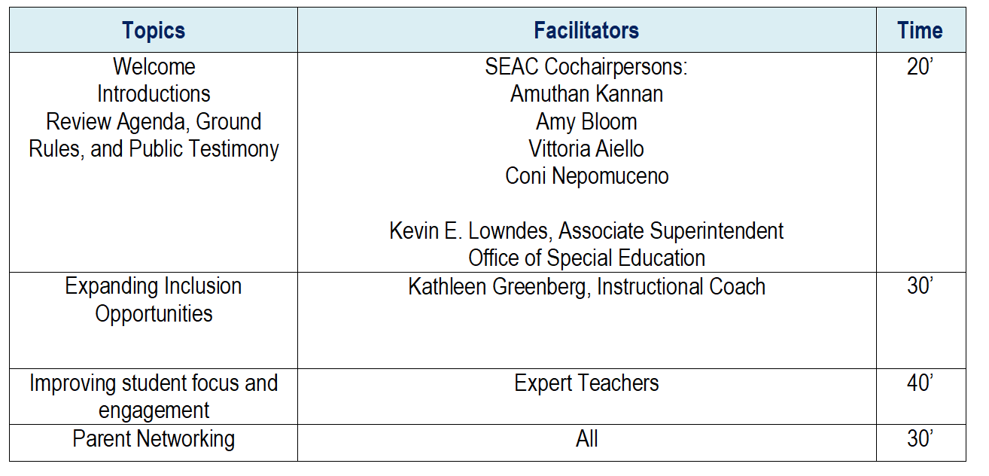
Agenda

Slide 3
Increasing the Inclusion and Engagement of Students with Significant Cognitive Disabilities in General Education
Presented by: Kathleen Greenberg
MCPS Instructional Coach
Kathleen_S_Greenberg@mcpsmd.org
Notes:
Deb

Slide 4
Inclusion: By the Numbers
Cabin John Middle School
Lakewood Elementary School
28
Total # of students enrolled in 3 LFI classes
30
Total # of students enrolled in 3 LFI classes
100 %
6
All students in LFI are included in electives.
students included in third and fourth grade science classes
28
Kindergarten students included in two general education periods per week.
2
6
9
Students included in general education social studies
Students Included in general education science
Number of Students included in one or more general education periods per week.
Scheduling models
Planning for instruction

Slide 5
Supporting More Schools
Rockville High School
Farmland Elementary School
9
Students pursuing ALO included in general education US History
9
Students pursuing ALO included in general education biology
30
Total # of students enrolled in 3 LFI classes
2
80% of the school Day
2
Certified special education teachers supporting 2 US History and 2 Biology sections.
Systematic approach to including students from LFI in general education classes
Focus on meaningful participation and skills for independence

Slide 6
Barriers and Bridges
Creating Time for planning within an already packed day
Leveraging staff and student strengths
Balancing competing initiatives:
New Language Arts Curriculum with a large dedicated block of time
Tie into existing structures and processes

Slide 7
Curriculum Modification and Collaboration
Meaningful student engagement through modifying curriculum resources to align with content delivered in the general education classrooms.
Lakewood Elementary School
Cabin John Middle School
New Language Arts Curriculum
ALO Multi-Department Professional Development with
Collaboration Time to Source and Modify Materials
District Instructional Specialist, TIES, CJMS Staff
General and Special Educators
Department of Special Education Services
Summer ALO training attended by General Education Kindergarten Teacher and LFI Teachers; Stepwise Process
Two kindergarten students from LFI students included in general education for part of the language arts block
Combined self-contained science classes to provide time for Special Education teacher to Co-teach Science 8
ALO Multi-Department Professional Development with Collaboration Time to Source and Modify Materials
District Instructional Specialist, Reading Specialists, LES Staff
General and Special Educators
Quarter two US History materials are accessible to student pursuing ALO, compiled and filed
Curriculum Offices
Plan for shared responsibility for the planning and adapting of materials
More opportunities for inclusion during the language arts block and increased learning opportunities in general education curriculum

Slide 8
Distance Learning
Weekly Planning Meetings
Small group and individual support
Opportunities for pre-teaching and reteaching
Virtual Check-Ins
Parent involvement

Slide 9
Next Steps
Create a model for moving inclusion forward based on the experience at each location.
Leverage expertise from the TIES Center and other resources to create systematic professional development sessions.
Widen the scope of data used when making decisions regarding student placement and instructional settings
Focus developing skills for independence in the 21st century and beyond.

Slide 10
We can build capacity in our students, infrastructure and personnel to do new and challenging things.
Scaling up depends on efficient context based systems that are sustainable.
Our students want to be a part of the group and they prioritize social interaction with peers above academics.
Now we know...

Slide 11
Resources for helping your student with Assistive Technology
Linda Wilson, AT Instructional Specialist
linda_b_wilson@mcpsmd.org

Slide 12
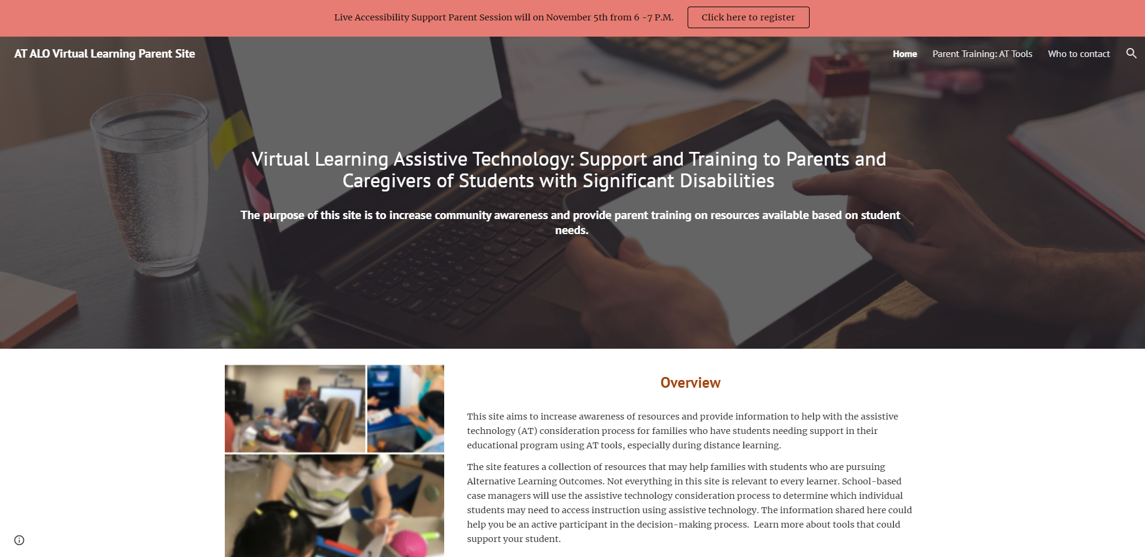
https://sites.google.com/mcpsmd.net/assistive-technology-alo/
Notes:
https://sites.google.com/mcpsmd.net/assistive-technology-alo/

Slide 13
Incidence
Notes:
https://www.montgomeryschoolsmd.org/departments/parentacademy/workshops.aspx

Slide 14
5 tips to
increase engagement and maintain focus with distance learning
Presented by: Alesha Ashe
Westland Middle School
ARS Program

Slide 15
**DISCLAIMER: You know your child best. This new way of learning have driven us to explore different strategies to help increase engagement and maintain focus on Zoom.

Slide 16
TURN & KEEP CAMERA ON
This will help teachers assess engagement and encourage participation which will help better support your student
Accountability
Creates sense of community being able to see peers and peers being able to see your student!

Slide 17
2. CREATE AN ENCOURAGING LEARNING SPACE
A quiet, private space
Personalized learning space - let the student create
-Students can write positive and encouraging notes (positive self-talk) to promote focus and participation
-Students can have visuals to remind them to focus or stay muted
-Students can have fidgets or flexible seating to best serve their learning experience
- Student-created and student-focused
- Consistent routine
- Headphones
- Timers

Slide 18
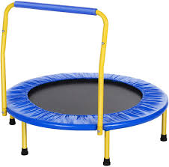
3. MOVEMENT BREAKS
Allow students the time to move around with activities they enjoy
Consider frequency of movement breaks (timer)
Take break time serious--we all need a break from the screen
Increases the likelihood that students will be more focused during the following learning session

Slide 19
4. CELEBRATE THE VICTORIES
Celebrate the small and big wins
“Focused and attended for 5 straight minutes”
“Raised a hand to participate once this week”
(i.e. shared a story with the class, raised their hand, used a Zoom tool, etc.)
- Positive encouragement and praise will increase the likelihood that the behavior will be shown again

Slide 20
5. STUDENT CREATED INCENTIVES FOR FOCUS
Students creates a “menu of motivation”
Students create a list of things they would want to earn if they focus and participate in class (daily, weekly, etc.)
- This gives the student ownership in the creation of rewards

Slide 21
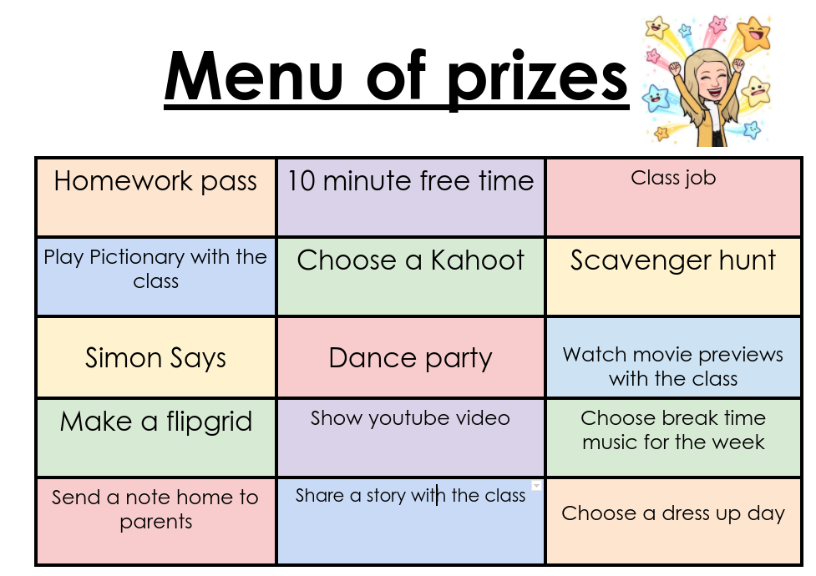
Motivation menu
Choose movie to rent
Watch netflix with your favorite snack
Car radio DJ
iPad time
Video games with your favorite snack
Walk with Mom and the dog

Slide 22
STUDENT ENGAGEMENT BEGINS WITH US
SUSAN S. LEE
TILDEN MIDDLE SCHOOL
ASPERGER’S PROGRAM

Slide 23
Improving Student Focus & Engagement
THREE KEY FACTORS IN STUDENT FOCUS & ENGAGEMENT ACTUALLY BEGINS WITH US…
We need to be…
Mentally Prepared
Emotionally Prepared
Practically Prepared
Notes:
Make sure to introduce myself--explain where this is coming from

Slide 24
MENTAL PREPARATION
Be able to identify where you are at...
Would it be better to start later or can you work through all of the “feels”?
What would help you be successful? What do you need?
Are you ready to adjust expectations and outcomes?
Notes:
This is a process we often use with our students, it’s a powerful message when we see that it works for grown-ups too. During those tough spots, focusing on what we CAN do vs. what we THINK we should do has a dramatically positive impact on outcomes--takes away the doom and gloom focus

Slide 25
EMOTIONAL PREPARATION
Know that your role is evolving and so is your child’s response to that change.
Sometimes there will be great days, and sometimes there will horrendous days and all of that is okay.
It is not only okay, but imperative to ask for help. Keep asking/advocating--you may not get exactly what you want, but you’ll be much farther along than if you say nothing.
Notes:
When we utilize the strategies we tell our students to use, we not only are modeling positive outcomes, we are showing them that taking the time to process makes a huge difference.

Slide 26
PRACTICAL PREPARATION
The current circumstances put many parents/guardians in the awkward position of going against instinct.
Instinctually, parents and guardians put the needs of their children first. But, in order to truly support our students in a sustainable and successful manner, we’ve got to come from a point of strength.
WHAT DOES THIS MEAN?

Slide 27
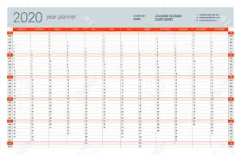
COMMUNICATION
As our lives are colliding both physically and emotionally, how do we prepare for this?
Notes:
having a large-ish wall calendar for each member of the family--means that there is a transparency regarding what we have to do and how we have to prioritize--knowing when you can/cannot check in, students knowing they should have work to show/questions to ask--encouraging students to take ownership for self-advocacy--if possible, encourage students to write emails to teacher--it will take more time up front but save a great deal of time in the long term

Slide 28
ORGANIZATION
Notes:
Putting each task on a post-it allows for flexibility--sometimes circumstances change so students can’t finish everything when they expected. This way tasks/assignments can be moved but they don’t go away until completed.

Slide 29
Consistency
When coming up with a system, have the student involved in the process--the time spent on what works for them can be empowering
Make sure that plans/systems are realistic and doable.
Knowing when changes need to be made does not interfere with consistency.

