Slide 1

2020 Maryland Comprehensive Assessment Program
Donna M. Blaney – Supervisor, Testing and Reporting Unit, Office of Shared Accountability

Slide 2
Agenda
MCAP – Maryland Comprehensive Assessment Program
  Orientation
Maryland Assessment, Accessibility, & Accommodations Policy Manual
  Accessibility Features for All Students
  Administrative Considerations for All Students
  Accommodations for Students with Disabilities
Practice Tests – let’s take a look!

Slide 3
MCAP – Maryland Comprehensive Assessment Program
Content | Grades | Assessment
English Language Arts | 3-8, 10 3-8, 11 | MCAP ELA Alternate – Alt-ELA
Mathematics (3-8, Alg 1, Geo, Alg 2) (HS – Alg 1 only) | 3-8, HS 3-8, 11 | MCAP Mathematics Alternate – Alt-Math
Government | HS – end of course | Government
Science | 5, 8 HS – mid 3rd course 5, 8, 11 | MISA HS-MISA Alternate – Alt-MISA
World Studies | 8 | Social Studies 8
Limited English Proficiency | K-12 1-12 | ACCESS for ELLs Alt-ACCESS for ELLs
Kindergarten Readiness | K | Kindergarten Readiness Assessment (KRA)

Slide 4


Slide 5
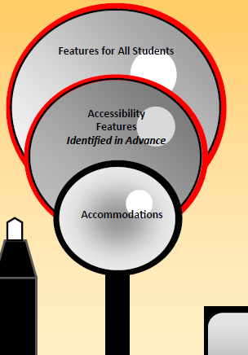
Features for All Students
Accessibility Features for All Students (1s)
  Fact Sheet AFA-1
Accessibility Features for All Students Identified in Advance (1s)
  Fact Sheet AFA-2
Administrative Considerations (2s)
  Fact Sheet AC-1

Slide 6
Accessibility Features
All students will be able to use:
  1b. Audio Amplification
  1c. Bookmark (flag item for review)
  1e. Blank Scratch Paper (graph, lined, or unlined)
  1f. Eliminate Answer Choices
  1g. General Directions Clarified
  1h. General Direction Read Aloud and Repeated as Needed
  1i. Highlight Tool
  1j. Headphones or Noise Buffers
  1k. Line Reader Mask Tool
  1l. Magnification/Enlargement Device
  1m. Notepad

Slide 7
Accessibility Features
All students will be able to use:
  1l. Magnification/Enlargement Device
  1m. Notepad
  1n. Pop-up glossary
  1o. Redirect Student
  1p. Spell Check or External Spell Check Device
  1w. Writing Tools
  1u. Graphic Organizer – INSTRUCTION ONLY
  1v. Audio Materials – INSTRUCTION ONLY

Slide 8
Accessibility Features
Test Form Implications
1a. Answer Masking – electronically covers answer options; students will uncover answer options when ready
1d. Color Contrast – alternate onscreen background and/or font color
1q. Student Reads Assessment Aloud to Him or Herself (no implication on test form, data point only)
1r. Text-to-Speech for Mathematics, Science and Government Assessments – test is read aloud to the student using embedded text-to-speech software. Headphones must be used. (Whole text and Selected Sections)
1s. Human Reader/Signer for Mathematics, Science and Government – human reader or signer reads aloud to a student.
Notes:
1r and 1s must be selected for students on an individual student-need basis

Slide 9
Administrative Considerations
School education teams may determine that any student may require one or more of the following test administration considerations, regardless of the student’s status as a student with a disability or who is an English learner:
  2a. Small Group
  2b. Time of Day
  2c. Separate or Alternate Location
  2d. Specified Area or Setting
  2e. Adaptive and Specialized Equipment or Furniture
  2f. Frequent breaks
  2g. Reduce Distraction to Self
  2h. Reduce Distraction to Others
  2i. Change Location within School
  2j. Change Location outside School

Slide 10
Break Policy
If testing more than one unit in a day, a break must be scheduled in between units. Students may use the restroom, stretch and get a drink. Consider hallway monitoring as to not disturb other testing groups.
Silent “stand and stretch” breaks may occur during a unit, but must be no more than 3 minutes. (Unit clock stops and resumes). Screens should be covered, but not closed.
Encourage restroom use before the unit begins. Unit time may NOT be adjusted for a restroom break.
Medical Breaks – testing time stops
Frequent Break Administrative Consideration – testing time stops

Slide 11
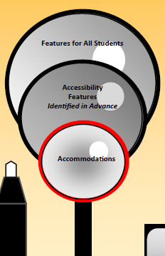
Accommodations for SWD
Presentation Accommodations (3’s)
  Fact Sheet SWD-1
Response Accommodations (4’s)
  Fact Sheet SWD-2
Timing and Scheduling Accommodations (5’s)
  Fact Sheet SWD-3

Slide 12
Accommodations
(IEP and 504 students only)
Test Form Implications
3’s - Presentation Accommodations – assistive technology, large print, Braille, paper-based, text-to-speech for ELA/Literacy, human reader/signer for ELA/Literacy
4’s - Response Accommodations – assistive technology, Braille writer, calculation device/math tools, speech-to-text responses, scribe
5’s - Timing/Scheduling Accommodations – extended time
Notes:
Some of them also drive the form of test that the student will take, such as paper vs online and the different features that are available to some of our students such as American Sign Language, closed captioning, etc.

Slide 13
Allowable Resources
Grade Appropriate Calculators
    Grades 3-7 – four-function calculator w/√ and %
    Grade 8 – scientific calculator
    Algebra 1, Geometry, Algebra 2 – graphing calculator – TI-84
    Students w/accomms. may use the calculator throughout all sections of the assessment
Mathematics Tools
    Math reference sheets and protractors/rulers are provided on the testing platform
    Arithmetic tables, two-color chips, counters and counting chips, square tiles, base ten blocks, or 100s charts

Slide 14
Administration of Accommodations and Features
Read-to Entire Test ELA – must qualify under decoding, hearing impairment or visual disability criteria (Appendix D of the Manual)
TTS for Math & Science – accessibility feature, entire and selected
Human Reader – group size limited to 5 students
      Math Human Reader Script or Proctor Reads Aloud Testing Ticket
Scribe – administered one-on-one
Extended Time – 1.5x or 2x, a single test unit must be completed in one day

Slide 15
TestNav – the testing platform
https://md.mypearsonsupport.com/practice-tests/

