Slide 1
Supporting Students with Motor Needs
Physical Disabilities Program
Lynnbrook Center
301-657-4959

Slide 2
Learning Outcomes
Upon completion of this presentation, participants will be able to…
Identify why it is important to lift with proper mechanics.
Describe proper posture for lifting.
Describe the best and preferred working zones.
Identify types of lifts and transfers.
Know the proper sequence for preparing to lift.
Describe safe lifting principles and strategies.
Describe preschool considerations.
Identify commonly used positioning and mobility equipment.

Slide 3
Introduction
Many of students that you work with have physical conditions that make it difficult to move themselves. These children need to be lifted into and out of adaptive equipment throughout the school day. Unless proper lifting procedures are utilized, injuries to students or staff may occur. This presentation was designed to teach you safe, efficient methods to lift students while performing the duties associated with your job.
Please keep in mind that watching this presentation should be done in conjunction with hands-on training. Please contact your school administrative staff for information about training for each student’s individual precautions and needs during the lifting process.

Slide 4

Posture and Body Mechanics
Notes:
Reference for picture: https://www.google.com/search?q=carrying+boxes&rlz=1C1CHFX_enUS690US691&espv=2&biw=1366&bih=638&source=lnms&tbm=isch&sa=X&ved=0ahUKEwiq5cfFzIDQAhXm7IMKHU2FDGAQ_AUIBigB#imgrc=LYCXLxCVsuIZ2M%3A

Slide 5
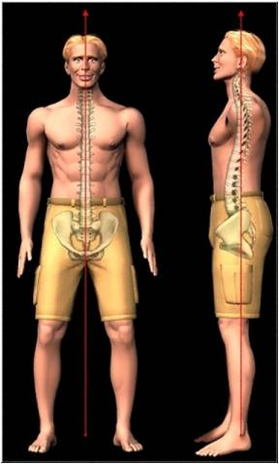
Posture
Good standing posture
Important for you and the student!
When viewed from the side:
Vertical alignment of feet,
hips, shoulders and ears.
Pelvis in neutral position with normal lumbar curve (S curve).
Knees slightly flexed.
When viewed from the front:
Symmetrical
Feet are shoulder width apart
Notes:
The red line = normal “S curve” of the spine
Reference for picture: http://www.drshannonhunt.com/uploads/Posture.jpg

Slide 6



Good Posture vs. Bad Posture
Bad
Avoid rounded shoulders, flat back,
and forward head.
Bad
Avoid extreme arched back and tucked chin.
Good
Ears, shoulders, hips, and ankles should line up.
Notes:
Reference for picture: http://www.fitness-programs-for-life.com/images/StandingPosture.jpg

Slide 7
Best and Preferred Work Zones
Performing work within the best and preferred work zones facilitates productivity and comfort. Work is safest when lifting and reaching is performed in these zones. Working outside these work zones results in non-neutral postures that may increase the risk of injury. It is particularly important to perform heavy lifting tasks within the best work zone.

Slide 8
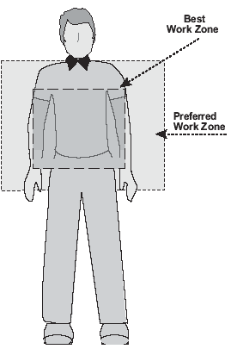
Best and Preferred Work Zones
Best Work Zone
The zone is a foot on either side of the shoulders.
Foot placement as wide as the shoulders.
Upper level at about heart height.
Lower level at about waist height.
(Guidelines, 2004)
Notes:
Reference for picture: http://www.osha.gov/ergonomics/guidelines/retailgrocery/images/insert10.gif (Guidelines, 2004)

Slide 9
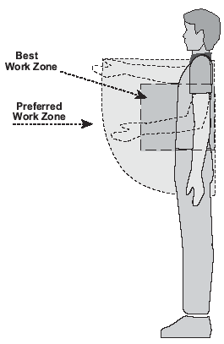
Best and Preferred Work Zones
Preferred Work Zone
As far forward as your hand when you hold your arm out straight.
Upper level at shoulder height.
Lower level at tip of fingers with hands held at the side.
(Guidelines, 2004)
Notes:
Reference for picture: http://www.osha.gov/ergonomics/guidelines/retailgrocery/images/insert11.gif (Guidelines, 2004)

Slide 10
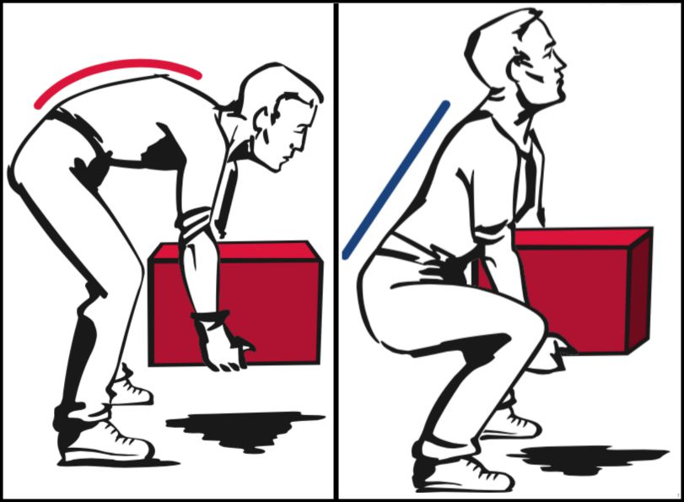
Good Lifting vs. Bad Lifting
Good Lifting
  Maintain natural “S” curve.
  Lift by using your leg muscles.
Bad Lifting
  No “C” curve!
  Don’t use back muscles.
Notes:
Reference for pictures (Right and Left): https://www.google.com/search?q=lifting+mechanics&rlz=1C1CHFX_enUS690US691&espv=2&biw=1366&bih=638&source=lnms&tbm=isch&sa=X&ved=0ahUKEwinsODN1oDQAhXq54MKHQrkCA4Q_AUIBigB#imgrc=j6oxW5HZwZLvuM%3A
10

Slide 11
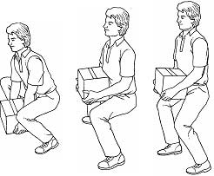
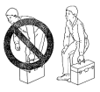
Good Lifting vs. Bad Lifting
Good Lifting Examples
Back remains upright with S-Curve.
Leg muscles are used instead of back muscles.
Load is kept in the “Preferred Work Zone”.
Feet are spread for a wide, stable base of support.

Slide 12
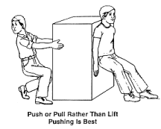
Moving Heavy Objects
Try to PUSH whenever possible.
Avoid PULLING heavy objects.
If pulling is necessary, keep good posture!

Slide 13
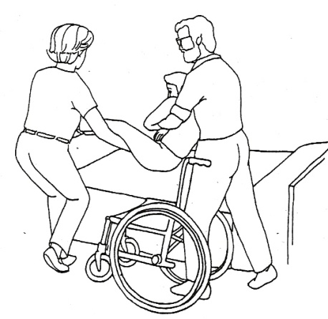
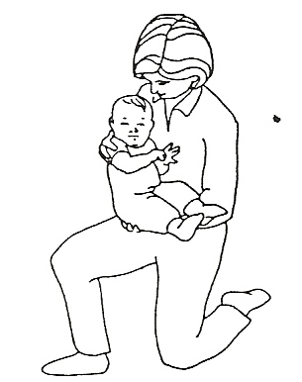
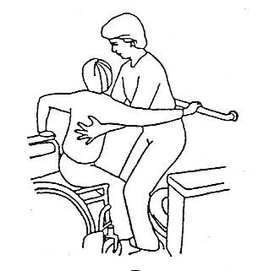
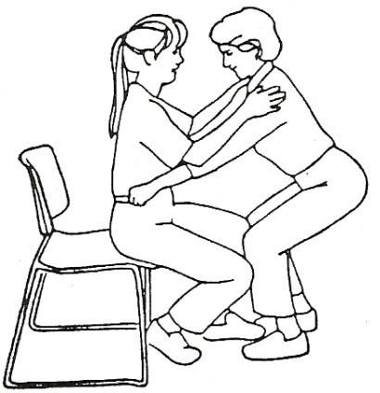
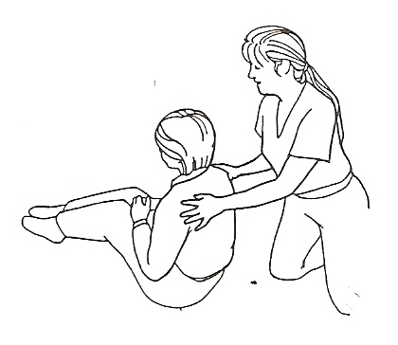
Types of Lifts
&
Transfers
Two person dependent lift
One person dependent lift
(Second staff member acting as a spotter is recommended)
Pivot transfer
Sit to stand transfer
Floor to stand transfer
Consult the physical therapist assigned to your school for individualized training.

Slide 14
Sequence for a General Lift
Transfer
Wear comfortable, supportive shoes and appropriate clothing.
  No open-toed shoes, No flip-flops/sandals.
  No dangling objects – necklaces, earrings, Lanyards should be breakaway.
  Clothes should permit free movement, but not loose enough to get caught on objects.
Always ask for help.
  Even when a student doesn’t require a Two-person lift, consider having another staff member act as a “spotter”.
Assess the load to be lifted.
  Know the student’s weight and their ability to assist.

Slide 15
Plan the maneuver.
  Talk with the other staff member that will be assisting about the lift before actually performing the lift.
  Avoid rushing.
Think of ways to make the task easier:
  Reduce the distance to be traveled during the lift.
  Consider pushing, pulling, rolling, or sliding the student instead of lifting.
Clear obstacles in your path.
Always consider using mechanical lifting devices.
  To be determined on a case by case basis.

Slide 16
Communicate with the student what is going to happen during the lift.
Make sure all surfaces are stable.
  Lock wheels on adaptive equipment and wheelchairs.
  Position equipment against a wall for added support, if possible.
Grasp the student in a firm and comforting manner.
Position your feet at shoulder’s width apart to give you a broad base of support.

Slide 17
Make sure the student is as close to you as possible.
  Keep them in the “Preferred Work Zone”
Communicate clearly what you plan to do, the sequence, and provide a clear start.
  (For example “1…2…3…Lift”)
While grasping student, bend your knees and keep your back in neutral alignment.
Use your leg muscles, not your back muscles to lift.
Do not twist your body while lifting or carrying a load. A back injury may result. Pivot your whole body as a unit instead.
Move smoothly and calmly, in a secure fashion.

Slide 18
Summary Slide
Proper Posture.
  Vertical Alignment of head, shoulders, hips and ankles
  Neutral posture (S curve in spine)
Best Working Zone.
  Shoulder width, from waist to arm pit level and out as far as your forearm.
Preferred working zone.
  One foot wider than shoulder width, from the top of the shoulders to arms’ length down the leg, out to arms’ length in front of the body.
There are several types of student transfers.
  Two Person lift
  One person lift (should have a spotter available)
  Pivot transfer
  Sit to stand Transfer
  Floor to stand transfer
Lifts must be planned and sequenced before being performed.

Slide 19
Determining the correct technique when lifting students
Most appropriate technique to lift is specific to each student.
  Each student’s needs are individualized based on medical conditions, physical needs, and factors such as size (height and weight) and movement ability.
Consultation with the school’s physical therapist is available if needed. Contact the Physical Disabilities Program at 301-657-4959 to determine which PT is assigned to your school.

Slide 20
Safe Lifting Techniques
Avoid lifts that require stretching or bending to reach the student. Redesign the work area so when you lift, the student is close to the body and at waist height.
When lifting, keep your back straight and lift with your legs.
Lift slowly and carefully and don’t jerk the student.
Keep the weight of the student as close to your body as possible while lifting.
Don’t twist or turn your spine while carrying out the lift.
Make sure your path is clear while lifting the student. Remove obstacles that could cause you to trip.
Avoid prolonged postures/positions and repetitive motions (take breaks).
(Controlling ergonomic, n.d., p. 3)

Slide 21
Positioning and Mobility Equipment
A variety of different types of assistive equipment available.
Speak with the physical therapist regarding specific questions about how to use a piece of equipment or how to help a student transfer from one piece of equipment to another.
Types of equipment you might see…
  Wheelchairs, gait trainers, standers
  Adjustable changing table
    Lower for transfers and raise for changing
  Commode chair
  Adapted strollers and chairs

Slide 22
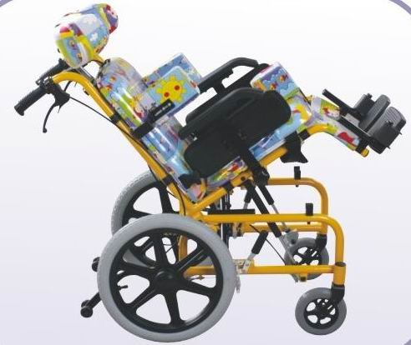
Wheelchairs
For transfers:
  Place chair at 45 degree angle to transfer surface for pivot transfer.
  Might be easier to place the chair parallel to the table for two person lift.
  Lower the table to the height of wheelchair seat.
  Swing foot rest out of the way.
  Flip arm rest back.
Notes:
Reference for top picture: https://www.google.com/search?q=wheelchair+transfer&rlz=1C1CHFX_enUS690US691&espv=2&biw=1242&bih=580&tbm=isch&source=lnms&sa=X&ved=0ahUKEwjMoN3okffPAhXp64MKHXiaDeEQ_AUICCgD#tbm=isch&q=pivot+transfer+wheelchair&imgrc=X5VK8BCz8bf1YM%3A
Reference for bottom picture: https://www.google.com/search?q=child+with+wheelchair&espv=2&rlz=1C1CHFX_enUS690US691&biw=1242&bih=580&source=lnms&tbm=isch&sa=X&ved=0ahUKEwiihbKc7ILQAhWL7YMKHenAAykQ_AUIBigB#imgrc=F_VbNgPi_K6yjM%3A

Slide 23
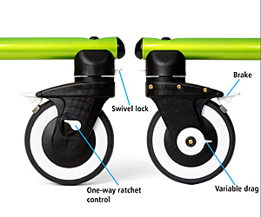
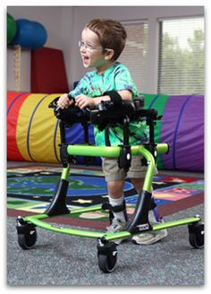
Gait Trainers
Can use different attachments to provide more or less support
Can be used for walking or standing
Weight bearing is important to a child’s development and overall health
Notes:
Reference for top picture (anterior gait trainer): https://www.google.com/search?q=posterior+gait+trainer&rlz=1C1CHFX_enUS690US691&espv=2&biw=1242&bih=580&source=lnms&tbm=isch&sa=X&ved=0ahUKEwiRkY7UlffPAhUHwYMKHTv5CTQQ_AUIBigB#imgdii=Jya3JtIMJPBn_M%3A%3BJya3JtIMJPBn_M%3A%3BNy7pauqc7e7YNM%3A&imgrc=Jya3JtIMJPBn_M%3A
Reference for bottom picture: https://www.google.com/search?q=gait+trainer&espv=2&rlz=1C1CHFX_enUS690US691&biw=615&bih=561&source=lnms&tbm=isch&sa=X&ved=0ahUKEwj2rbeTk_fPAhUG_4MKHYjxD2wQ_AUIBygC#tbm=isch&q=gait+trainer+wheeel+brakes&imgrc=m16zWnGr9zyvkM%3A

Slide 24
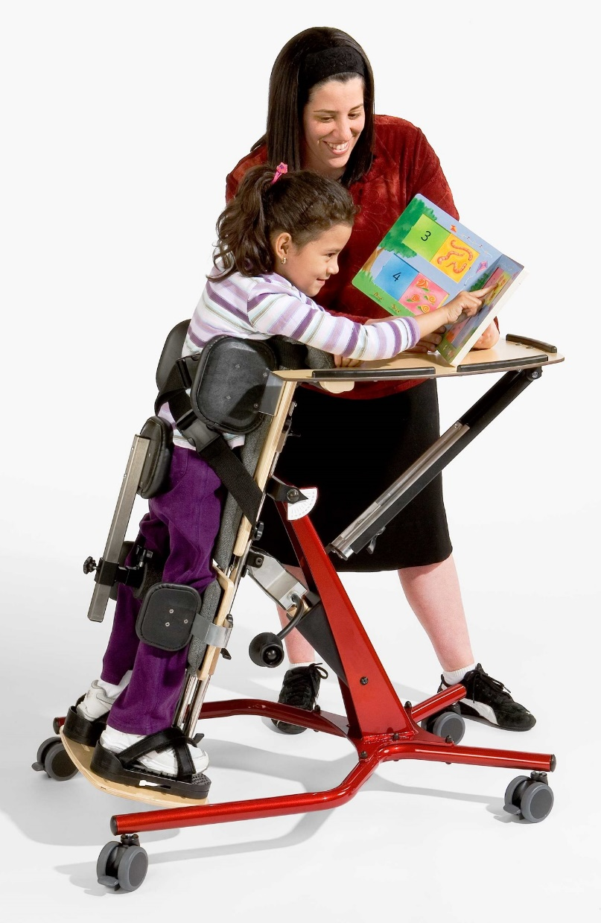
Standers
Types:
  Prone stander
  Supine stander
  Vertical stander
  Rabbit mobile stander
Benefits:
  Improves attention to task
  Promotes weight-bearing
  Can aide and/or strengthen head and trunk control
Notes:
Reference for picture (prone stander): https://www.google.com/search?q=prone+stander&rlz=1C1CHFX_enUS690US691&espv=2&biw=1242&bih=580&source=lnms&tbm=isch&sa=X&ved=0ahUKEwjI-7qalvfPAhVE9IMKHdirCRUQ_AUIBigB&dpr=1.1#imgrc=4Pe6yIdHfK2g1M%3A

Slide 25
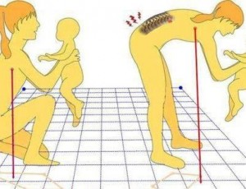
Preschool considerations
Notes:
Reference for picture: https://www.google.com/search?q=lifting+mechanics&rlz=1C1CHFX_enUS690US691&espv=2&biw=1366&bih=638&source=lnms&tbm=isch&sa=X&ved=0ahUKEwinsODN1oDQAhXq54MKHQrkCA4Q_AUIBigB#imgrc=ss89XsSPBnpMZM%3A

Slide 26
Preschool considerations
Working at low work heights (e.g. child-size tables and chairs.
  Options for improved posture:
    Drop your knees below the level of your hips.
    Try kneel sitting intermittently.
    Use adult size chair or rolling stool when possible.
    Use a chair that allows you to slide your legs under the table.
Frequent sitting on the floor with back unsupported:
  Use the wall or other stable object for back support.
  Frequently stretch body to upright position.
Notes:
- Dropping your knees below the level of your hips (extending your legs) allows for the low back to arch more so that you are not sitting for a long time in a rounded back posture.
- For kneel sitting, placing a pillow under the thighs may help to ease pressure on knees.

Slide 27
References
Campbell, S. K., Vander Linden, D. W., & Palisano, R. J. (2006). Physical therapy for children
(3rd ed.). St. Louis, MO: Elsevier Inc.
Controlling ergonomic hazards. (n.d.). Retrieved from WOSH Specialist Training
Supplemental Module website https://www.osha.gov/dte/grant_materials/fy11/sh-22240- 11/ErgoHazards.pdf0- 585
Goodman, C. C. & Fuller, K. S. (2009). Pathology: Implications for the physical therapist (3rd
ed.). St. Louis, MO: Saunders.
Guidelines for retail grocery stores: Ergonomics for the prevention of musculoskeletal
disorders (2004). Retrieved from U.S. Department of Labor Occupational Safety and Health Administration website https://www.osha.gov/ergonomics/guidelines/retailgrocery/retailgrocery.html
Nonfatal occupational injuries and illnesses requiring days away from work, 2014. (2015).
Retrieved from U.S. Department of Labor Bureau of Labor Statistics website http://www.bls.gov/news.release/pdf/osh2.pdf

Slide 28
References (continued)
Safe patient handling (n.d.). Retrieved from U.S. Department of Labor Occupational Safety and Health
Administration website https://www.osha.gov/SLTC/healthcarefacilities/safepatienthandling.html
Waters, T. R., Nelson, A., Hughes, N., & Menzel, N. (2009). Safe patient handling training for schools of
nursing: curricular materials. Retrieved from Department of Health and Human Services Centers for Disease Control and Prevention National Institute for Occupational Safety and Health website https://www.cdc.gov/niosh/docs/2009-127/pdfs/2009-127.pdf

