Slide 1
Montgomery County State’s Attorney’s Office
John McCarthy State’s Attorney
50 Maryland Ave, Rockville, MD 20850
Presenters: George E. Simms III, Lynda Earle, Arielle Hinton
Assistant State’s Attorneys for Montgomery County, Maryland
Phil Andrews (Director of Crime Prevention Initiatives)
(Researched by Amrit Mann, University of Maryland, 2021)

Slide 2
Stop the Bullying Presentation
Have you ever spread rumors or harmful information about somebody else?
Has anyone ever spread rumors about you?
Would you stand up for somebody who was being bullied?

Slide 3

What Do We Do
State’s Attorney's Office:
Prosecutes crimes (committed by adults) and delinquent acts (committed by juveniles)
For example, murder, assaults,
Robbery, thefts
Office works to prevent crimes
We are here to educate and prevent crimes
“It’s a crime to be mean online”
Maryland has strong laws to protect young people from being bullied

Slide 4
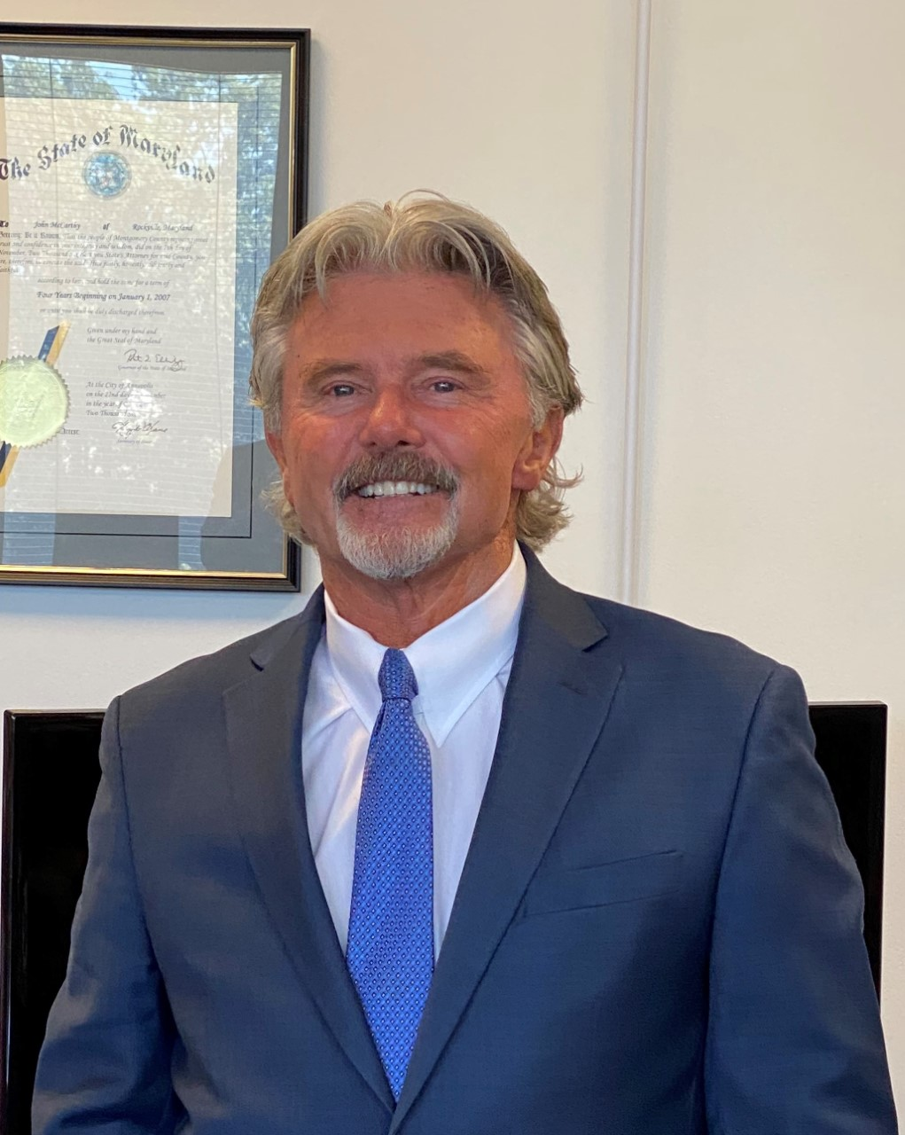
Who works at the State’s Attorney's Office?
John McCarthy-State’s Attorney for Montgomery County
Crime Prevention Specialists
Attorneys
Paralegals
Computer specialists
Administrative Assistants
Victim Witness coordinators
Investigators
High School and College Interns

Slide 5

This Presentation is About…
Cyber Bullying
Bullying
The Laws
Bystander vs. Upstander
Consequences
Consequences
  Personal
  Career opportunities
  College choices
  Moral
  Legal

Slide 6
Electronic and Social Media: Risks
The widespread mobile use of electronic and social media connects people like never before
But it can also be dangerous:
  Cyber Bullying
  Sharing Too Much
  Sexting
  Online Predators

Slide 7
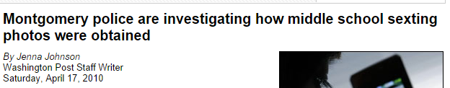
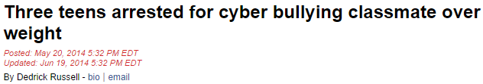

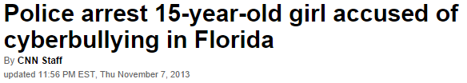

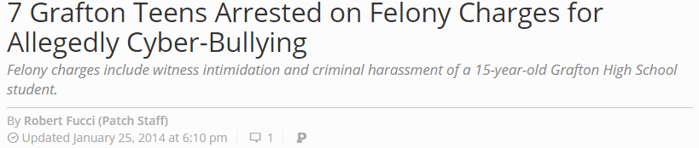

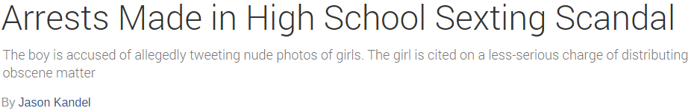


Slide 8

  Mother pushes Montgomery County Public Schools to address cyberbullying happening on Zoom classes
Back on September 11, 2020, she said a non-JPMS student gained access to the Zoom meeting ID and passcode and “broke” into class, assuming her son’s identity and screen name. The student kept the camera off but began hurling foul language and racial slurs in the class under the assumed name of her student, according to Rook.
- A link was later shared, and her son was subject to his peers calling him a racist as a result. Rook said she appealed to the Montgomery County Board of Education and they finally ruled her son’s case was cyberbullying.
https://www.wusa9.com/article/news/local/parent-push-school-system-to-address-cyberbullying/65-126d2d91-0a0d-4da1-86f1-fef80c1bfc7b

Slide 9
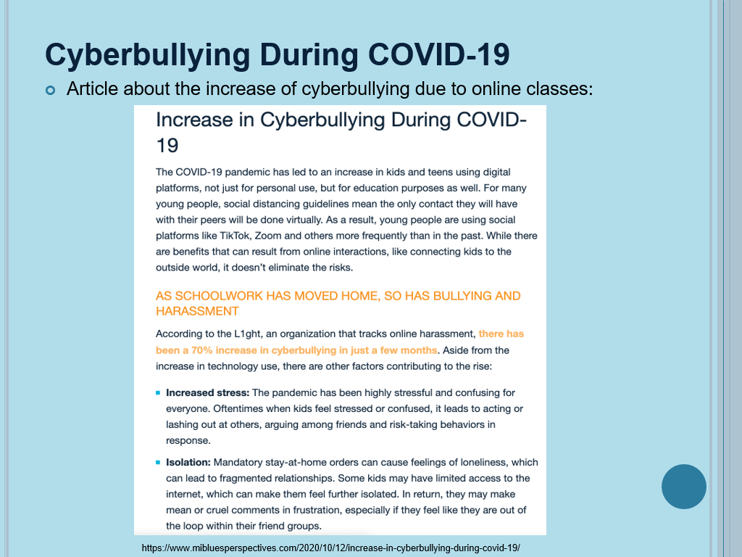

Slide 10
Dangerous Usage of Social Media
4 boys charged with making online threats against Montgomery County schools (October 6th, 2016)
Four 13-year-old boys arrested for making multiple threats towards students through Instagram
Made Instagram account and warned the school to “Be ready”
Posts also stated “Kill them”
http://wtop.com/montgomery-county/2016/10/4-boys-charged-with-making-online-threats-against-montgomery-co-schools/

Slide 11
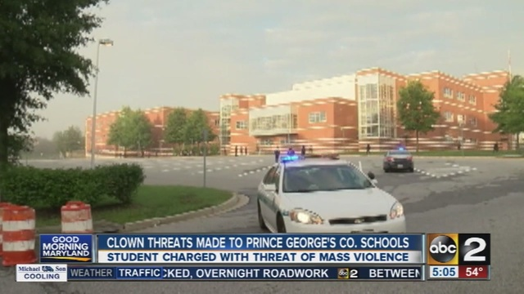

Prince George’s County police arrest 8th grader in connection with online school threat (October 3rd, 2016)
An 8th grader from Middle School charged with making a threat of violence
Set up a clown-themed Twitter account in class and threatened to hurt students
http://www.wusa9.com/news/local/prince-georges-co-school-officials-cancel-activities-move-students-due-to-threats/328602967

Slide 12
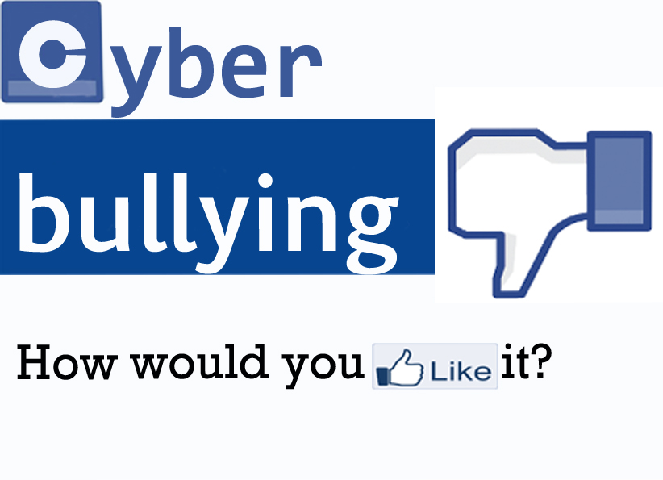
Notes:
Before showing the next slide ask: What’s the difference or your knowledge between bullying and cyber-bullying? What do you guys think it cyber-bullying means? *- maybe delete this *

Slide 13
WHAT IS CYBER-BULLYING?
Cyberbullying is the repeated use of technology to bully, harass, annoy, bother, or torment another person
  Direct Indirect
  Verbal harassment Spreading rumors & gossip
  Taunting/ Teasing Getting someone to bully for you
  Threats/ Obscene gestures Deliberately excluding someone
Notes:
So what is cyber-bullying?
4

Slide 14
EXAMPLES of Cyberbullying
  Repeatedly sending offensive, rude, and insulting messages
  Distributing or posting negative information about another
    “I wish you would die.”
  Posting or sending pictures without consent
    Digitally altered or nude images
  Stealing passwords to assume someone’s identity
    Impersonating another and sending offensive messages
  Tricking someone into revealing embarrassing information and forwarding it to others
Notes:
5

Slide 15

Broken Friendships

Slide 16
Why do they do it?
Reasons people cyberbully:
o To show off to friends
o To be mean
o To embarrass
o For fun or entertainment
o “They deserved it”
o To get back at someone
http://www.internetsafety101.org/cyberbullyingstatistics.htm

Slide 17
CYBER-BULLYING AND SOCIAL MEDIA
81% of youth agree that bullying online is easier to get away with than bullying in person. [1]
Social media can offer bullies a private way to torment someone
  The attacks can be anonymous, able to be shared and spread among a wide audience during every hour of every day
  For the victims, it is often inescapable
AS A RESULT – It encourages bullies to behave more aggressively than a traditional “physical world” bully.
    Why? Because there are no physical interactions and less social limitations online.
[1] Teen Online & Wireless Safety Survey: Cyberbullying, Sexting and Parental Controls. Cox Communications Teen Online and Wireless Safety Survey in Partnership with the National Center for Missing and Exploited Children, 2009.
Notes:
Anonymity empowers bullies. Some social media like Facebook requires you to accept connections from people, but they might not be who you think they are
5
[1] Teen Online & Wireless Safety Survey: Cyberbullying, Sexting and Parental Controls. Cox Communications Teen Online and Wireless Safety Survey in Partnership with the National Center for Missing and Exploited Children, 2009.

Slide 18

THE EMOTIONAL CONSEQUENCES
Cyber-bullying can result in destructive emotional effects on victims, ranging from hurt feelings to intense anger
  Grace McComas
Notes:
In the case of Grace McComas, she did report it and the family did try. It is a sad story, but in the case of other teens, most do not report or tell an adult of such emotional abuse they are expriencing from being bullied online
3 – this needs work for teens

Slide 19
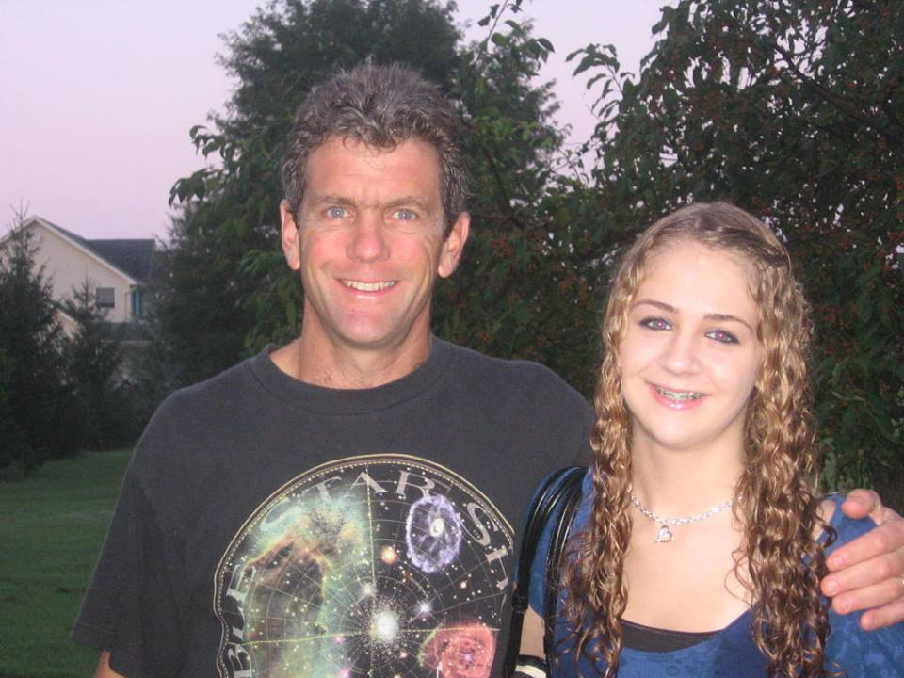
GRACE’S STORY
“… Next time my name rolls off your tongue, choke on it.. and DIE …”
  15-year-old, Glenelg High School sophomore
Committed suicide on Easter Sunday 2012 after repeatedly being bullied via Twitter
Grace did tell her parents
The law was unable to act, for at that time, there was no law prohibiting cyberbullying via social media
Laws now prohibit electronic cyberbullying
Bully only received a 10-day school suspension
Grace McComas & her father, David
“We did everything the bullying experts tell you to do…. Everything wasn’t enough.”
“… I hope you somehow see this and cry yourself to sleep then kill yourself…”
Notes:
--- The parents tried to help. They first called the bullies parents, which only ensued and elevated his anger to post angry tweets about Grace… and the worst part – Grace didn’t even have a twitter.
With nothing to do from the law side, they contacted the school and only gave him a 10-day suspension.
5
19

Slide 20
PREVENTION
- BE AWARE -
NEVER do the following:
  Give out your passwords to anyone other than your parents
  Reveal something private online
    What is best way to keep something a secret?
  Send embarrassing photos of yourself
    They are not as private as you think they are!
  Write something in an email or post what you wouldn’t say in person
Remember To Always Be RESPECTFUL Online
Think before you speak

Slide 21
Life Consequences of Cyber Bullying
Trouble at school and at home
Denied participation in extracurricular activities
Denied college admission
Destroyed reputation
Risk of being a victim to online predators
Arrests/Criminal Charges
Don’t be a headline in the news…

Slide 22

THE LAWS

Slide 23
MISUSE OF ELECTRONIC MAIL
Md. Criminal Law Code Ann. § 3-805
Prohibited. -- A person may not maliciously engage in course of conduct through electronic communication that alarms or annoys another
  With intent to harass, alarm or annoy the other,
  After receiving a reasonable warning or request to stop,
  Without a legal purpose
Maximum penalty: one year in prison and/or $500 fine
This law has been expanded
In honor of Grace McComas, a Howard County teen who committed suicide due to cyberbullying -- an expansion to this law was created (Grace’s Law) to include the “misuse of interactive computer services”
Notes:
5
23

Slide 24
MISUSE OF INTERACTIVE COMPUTER SERVICES (GRACE’S LAW)
Md. Criminal Law Code Ann. 3-805
Subjections (a)(3) and (b)(2) added:
(a)(3) – “Interactive computer service” means an information service, system or access software provider that provides or enables computer access by multiple users to a computer server, including a system that provides access to the Internet and cellular phones.
(b)(2) - Prohibits a person from using an “interactive computer service” to maliciously engage in a course of conduct that inflicts serious emotional distress on a minor or places a minor in reasonable fear of death or serious bodily injury with the intent to…
(1) To kill, injure, harass or cause serious emotional distress to the minor or
(2) To place the minor in reasonable fear of death or serious bodily injury.
It is now a criminal misdemeanor to repeatedly and maliciously use a computer or smartphone to bully someone under the age of 18
Notes:
5
24

Slide 25
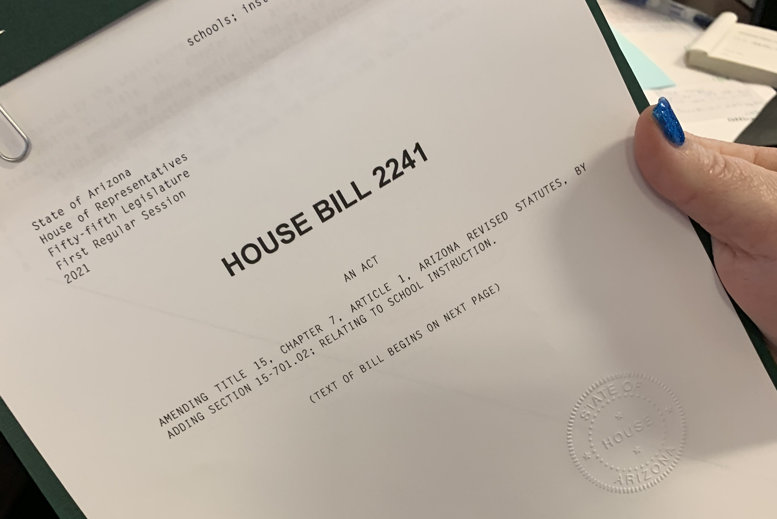
Grace’s Law 2.0, Enacted in 2019
What is different about this law?
Under the previous legislation, penalties would apply only if the intended victim was the direct recipient of electronic harassment.
Prior Grace’s law only applied to social media harassment.
  Under the new Grace’s law; using electronic communications (including text, image, phone, computer or any electronic means) to transmit a harassing message to a minor, or to a broad audience, would qualify as an offense.
  The intended victim wouldn’t have to receive the message.
  The new law makes cyberbullying that targets a minor a serious offense
  https://wtop.com/maryland/2019/04/marylands-latest-law-on-cyberbullying-could-be-a-national-model/

Slide 26
HARASSMENT
Md. Criminal law Code Ann. § 3-803
Prohibited. -- A person may not follow another in or about a public place or maliciously engage in a course of conduct that alarms or seriously annoys the other:
  with the intent to harass, alarm, or annoy the other;
  after receiving a reasonable warning or request to stop by or on behalf of the other; and
  without a legal purpose.
Maximum penalty: 90 days in jail and/or $500 fine. Up to 180 days for repeat offenders
Notes:
5

Slide 27
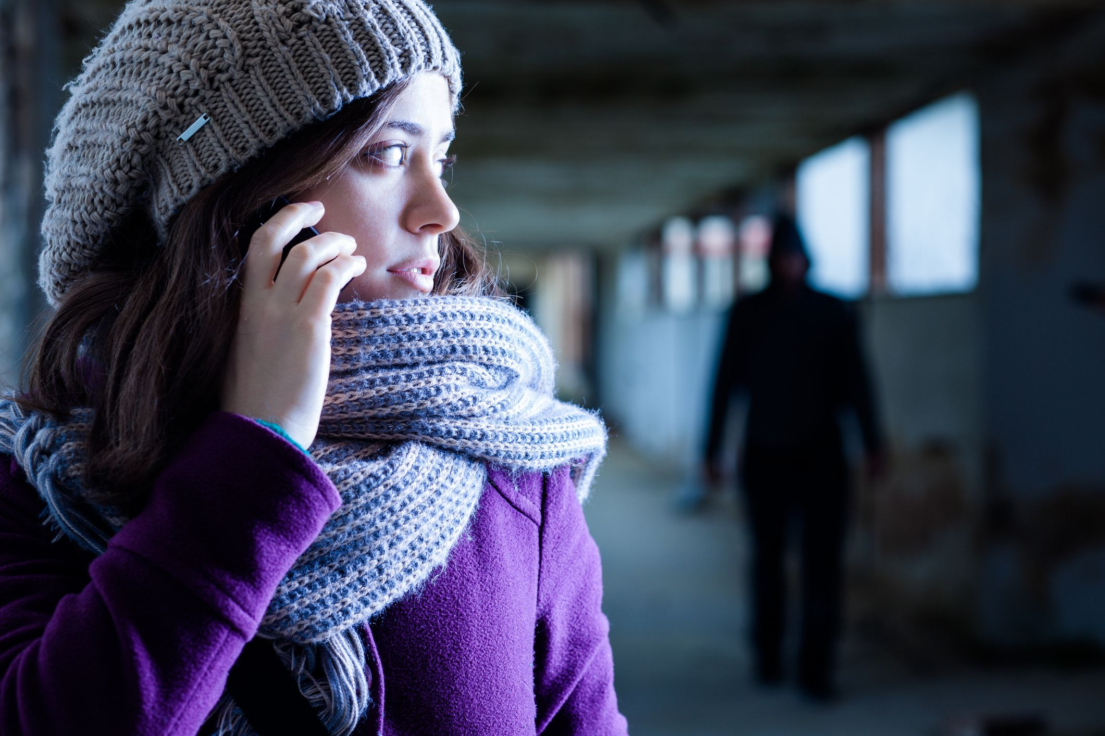
STALKING
Md. Criminal law Code Ann. § 3-802
"Stalking" defined. -- In this section, "stalking" means a malicious course of conduct that includes approaching or pursuing another where the person intends to place or knows or reasonably should have known the conduct would place another in reasonable fear:
  (i) of serious bodily injury;
  (ii) of an assault in any degree;
  (iii) of rape or sexual offense as defined by§3-303 through 3-308 of this article or attempted rape or sexual offense in any degree
  (iv) of false imprisonment; or
  (v) of death; or
  that a third person likely will suffer any of the acts listed in item (1) of this subsection.
Maximum penalty: 5 years in prison and/or $5,000 fine
Notes:
5

Slide 28
OTHER LAWS RELATED TO CYBER BULLYING
  Misuse of Telephone Facility
  Md. Criminal law Code Ann. § 3-804
    Repeated calls with the intent to annoy, torment, or harass
  Willful Disturbance of School Activities
  Annotated Code of Maryland, Education, Section 26-101
    Threats of bodily harm or disturbing normal activities of school
  Identity Fraud
  Md. Criminal law Code Ann. §8-301
    Knowingly, willfully, and with fraudulent intent assume the identity of another
  Disorderly Conduct
  Md. Criminal law Code Ann. § 10-201
    Disturbing the peace through obscene language or written material
Notes:
4 –

Slide 29
Threat of Mass Violence (CR 3-1001)
Person may not knowingly threaten to commit or cause to be committed a crime of violence, that would place others at substantial risk of death or serious physical injury, if as a result of the threat, five or more people are:
  Placed in reasonable fear that the crime will be committed,
  Evacuated from a dwelling or public place,
  Required to move to a designated area within a public place, or
  Required to remain in a designated safe area within a public place
  (Public=schools and institutions of higher learning ).

Slide 30

Possible Sentences in the State of Maryland
Sexting
Possession of Sexually Explicit Material
  Retain an image/video of a child under 16
  Up to 5 years in prison and/or up to $2,500 fine
    Subsequent sentence: up to 10 years and/or up to $10,000 fine
Sharing Obscene Material with a Minor
  Up to 1 year in jail and/or up to $1,000 fine
    Subsequent sentence: up to 3 years and/or up to $5,000 fine
Child Pornography
  Up to 10 years and/or up to $25,000
    Subsequent sentence: up to 20 years and/or up to $50,000 fine
http://mobilemediaguard.com/states/sexting_laws_maryland.html
Notes:
4

Slide 31
Revenge Porn (CR 3-809)
A person may not intentionally cause serious emotional distress to another by placing on the internet a photograph, film, video or image of the other person that reveals the identity of the other person with his or her intimate parts exposed or while engaged in an act of sexual contact:
Knowing that the other person did not consent, and
Under circumstances where the other person had a reasonable expectation that the image would be kept private.
Penalty is 2 years in jail or $5,000 fine

Slide 32
“Dime con quien andas y te dire quien eres”
“Tell me who who walk with and I will tell you who you are”
An accomplice
A crime occurs and the defendant, with the intent to make the crime happen, knowingly aided, counseled, commanded or encouraged the commission of the crime, or communicated to a participant that he was ready, willing and able to lend support, if needed

Slide 33

Save every contact from the cyber bully.
This is evidence that you are being harassed.
Check your rep online.
If someone is writing about you online, you should try to find out what they are saying.
Still being harassed?
Tell your trusted adult.
If you receive a credible threat…
contact the police!

Slide 34

CYBERBULLYING LEGAL GUIDE
First Amendment –Freedom of Expression
    The state may legally place limits on free speech
    when it poses a serious and imminent threat
    Threats are NOT considered ‘protected speech’
Fourth Amendment – Search and Seizure
    Operates using a “reasonable expectation of privacy”
    Minors have reduced levels of Constitutional rights than their adult counterparts
    Remember: your cell phone, tablet, or laptop may be searched by law enforcement under some circumstances!
    If you use your smartphone to commit a crime, you give up your expectation of privacy
Notes:
http://www.criminaldefenselawyer.com/resources/cyberbullying-maryland.htm
4 – but condense
10 ways to protect yourself ** end slides ** filters . What to say what not to post

Slide 35
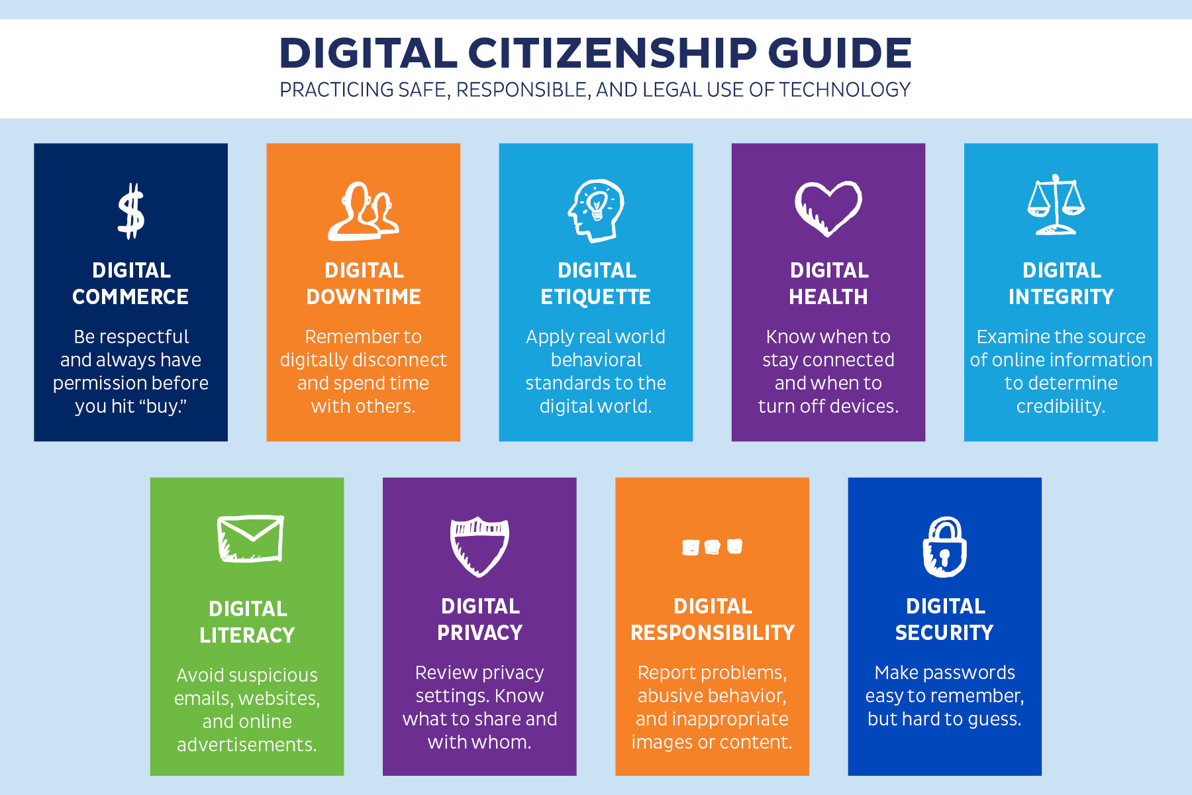

Slide 36

Be an Upstander
Not a Bystander

Slide 37

Respect in Relationships

Slide 38
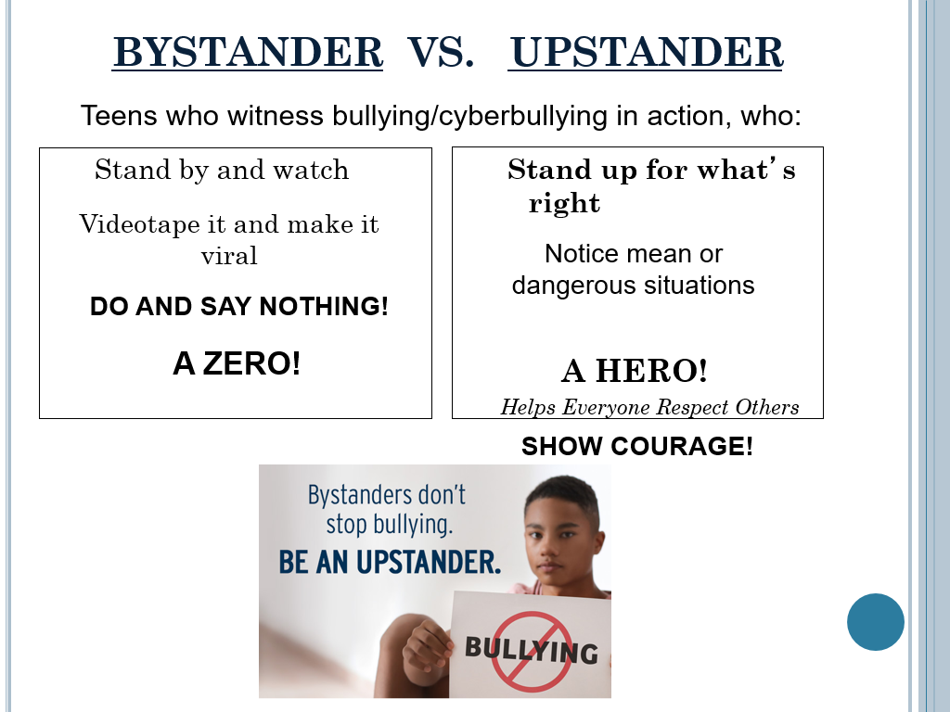

Slide 39

BYSTANDER CONSEQUENCES
By doing nothing you are sending a message to the bully that their behavior is acceptable!
  Bystanders empower cyber bullies even more
It also makes the victim feel isolated and helpless
REMEMBER
“Innocently” sharing or forwarding anything offensive is cyberbullying, even if you didn’t start it!
If you are NOT part of the solution, you ARE part of the problem!
Stop the bullying
Be an Upstander
Notes:
http://www.stompoutbullying.org/index.php/information-and-resources/about-bullying-and-cyberbullying/bystanders-become-upstanders/
5

Slide 40

BECOME AN UPSTANDER
What to do?
  Don’t add fuel to their fire
  Don’t keep this to yourself
  Tell an adult
  Speak out against bullying
  Report abuse online
  Support and empower the victim
  Don’t share things online that could be hurtful
  Get others to help stop the bullying
Things a bully should consider:
  “Show some respect”
  “Treat others as you wish to be treated”
  “Do not post harmful content”
  “Would you want someone to treat your sister this way?”

Slide 41

Helping Someone Who is Being Bullied
Encourage the person to talk to others who can provide help and guidance- a trusted adult
You, as the witness may want to discuss the problem with a trusted adult
Do not confront the bully if you feel it will jeopardize your safety
Express concern for your friend’s safety and well-being
Let your friend know that you are available to listen or help any time
Notes:
41
Review options to helping a friend. Many kids have verbalized wanting to assault the abuser. This is never the answer due to the harm that may come to them- getting a trusted adult involved or calling 911 is a better solution.

Slide 42
Do Teens Report Cyberbullying?
http://infographicsmania.com/cyberbullying-statistics-2012/

Slide 43

Statistics
The 2017 School Crime Supplement to the National Crime Victimization Survey (National Center for Education Statistics and Bureau of Justice) indicates that, among students ages 12-18 who reported being bullied at school during the school year, 15% were bullied online or by text.
The 2019 Youth Risk Behavior Surveillance System (Centers for Disease Control and Prevention) indicates that an estimated 15.7% of high school students were electronically bullied in the 12 months prior to the survey.

Slide 44

Be an up stander

Slide 45
Questions
What is the main message of the video?
What are three things you would tell a friend?
How did the video make you feel?

Slide 46

FINAL GOALS
Recognize that anything you put online could follow you for the rest of your life
Use electronic and social media responsibly
Start your Digital Citizenship off on a positive note
Identify your trusted adult
Understand that you are not anonymous – We are responsible for what we do online

Slide 47
Resources

Slide 48
MCPS RESOURCES
Bullying, Harassment, or Intimidation Reporting Form
http://www.montgomeryschoolsmd.org/departments/forms/pdf/230-35.pdf
CyberSafety hotline: 301-279-3669
cybersafety@mcpsmd.org
Cyber Tipline: 1-800-843-5678

Slide 49
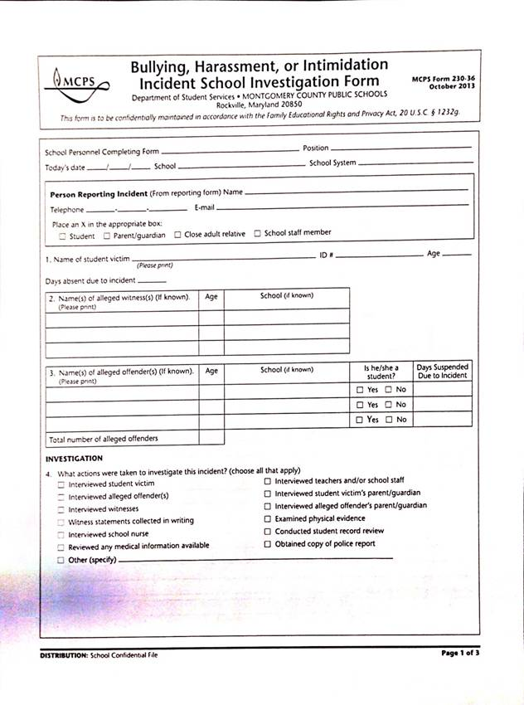
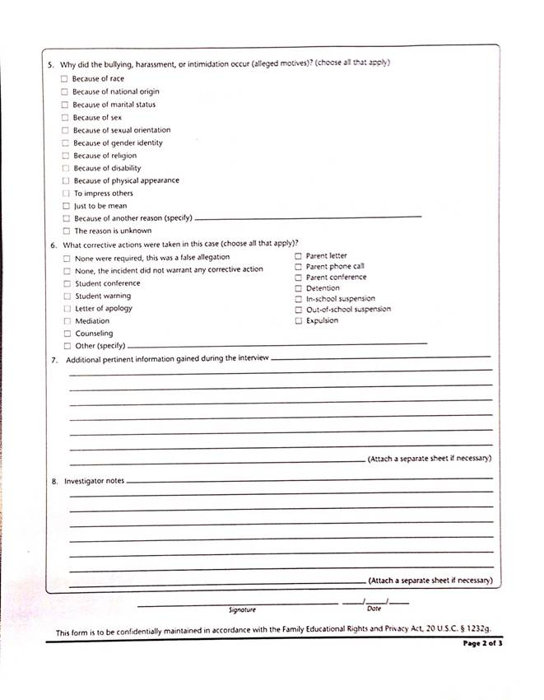
MCPS BULLYING FORM

Slide 50
ONLINE RESOURCES
www.netsmartz.org
www.Nsteens.org
www.staysafeonline.org
www.nobullying.com
www.fosi.org
www.isafe.org
www.athinline.org
www.dosomething.org
www.wiredsafety.org
Cyber Tipline: 1-800-843-5678

Slide 51

Questions
Notes:
51

